Slide 1
Latest numbers on COVID-19 in the UK – 23rd July 2021
Cases
School impact
Hospitalisations
Deaths
Vaccination
With many thanks to Bob Hawkins for his help in collating the data

Slide 2
Cases

Slide 3
Number of new UK confirmed COVID-19 cases by reported date
(people who have had a positive test)
New confirmed cases
7-day centred rolling average
Data from https://coronavirus.data.gov.uk

Slide 4
Number of new UK confirmed COVID-19 cases by reported date
(people who have had a positive test)
New confirmed cases
7-day centred rolling average
Data from https://coronavirus.data.gov.uk

Slide 5
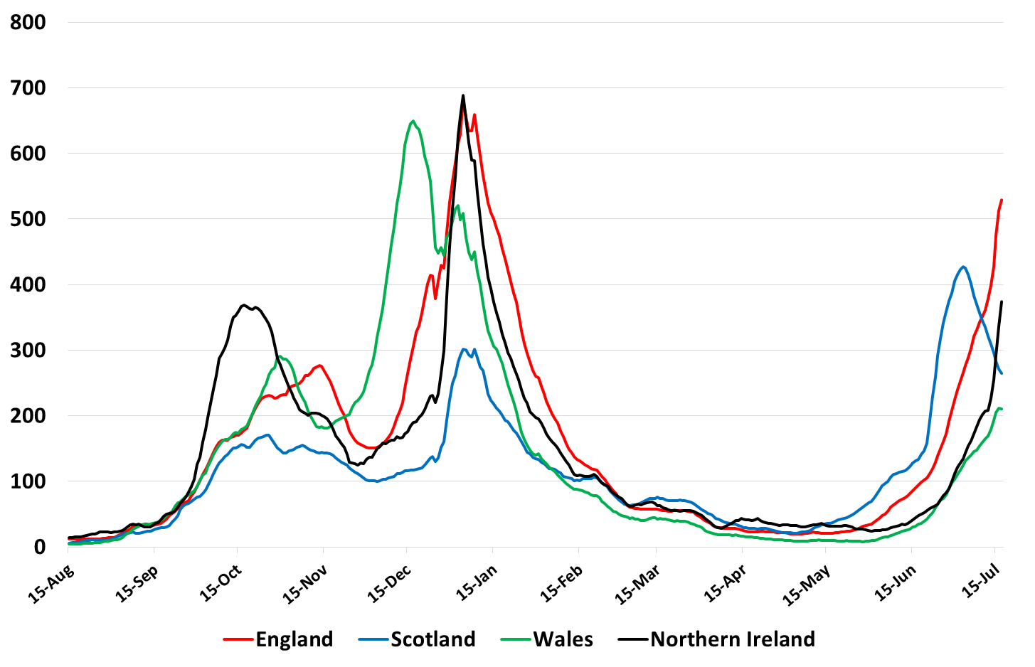
Number of cases per 100,000 people per week for UK nations by date reported to 17th July
Data from https://coronavirus.data.gov.uk

Slide 6
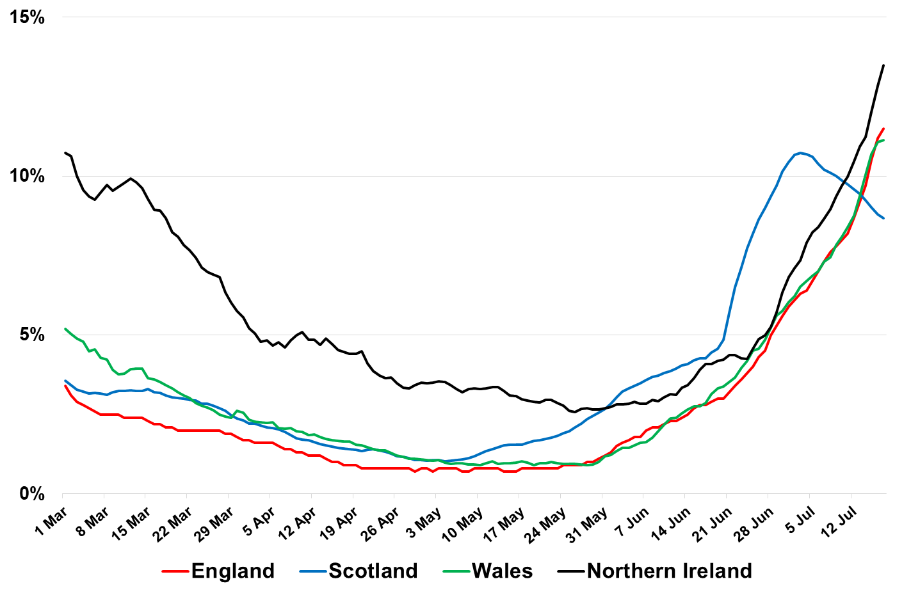
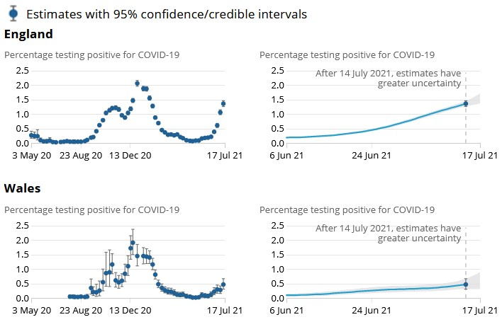
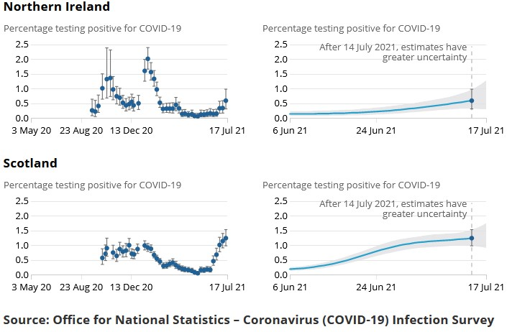
Daily Test Positivity Rate for the Home Nations Mar 1 – Jul 17
All rates are calculated based on PCR tests only and are comparable across the Home Nations
(Sources: England – Covid Daily Update and daily reports for all other Home Nations)
Data from https://coronavirus.data.gov.uk

Slide 7
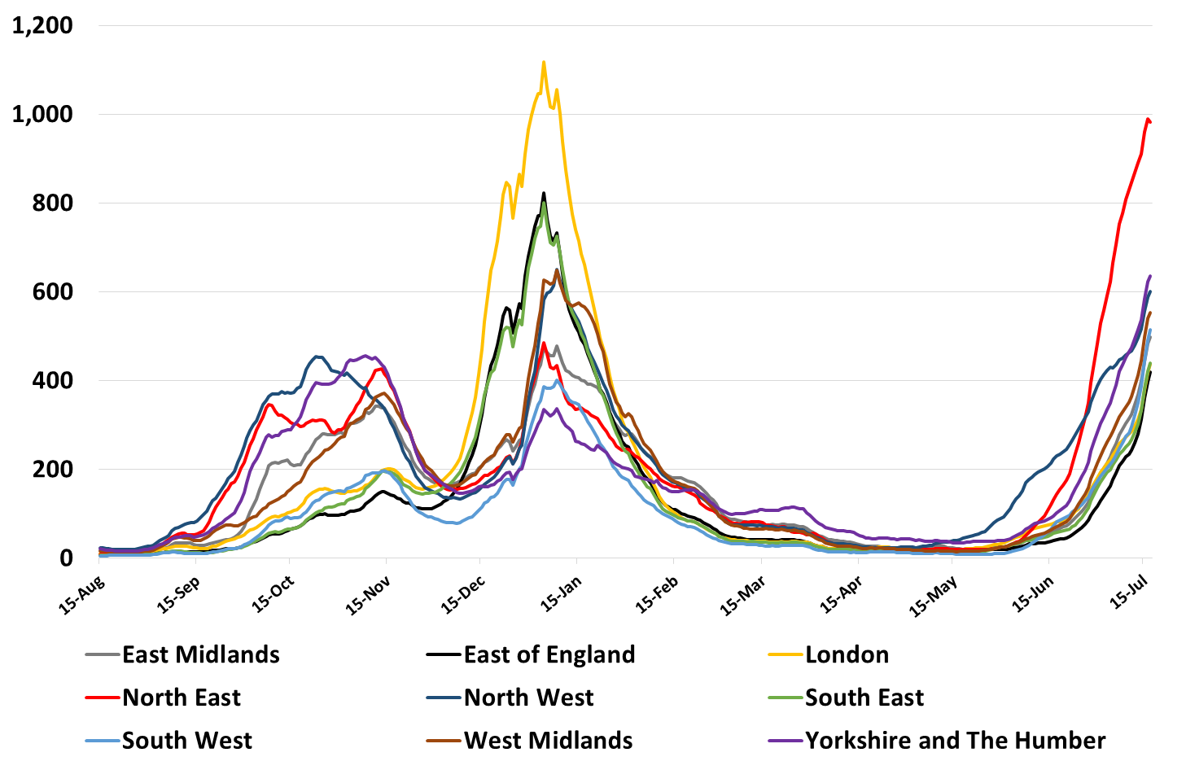
Cases per 100K per Week for English Regions Aug 15 – Jul 17
(Source: Covid Daily Update)
Data from https://coronavirus.data.gov.uk

Slide 8
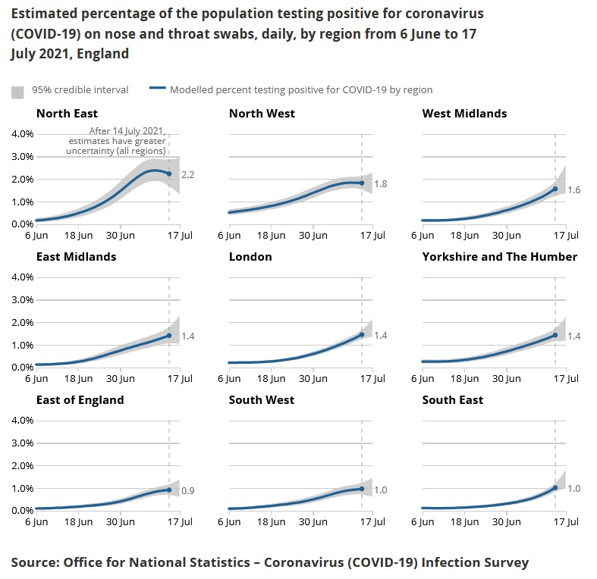
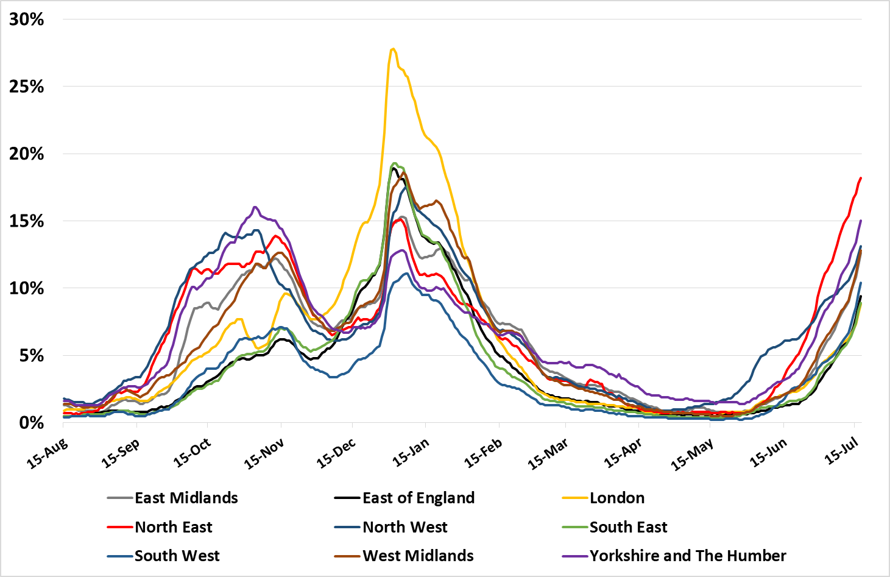
Daily Test Positivity Rate for English Regions Aug 15 – Jul 17
(Source: England – Covid Daily Update based on PCR tests only)
Data from https://coronavirus.data.gov.uk

Slide 9
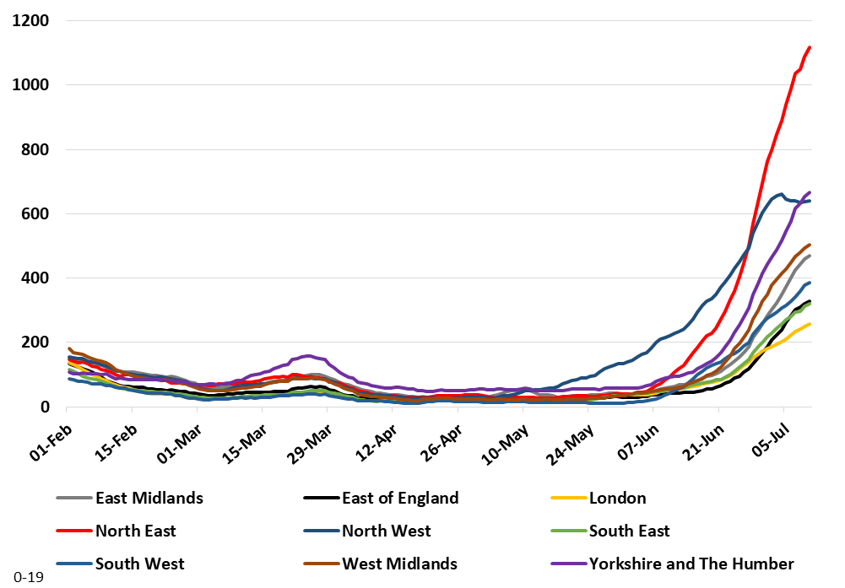
Cases per 100K by Rolling 7 Days for English Regions Aged Under 20 Years
(Source: England – Covid Daily Update)

Slide 10
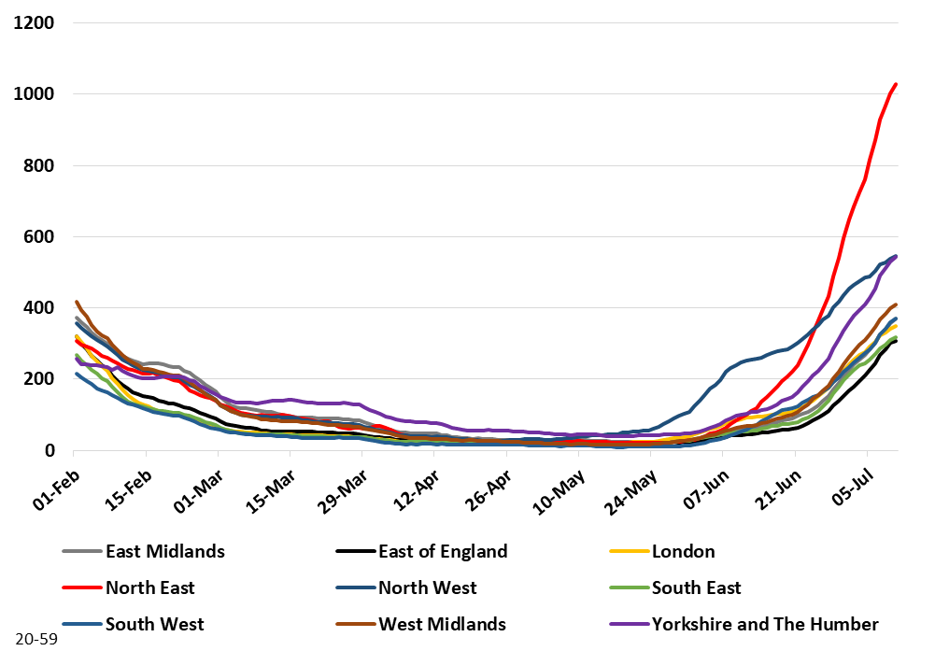
Cases per 100K by Rolling 7 Days for English Regions Aged 20- 59 Years
(Source: England – Covid Daily Update)

Slide 11
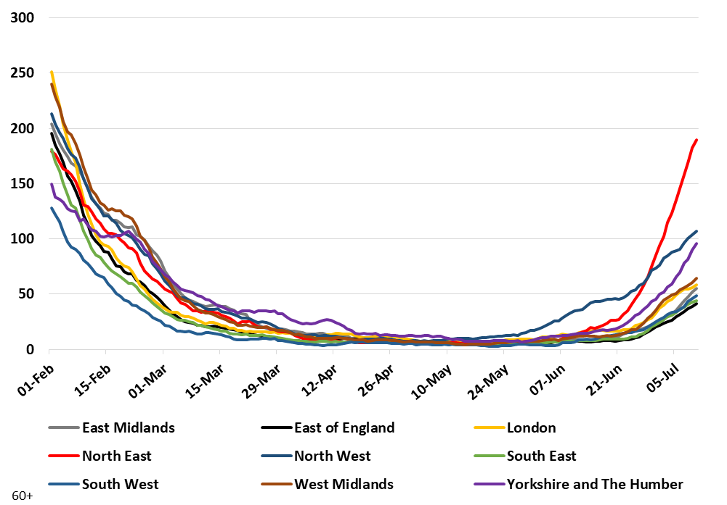
Cases per 100K by Rolling 7 Days for English Regions Aged Over 60 Years
(Source: England – Covid Daily Update)

Slide 12
School absences

Slide 13
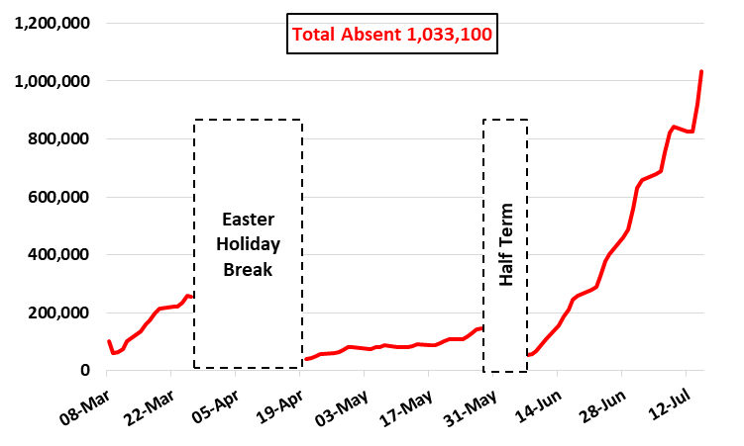
Number of Pupils in State Primary and Secondary Schools absent due to Covid-19 for England from Mar 8 to Jul 15
(Source: Attendance in education and early years settings during the coronavirus (COVID-19) outbreak)
Attendance in education and early years settings during the coronavirus (COVID-19) outbreak, Week 23 2021 – Explore education statistics – GOV.UK (explore-education-statistics.service.gov.uk)

Slide 14
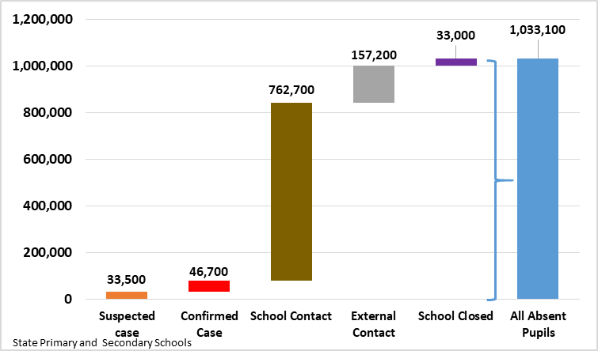
Number of Pupils in State Primary and Secondary Schools absent due to Covid-19 by Reason for England on Jul 15
(Source: Attendance in education and early years settings during the coronavirus (COVID-19) outbreak)
Attendance in education and early years settings during the coronavirus (COVID-19) outbreak, Week 23 2021 – Explore education statistics – GOV.UK (explore-education-statistics.service.gov.uk)

Slide 15
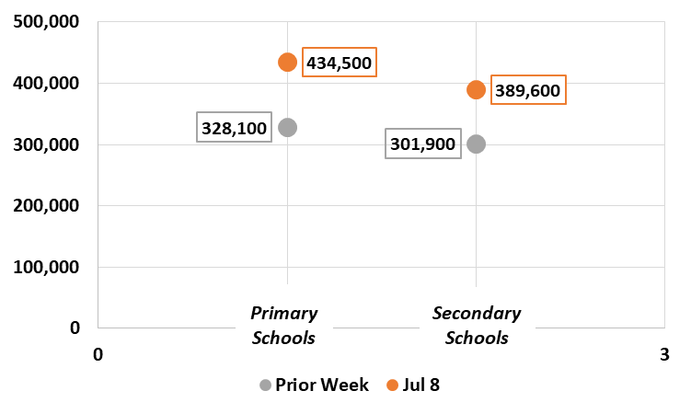
Week on Week Change in the Number of Pupils in State Primary and Secondary Schools absent due to Covid-19
(Source: Attendance in education and early years settings during the coronavirus (COVID-19) outbreak)
Attendance in education and early years settings during the coronavirus (COVID-19) outbreak, Week 23 2021 – Explore education statistics – GOV.UK (explore-education-statistics.service.gov.uk)

Slide 16
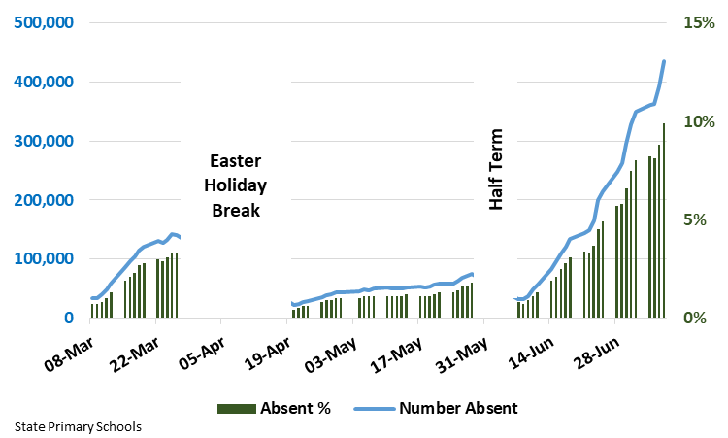
Primary School Pupils Absent by Day in England: Mar 8 to Jul 8
(Source: Attendance in education and early years settings during the coronavirus (COVID-19) outbreak)
Attendance in education and early years settings during the coronavirus (COVID-19) outbreak, Week 23 2021 – Explore education statistics – GOV.UK (explore-education-statistics.service.gov.uk)

Slide 17
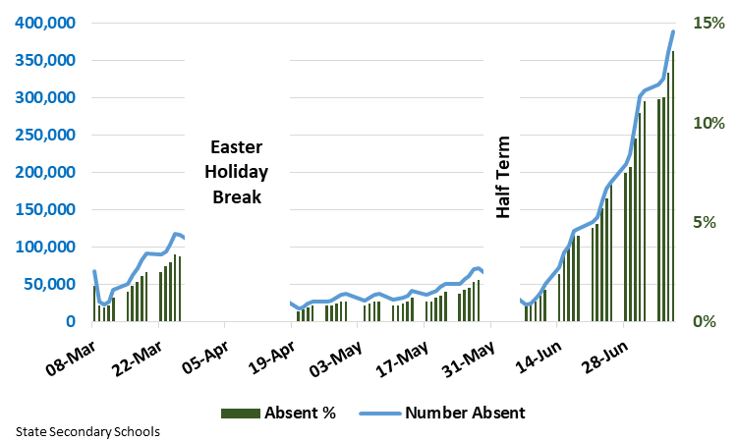
Secondary School Pupils Absent by Day in England: Mar 8 to Jul 8
(Source: Attendance in education and early years settings during the coronavirus (COVID-19) outbreak)
Attendance in education and early years settings during the coronavirus (COVID-19) outbreak, Week 23 2021 – Explore education statistics – GOV.UK (explore-education-statistics.service.gov.uk)

Slide 18
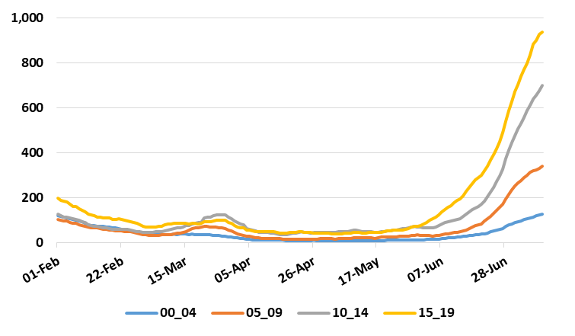
Cases per 100K by Rolling 7 Days for England Under 20’s
(Source: England – Covid Daily Update)
Return to School.
School Easter Holiday.
Half Term
Mainly secondary school children voluntarily tested
Primary / nursery children not routinely tested

Slide 19
Hospital data

Slide 20
Number of new admissions to hospital in England to 20th July
Data from https://coronavirus.data.gov.uk.

Slide 21
Number of new admissions to hospital in Scotland to 18th July
Data from https://coronavirus.data.gov.uk.

Slide 22
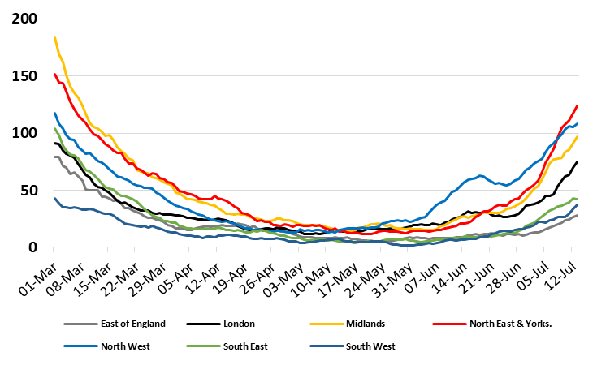
Daily Hospital Admissions (7 Day Moving Average) by Region
Mar 1 2020 – Jul 13 2021
(Source: Covid Daily Update)

Slide 23
Number of people in hospital per million people – UK nations (daily 7 day average)
Data from https://coronavirus.data.gov.uk.

Slide 24
Number of people in hospital per million people – UK nations
Data from https://coronavirus.data.gov.uk.

Slide 25
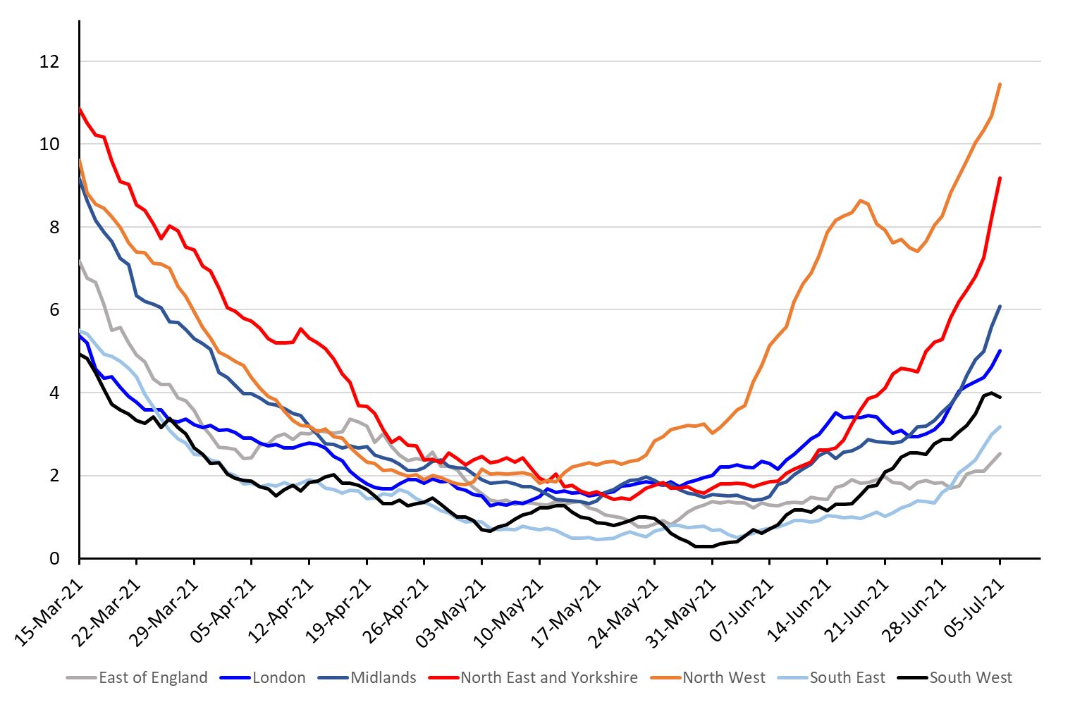
7-day average of daily number of new hospital admissions with COVID-19 per day per million people across different regions in England to 5th July
NW
NE & Yorks
Midlands
London
South West
South East
East
Data from https://www.england.nhs.uk/statistics/statistical-work-areas/covid-19-hospital-activity/

Slide 26
Deaths

Slide 27
Number of deaths within 28 days of +ve COVID test reported per day across the UK to 22nd July
Number of Deaths
7-day rolling average
Data from https://coronavirus.data.gov.uk/

Slide 28
Number of deaths within 28 days of +ve COVID test reported per day across the UK to 22nd July
Number of Deaths
7-day rolling average
Data from https://coronavirus.data.gov.uk/

Slide 29
Vaccination data

Slide 30
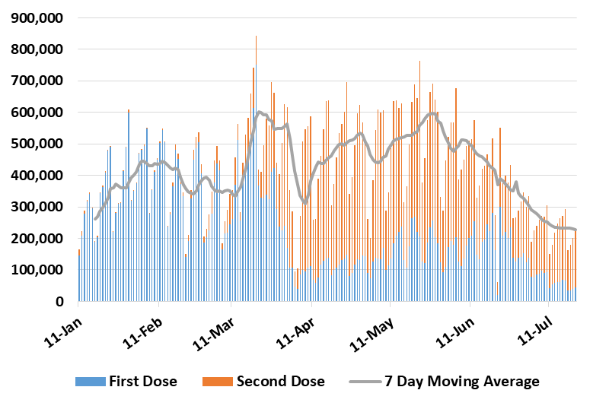
Number of First and Second Doses given by Day in the UK: Jan 11 to Jul 21
(Source: Covid Daily Update)
Data from https://coronavirus.data.gov.uk/
Thanks to Bob Hawkins for the chart

Slide 31
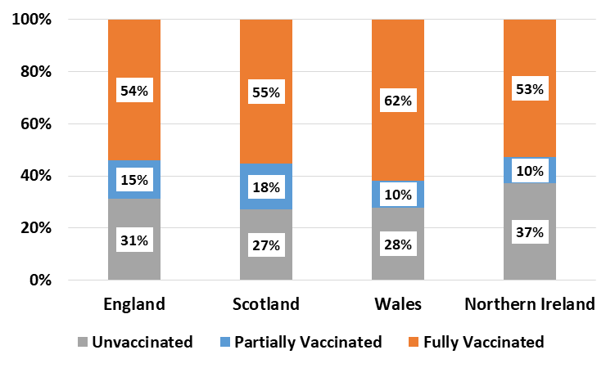
Percentage of Total Population Unvaccinated (no dose given),
Partially Vaccinated (1 dose) and Fully Vaccinated (2 doses) as at Jul 21
Data from https://coronavirus.data.gov.uk/
Thanks to Bob Hawkins for the chart

Slide 32
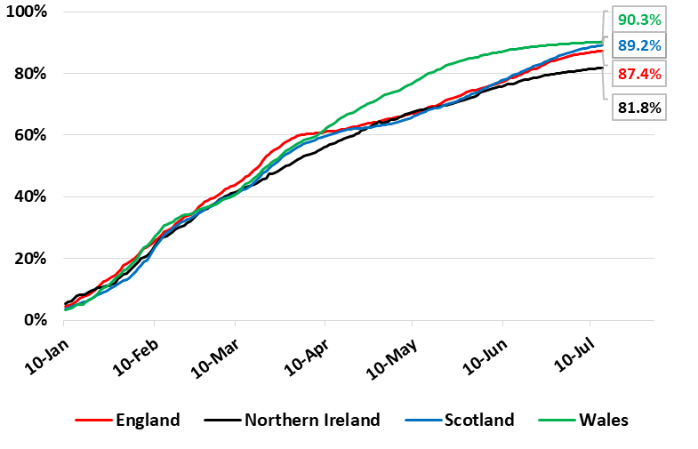
First Dose Coverage (% of adults) for the Home Nations by Day: Jan 10 to Jul 14
(Source: Covid Daily Update and Mid-2019 ONS Population Estimates)

Slide 33
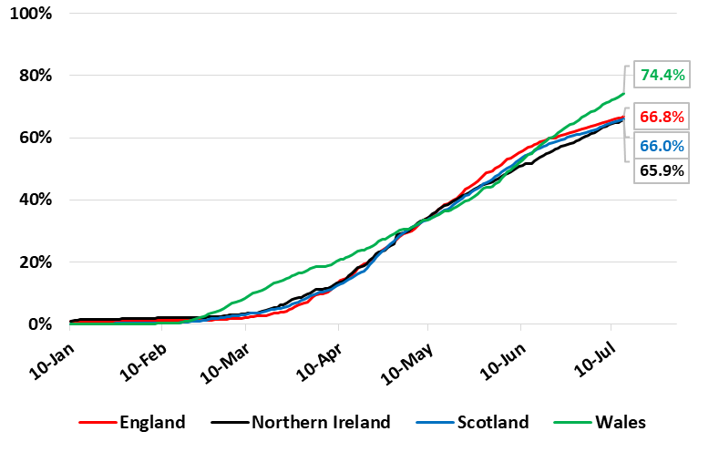
Second Dose Coverage (% of adults) for the Home Nations by Day: Jan 10 to Jul 14
(Source: Covid Daily Update and Mid-2019 ONS Population Estimates)

Slide 34
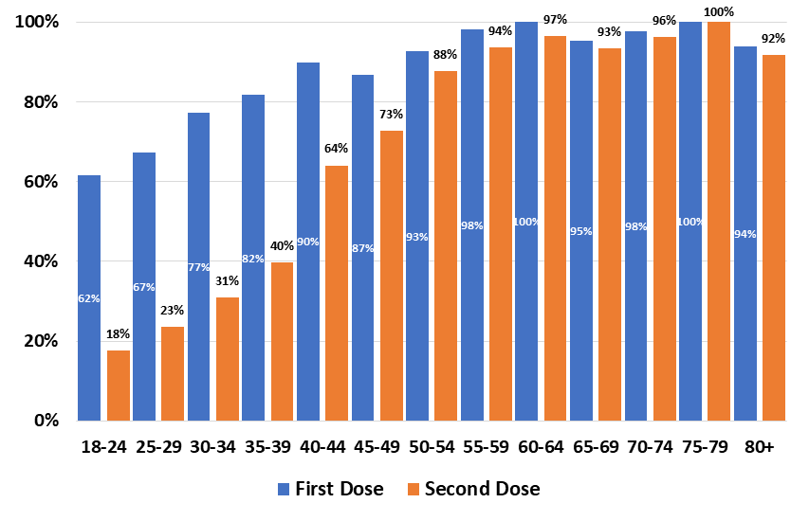
First and Second Dose Coverage by Age for England to Jul 11
(Source: https://www.england.nhs.uk/statistics/statistical-work-areas/covid-19-vaccinations and Mid-2019 ONS Population Estimates)

Slide 35
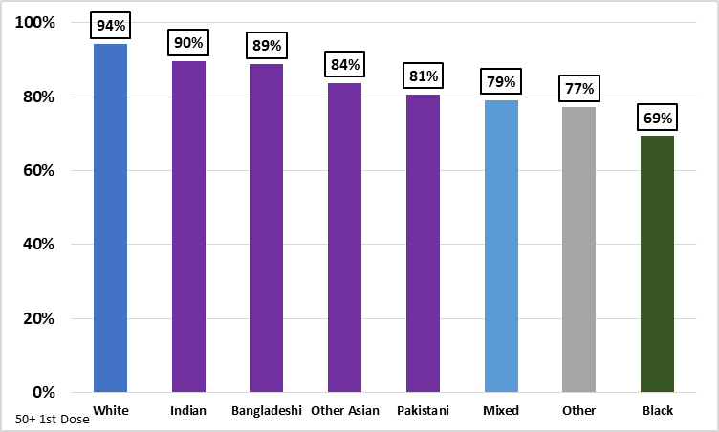
First Dose Coverage for Over 50s by Ethnicity for England: Jun 30
(Source: PHE Monthly Vaccination Reports)

Slide 36
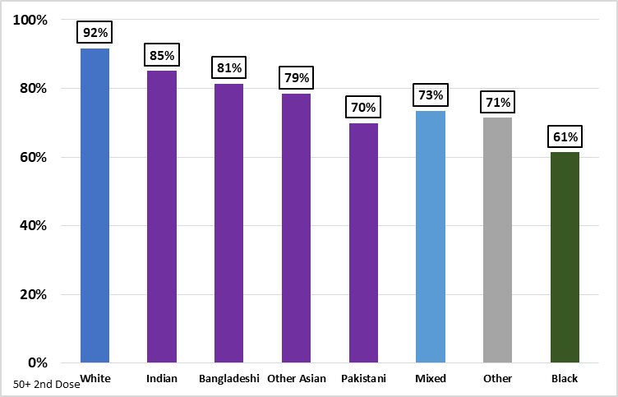
Second Dose Coverage for Over 50s by Ethnicity for England: Jun 30
(Source: PHE Monthly Vaccination Reports)

Slide 37
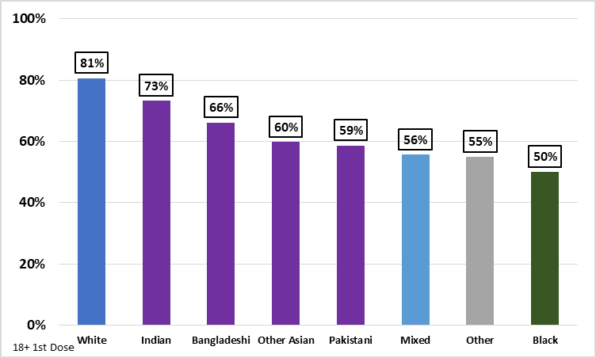
First Dose Coverage for Over 18s by Ethnicity for England: Jun 30
(Source: PHE Monthly Vaccination Reports)

Slide 38
Summary
Overall case numbers in the UK are falling.
This could mean we have peaked, but it could be for a variety of other plausible reasons.
Over 1,000,000 children missed school on one day last week for covid-related reasons.
This is significantly impacting on their education and is disruptive to children and parents.
Hospitalisations are rising in England, putting pressure on the NHS, but falling in Scotland reflecting previous falls in infection levels.
Deaths are also starting to rise more quickly. Tuesday saw the highest reported death figure since late March (96).
Vaccination continuing to slow down.

