Slide 1
Covid briefing for Independent SAGE
11/3/2022
Prof. Colin Davis
University of Bristol

Slide 2
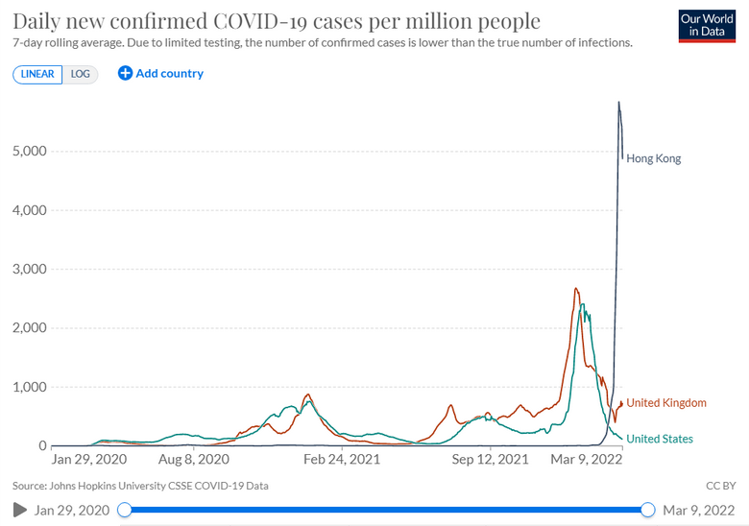
Is the pandemic over?

Slide 3
Is the pandemic over?
The UK is “Living with Covid”
SAGE no longer meeting regularly
Testing winding down In England:
Requirement to isolate dropped
Self-isolation payments dropped
Contact tracing dropped
Mask requirements dropped

Slide 4
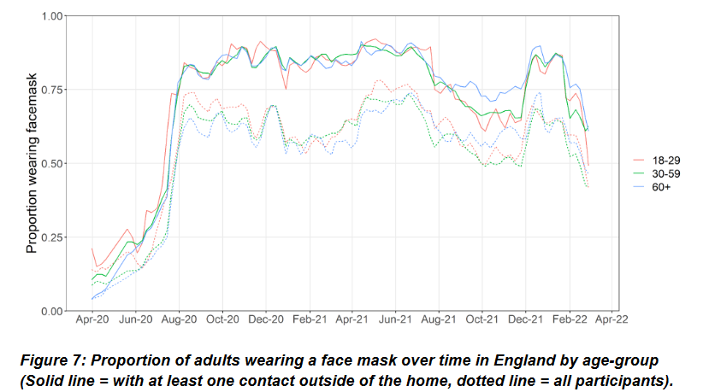
Behaviour: Mask wearing (Comix study)

Slide 5
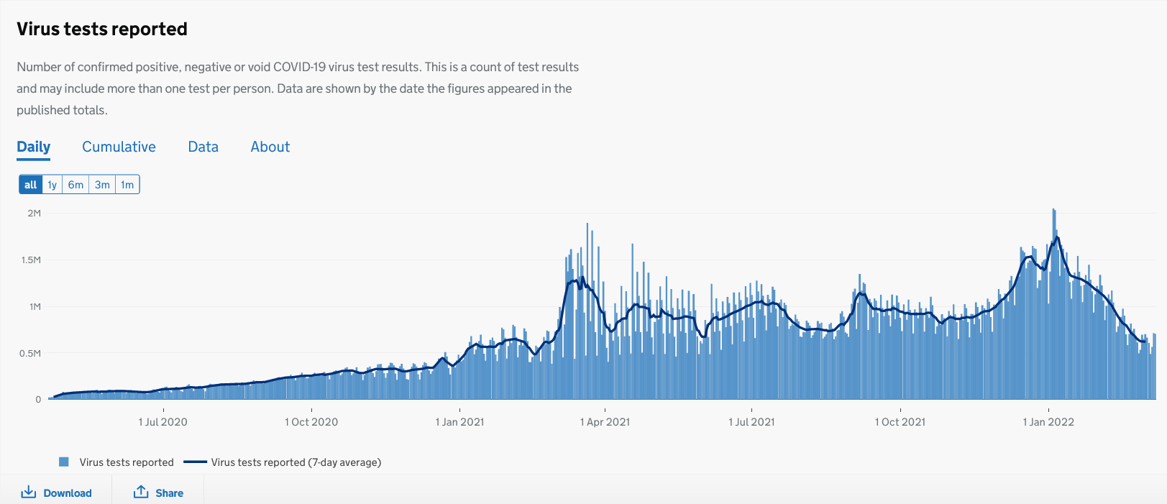
Behaviour: Testing

Slide 6
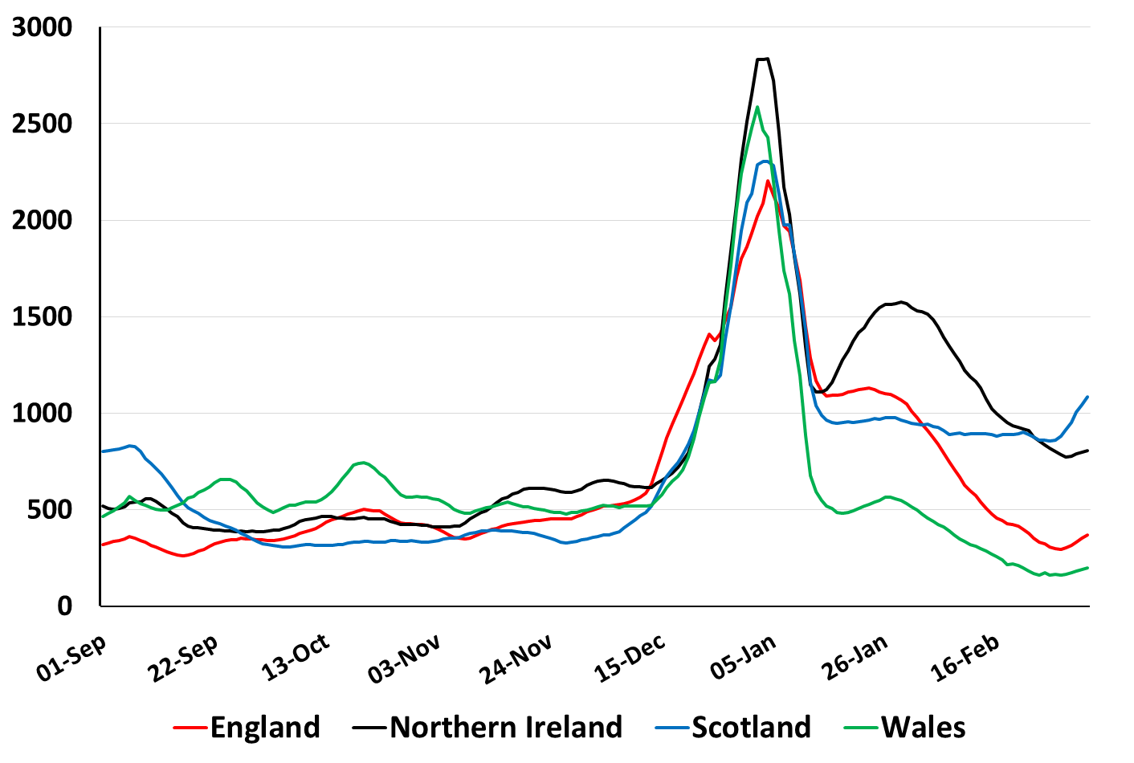
Cases per 100K per Week for the Home Nations
(Source: Covid Daily Update)
Thank you to Bob Hawkins for this and other graphs!

Slide 7
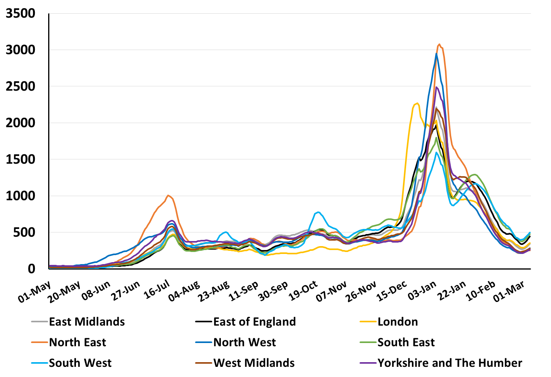
Cases per 100K per Week for English Regions
(Source: Covid Daily Update)

Slide 8
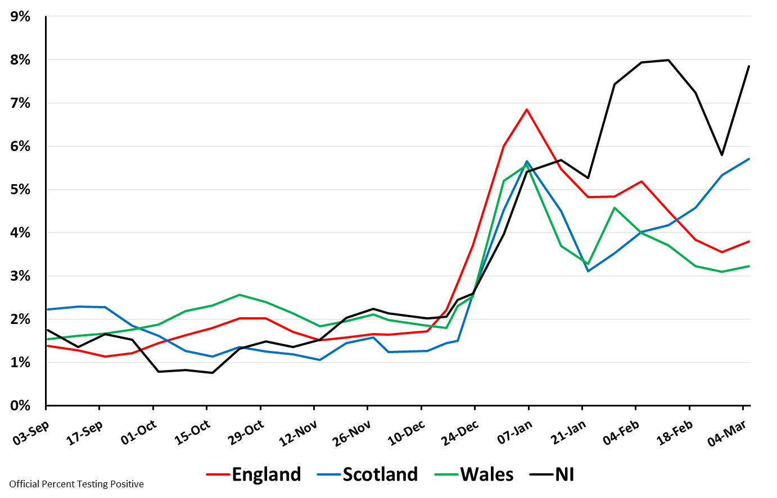
Percent Testing Positive by Nation: 3 Sep 2021 to 5 Mar 2022 (ONS survey)

Slide 9
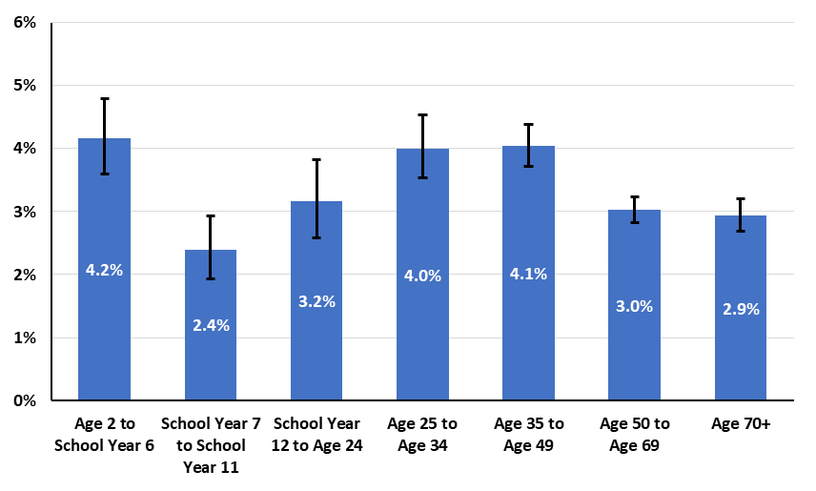
Percent Testing Positive by Age for England: 5 Mar 2022 (ONS survey)

Slide 10
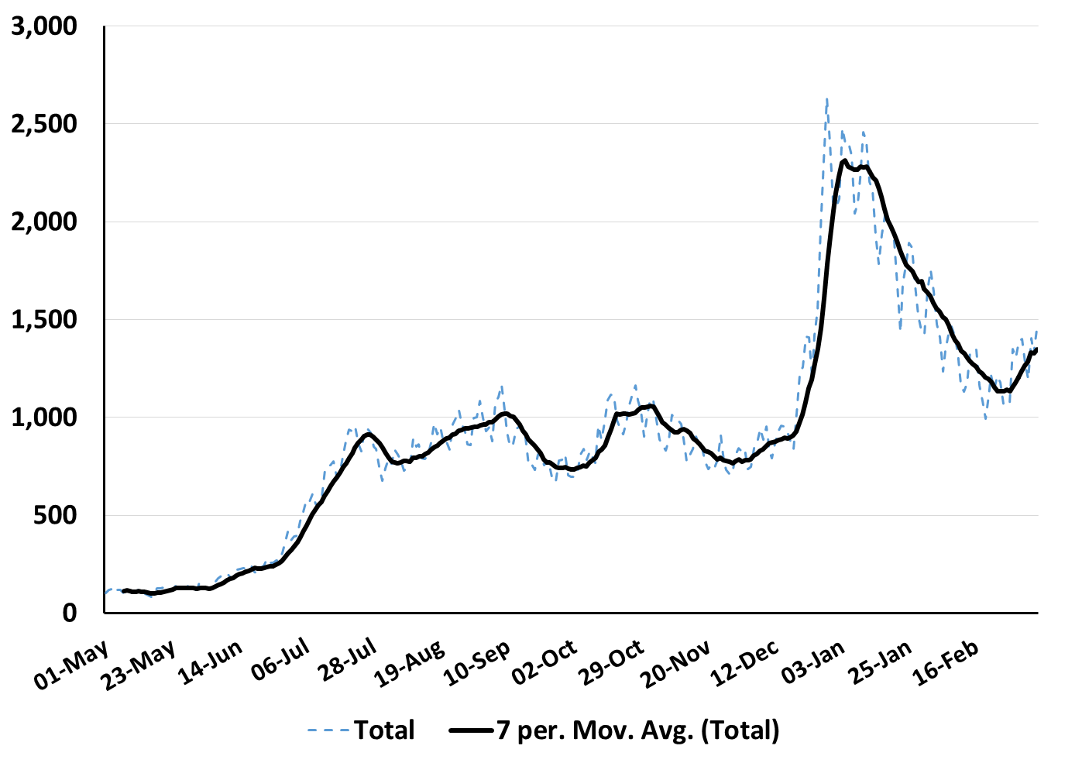
Hospital admissions for UK
(Source: Covid Daily Update)

Slide 11
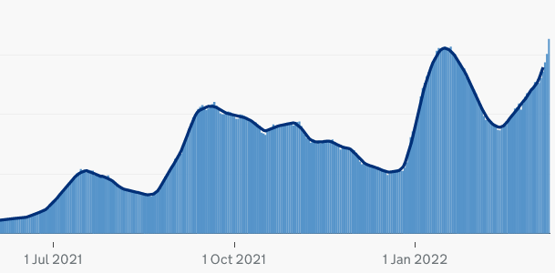
Covid-19 patients in hospital in Scotland
(Source: Covid Daily Update)

Slide 12
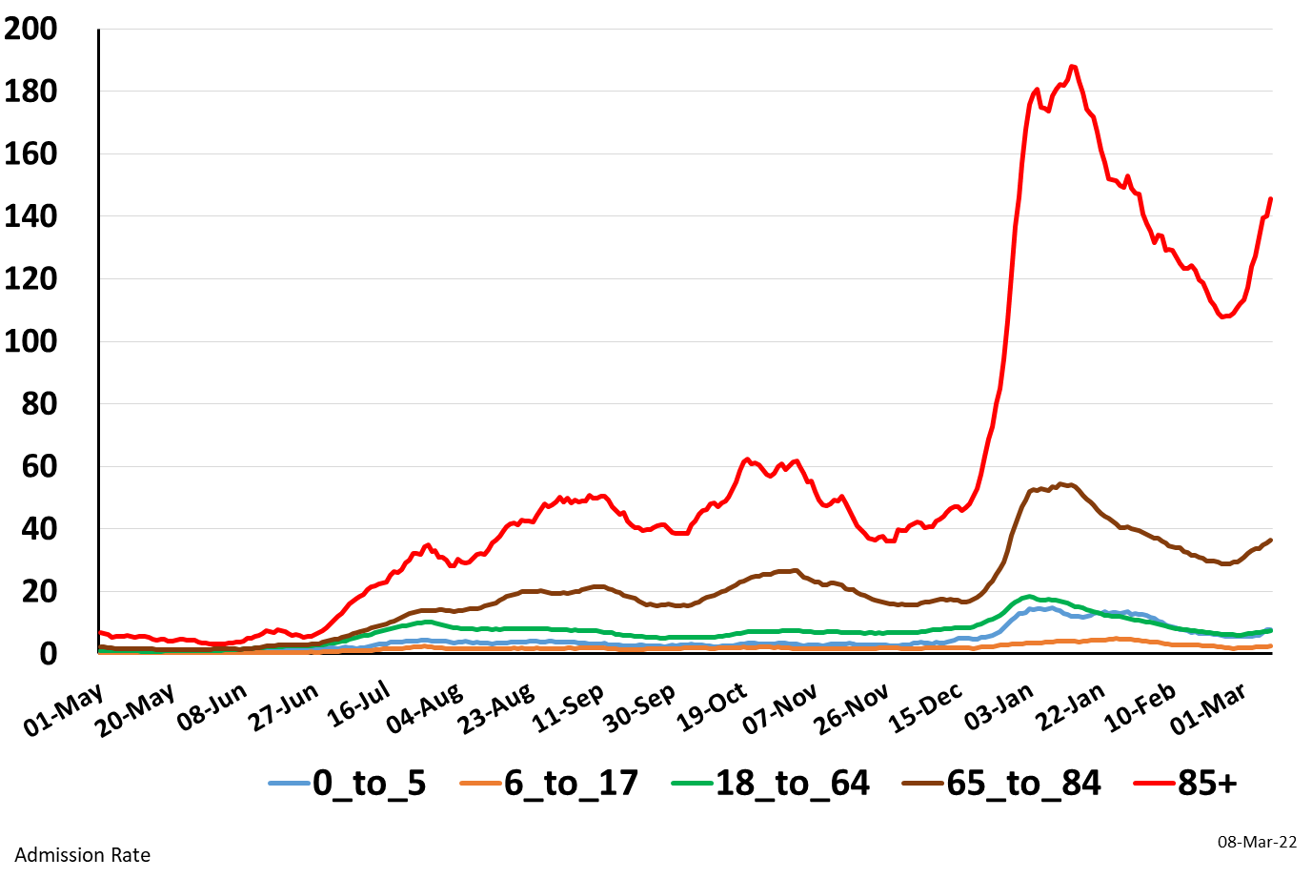
Hospital admissions by age (England)
(Source: Covid Daily Update)

Slide 13
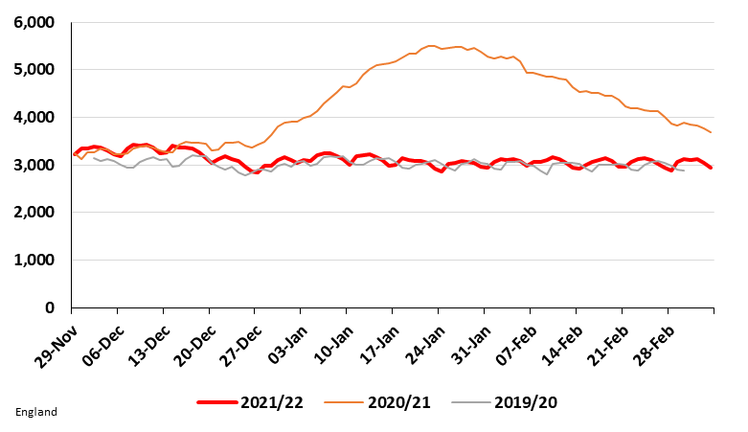
Number of Occupied Adult Critical Care Beds in England
29 Nov 2021 to 6 Mar 2022
(Source: NHS England Urgent and Emergency Care Daily Situation Reports 2021-22 )
https://www.england.nhs.uk/statistics/statistical-work-areas/uec-sitrep/urgent-and-emergency-care-daily-situation-reports-2021-22/

Slide 14
Hospitalisations “with Covid” vs “due to Covid”

Slide 15
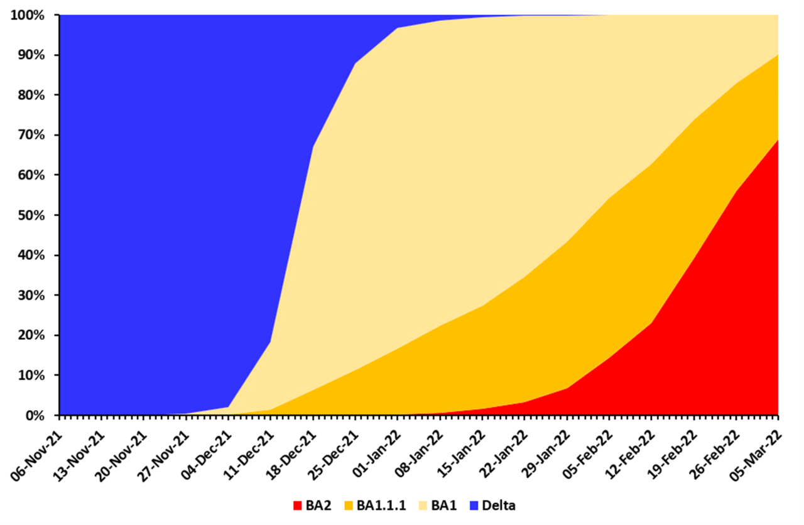
Variants

Slide 16
Behaviour
Testing
Mask wearing

Slide 17
Summary
Testing has dropped substantially
Prevalence is high and cases are up across all age groups
Hospital admissions are up across all regions/age groups
BA2 has become dominant (but probably not the reason for increase in admissions?)
Probably reflects changes in behaviour
Is the pandemic over?

Slide 18
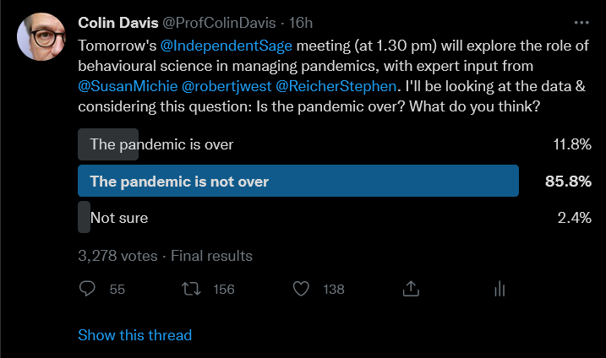
Who decides?

