Slide 1
Data 27 May 2022
Covid Dashboard now highlighting England data rather than UK data as data sources from other UK nations winding down
Variants: BA.4, BA.5, BA.2.12.1 still increasing in samples – now around 5% each of samples sequenced.
But hasn’t been reflected in ONS survey data (2nd anniversary of ONS survey) (falling BA.2 wave with increasing BA.4/5/2.12.1)
NHS Metrics
https://digital.nhs.uk/data-and-information/publications/statistical/nhs-sickness-absence-rates

Slide 2
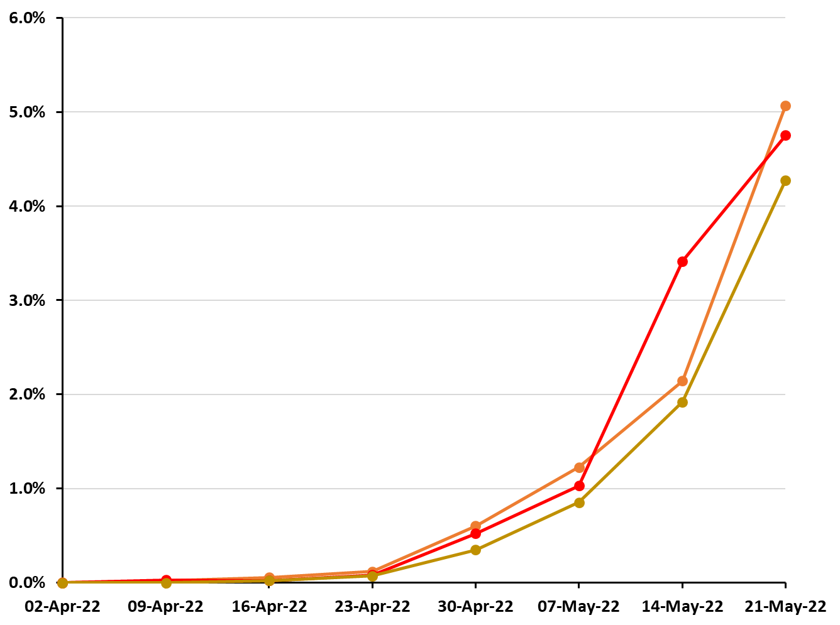
Proportion of sequenced cases in England that are Omicron BA.4, Omicron BA.5 & Omicron BA.2.12.1 from 1 April 2022 to 21 May 2022.
Most recent week’s data still incomplete (so numbers may change)
BA.2.12.1
BA.4
BA.5
Data from COG UK, https://www.cogconsortium.uk/priority-areas/data-linkage-analysis/public-data-analysis/

Slide 3
ONS INFECTION SURVEY

Slide 4
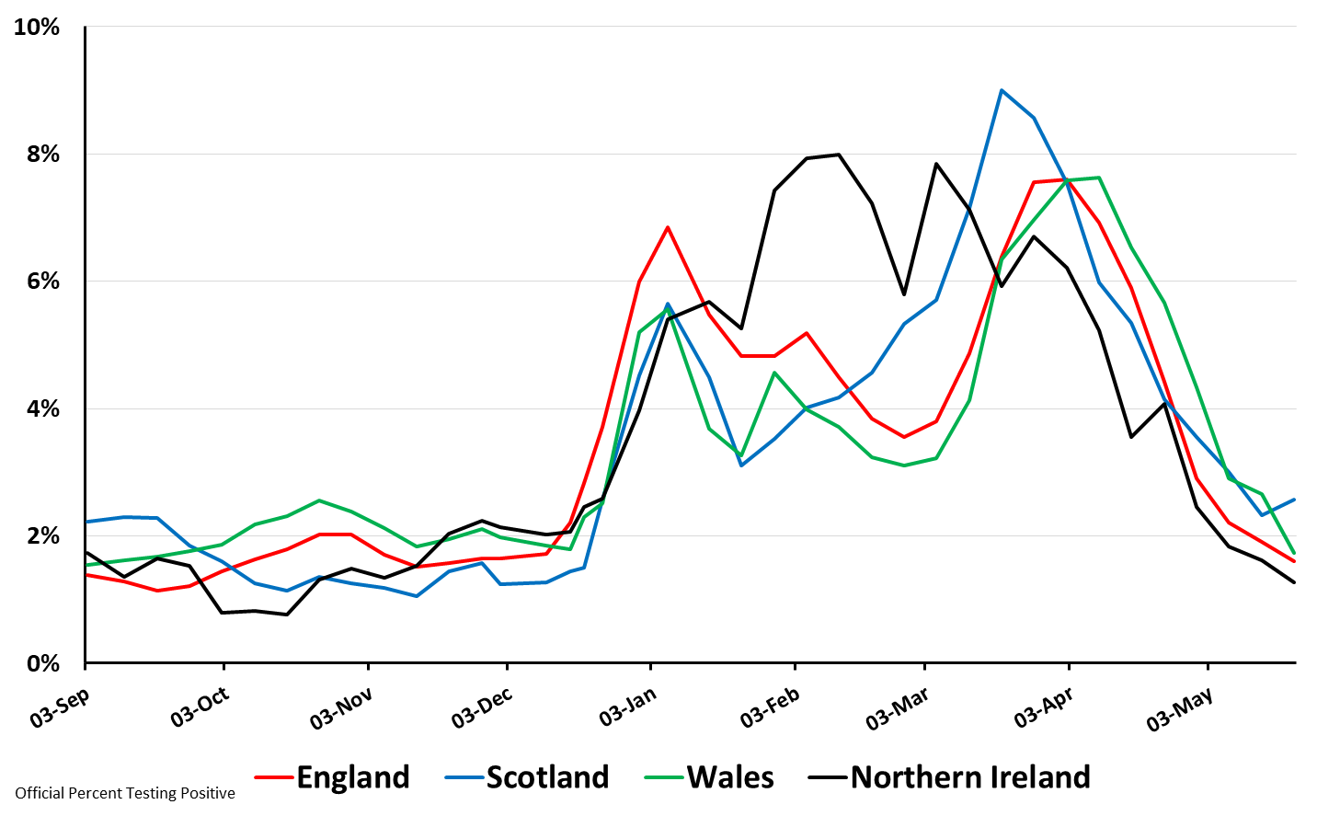
Percent Testing Positive by Nation: 3 Sep 2021 to 21 May 2022
(Source: ONS Coronavirus (COVID-19) Infection Survey results)
Thanks to Bob Hawkins for the chart

Slide 5
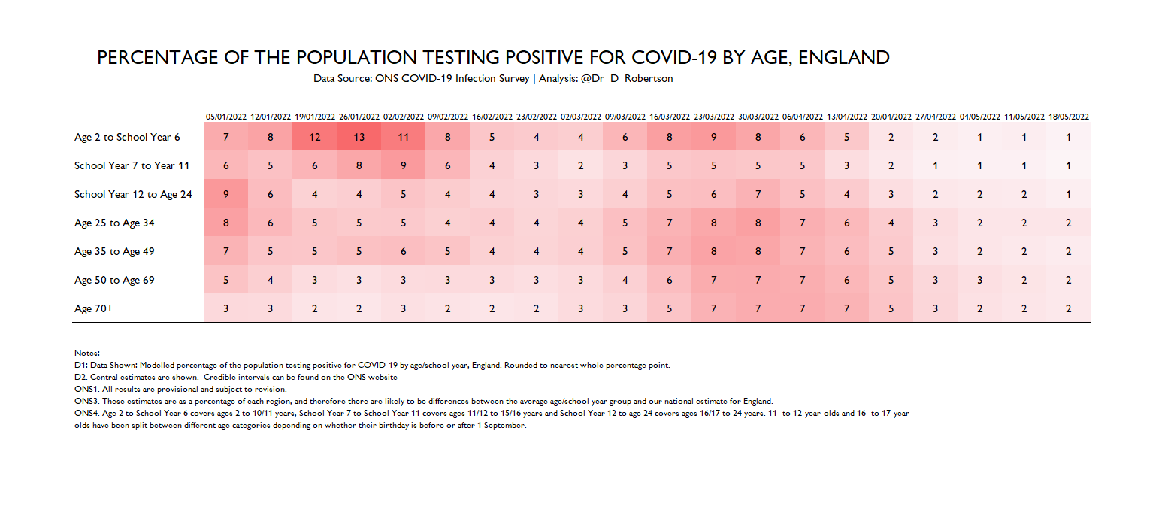

Slide 6
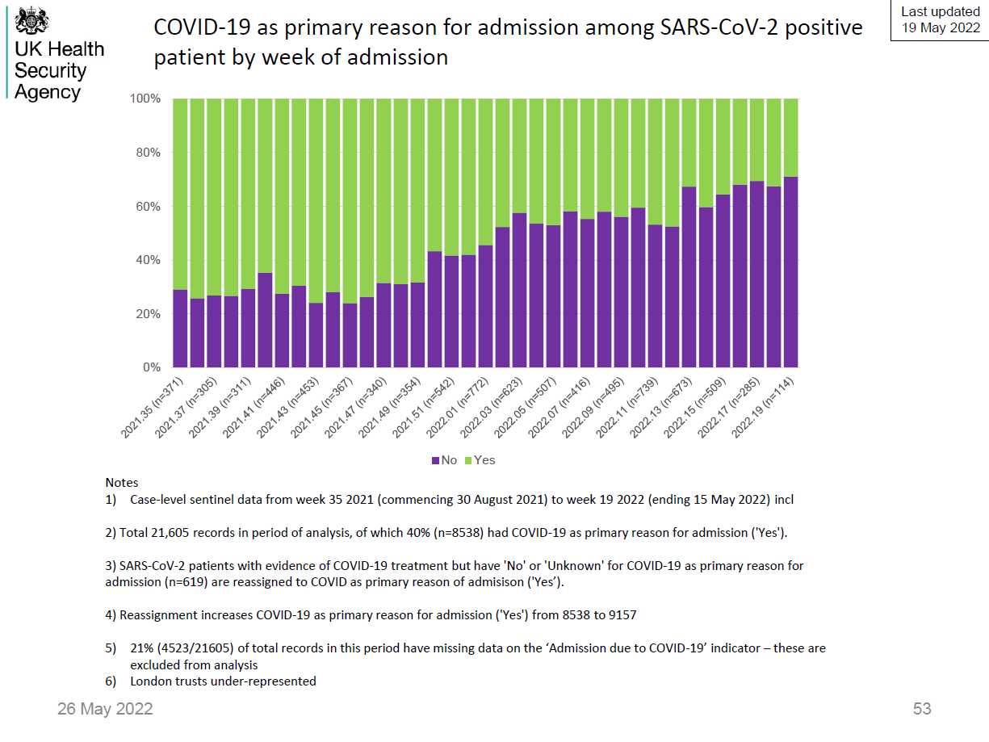
Source: UKHSA

Slide 7
NHS ENGLAND DATA STAFF SICKNESS

Slide 8
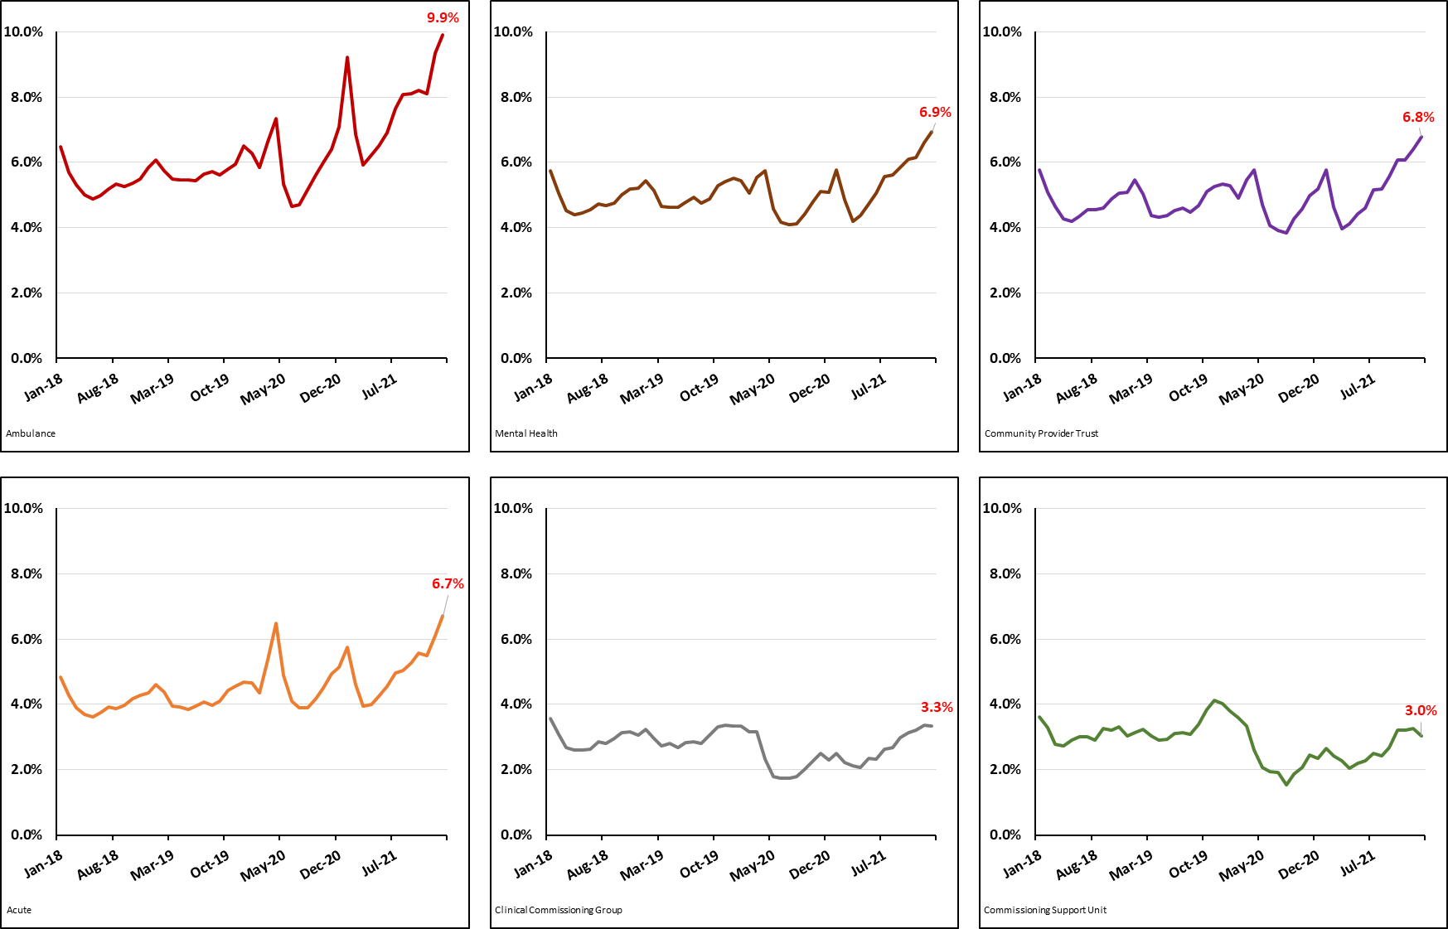
NHS England Staff Sickness Absence Rates by Staff Group
Jan 2018 – Jan 2022
(Source: NHS Sickness Absence Rates Reports)
Ambulance
Mental Health
Community Provider Trust
Acute
Clinical Commissioning Group
Commissioning Support Unit
https://digital.nhs.uk/data-and-information/publications/statistical/nhs-sickness-absence-rates

Slide 9
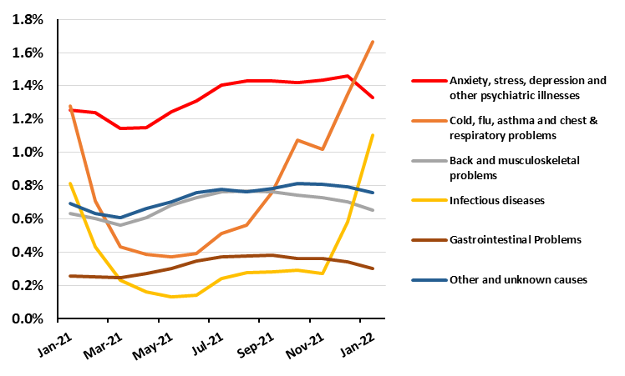
NHS England Staff Sickness Absence Rates by
Top 6 Reasons for Absence: Jan 2021 – Jan 2022
(Source: NHS Sickness Absence Rates Reports)
https://digital.nhs.uk/data-and-information/publications/statistical/nhs-sickness-absence-rates

Slide 10
NHS PERFORMANCE INDICATORS

Slide 11
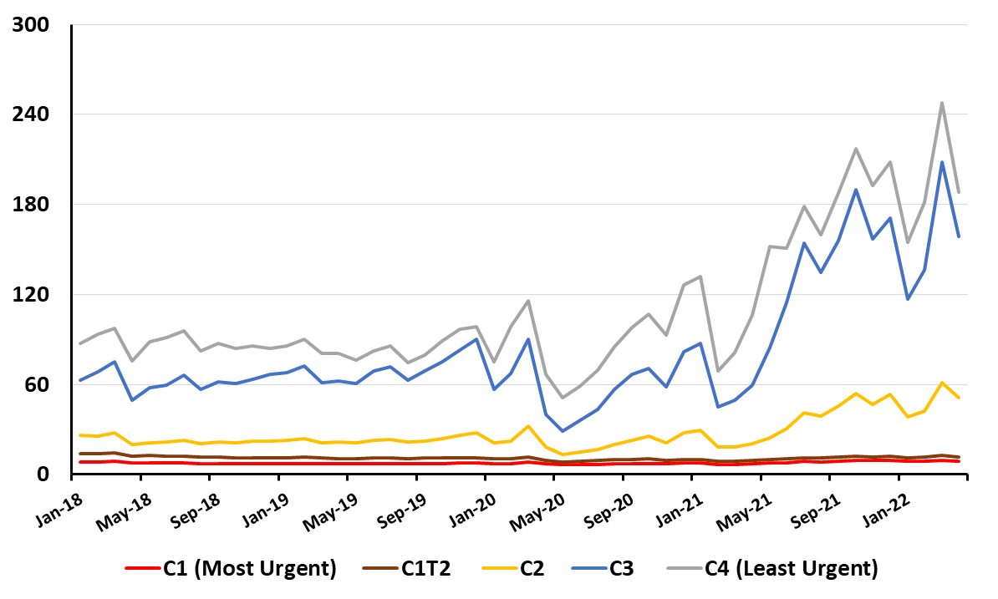
Average Ambulance Response Times (Minutes) by Urgency in England
Jan 2018 to Apr 2022
(Source: NHS England Ambulance Quality Indicators 2021-22 )
Minutes
https://www.england.nhs.uk/statistics/statistical-work-areas/ambulance-quality-indicators/

Slide 12
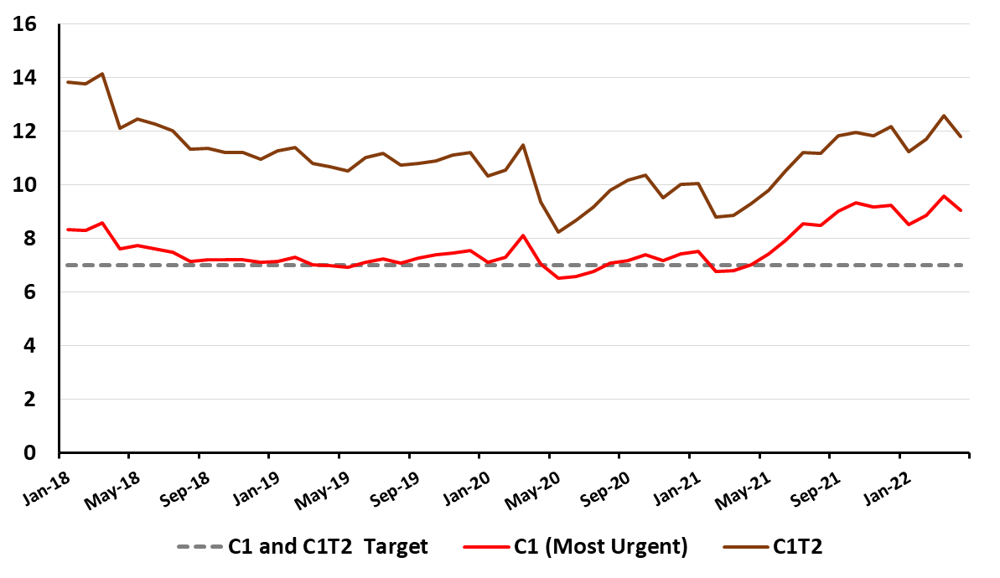
Average Ambulance Response Times (Minutes) for the Most Urgent Calls in England: Jan 2018 to Apr 2022
(Source: NHS England Ambulance Quality Indicators 2021-22 )
Minutes
https://www.england.nhs.uk/statistics/statistical-work-areas/ambulance-quality-indicators/

Slide 13
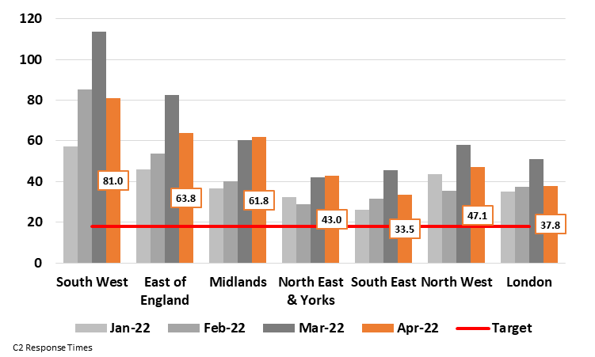
Average Ambulance Response Times (Minutes) for the Urgent C2 Calls
by Region: Recent Trend
(Source: NHS England Ambulance Quality Indicators 2021-22 )
C2 calls are for a serious condition, such as stroke or chest pain, which may require rapid assessment and/or urgent transport
Minutes
https://www.england.nhs.uk/statistics/statistical-work-areas/ambulance-quality-indicators/

Slide 14
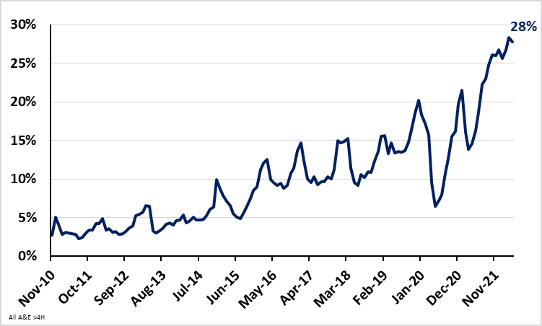
Percent of A&E attendances greater than 4 hours from arrival to admission, transfer or discharge for England: Nov 2010 – Apr 2022
(Source: NHS Monthly A&E Attendances and Emergency Admissions)
503,471 A&E Patients (28%) waited longer than four hours from arrival to admission / transfer / discharge in Apr 2022
https://www.england.nhs.uk/statistics/statistical-work-areas/ae-waiting-times-and-activity/

Slide 15
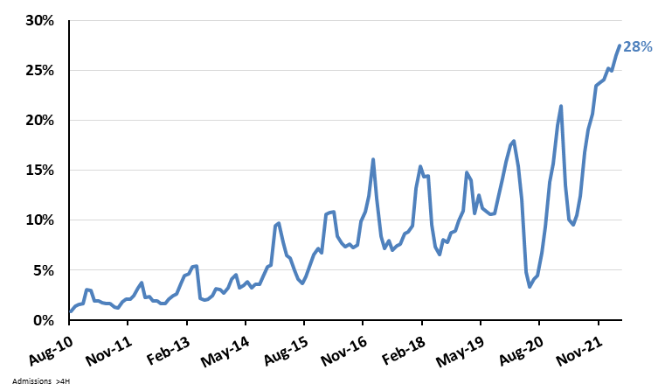
Percent of A&E attendances greater than 4 hours from ‘decision to admit’ to hospital admission for England: Nov 2010 – Apr 2022
(Source: NHS Monthly A&E Attendances and Emergency Admissions)
131,905 A&E Patients (28%) waited longer than four hours from ‘decision to admit’ to admission in Apr 2022
https://www.england.nhs.uk/statistics/statistical-work-areas/ae-waiting-times-and-activity/

Slide 16
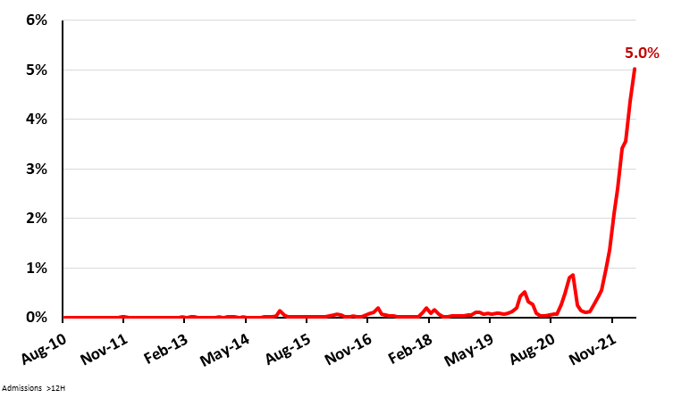
Percent of A&E attendances greater than 12 hours from ‘decision to admit’ to hospital admission for England: Nov 2010 – Apr 2022
(Source: NHS Monthly A&E Attendances and Emergency Admissions)
24,138 A&E Patients (5.0%) waited longer than 12 hours from ‘decision to admit’ to admission in Mar 2022
https://www.england.nhs.uk/statistics/statistical-work-areas/ae-waiting-times-and-activity/

Slide 17
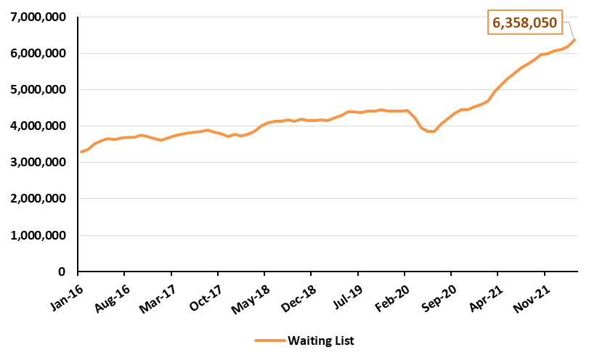
Number of Patients Waiting for Treatment in England (Jan 2016 to Mar 2022)
(Source: NHS Monthly A&E Attendances and Emergency Admissions)
Nearly One in Nine People were Waiting to Start Treatment in Mar 2022
https://www.england.nhs.uk/statistics/statistical-work-areas/rtt-waiting-times/rtt-data-2021-22/

Slide 18
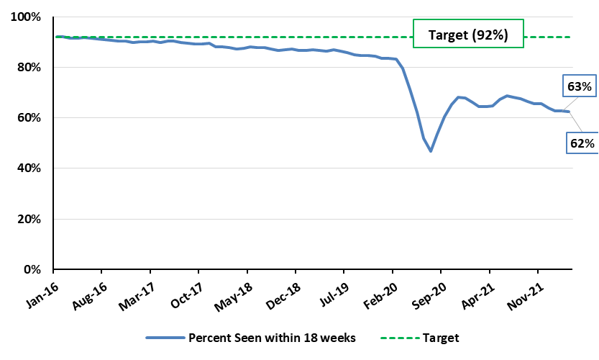
Percent of Patients Starting Non-Emergency Consultant Treatment within 18 Weeks of Referral by Month for England (Jan 2016 to Mar 2022)
(Source: NHS Monthly A&E Attendances and Emergency Admissions)
2,389,474 Patients (38%) waited longer than 18 Weeks to Start Treatment in Mar 2022
https://www.england.nhs.uk/statistics/statistical-work-areas/rtt-waiting-times/rtt-data-2021-22/

Slide 19
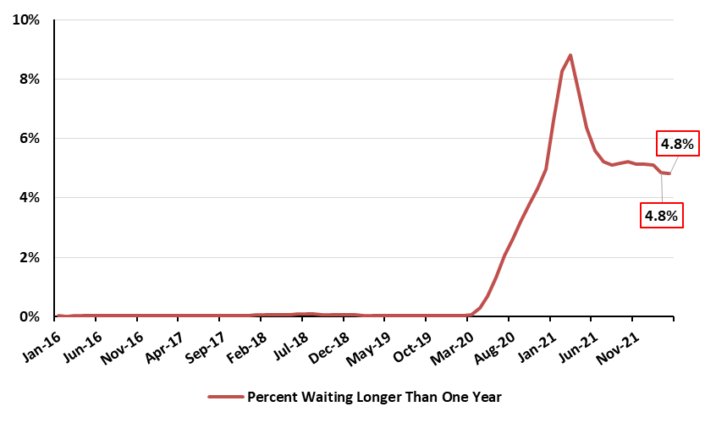
Percent of Patients Waiting Longer than One Year to Start Non-Emergency Consultant Treatment by Month for England (Jan 2016 to Mar 2022)
(Source: NHS Monthly A&E Attendances and Emergency Admissions)
306,286 Patients (4.8%) waited longer than One Year to Start Treatment in Mar 2022
https://www.england.nhs.uk/statistics/statistical-work-areas/rtt-waiting-times/rtt-data-2021-22/

Slide 20
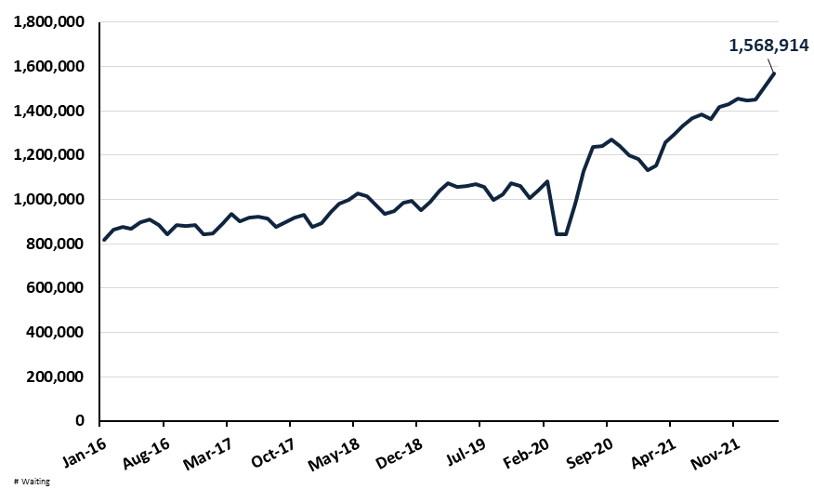
Number of Patients Waiting for Diagnostic Tests by Month
England (Jan 2016 to Mar 2022)
(Source: NHS Monthly Diagnostic Waiting Times and Activity Report)
https://www.england.nhs.uk/statistics/statistical-work-areas/diagnostics-waiting-times-and-activity/monthly-diagnostics-waiting-times-and-activity/monthly-diagnostics-data-2021-22/

Slide 21
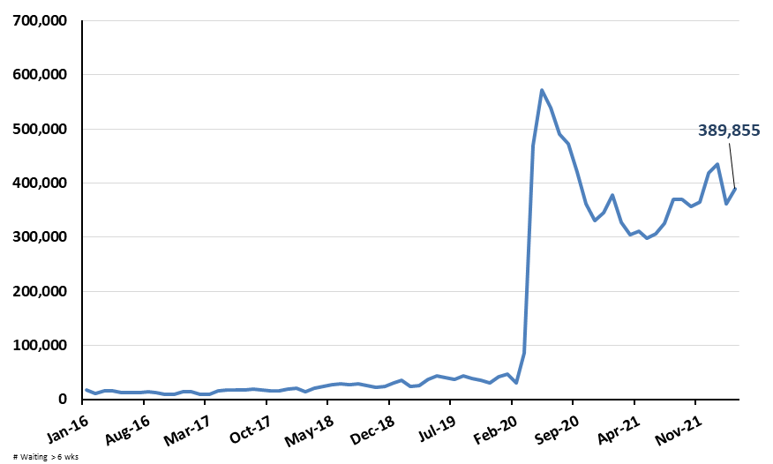
Percent of Patients Waiting Longer than 6 Weeks for Diagnostic Tests by Month for England (Jan 2016 to Mar 2022)
(Source: NHS Monthly A&E Attendances and Emergency Admissions)
End of Mar 2022
Patients waiting: 389,855
Percent waiting: 25%
Target: 1%
https://www.england.nhs.uk/statistics/statistical-work-areas/diagnostics-waiting-times-and-activity/monthly-diagnostics-waiting-times-and-activity/monthly-diagnostics-data-2021-22/

Slide 22
Data 27 May 2022
Covid Dashboard now highlighting England data rather than UK data as data sources from other UK nations winding down
Variants: BA.4, BA.5, BA.2.12.1 still increasing in samples – now around 5% each of samples sequenced.
But hasn’t been reflected in ONS survey data (2nd anniversary of ONS survey) (falling BA.2 wave with increasing BA.4/5/2.12.1)
NHS Metrics
Thanks to Bob Hawkins for help in preparing the slides
https://digital.nhs.uk/data-and-information/publications/statistical/nhs-sickness-absence-rates

