Slide 1
Data Presentation 12 August 2022
Infections expected to be falling & Hospitalizations and people in hospital falling (ONS data delayed)
Vaccination uptake in children low prior to return to school
Variants – BA5 wave peaked – no clear sign of next wave
Excess Deaths commentary
Thanks to Bob Hawkins for his assistance in preparing the presentation

Slide 2
INFECTIONS

Slide 3
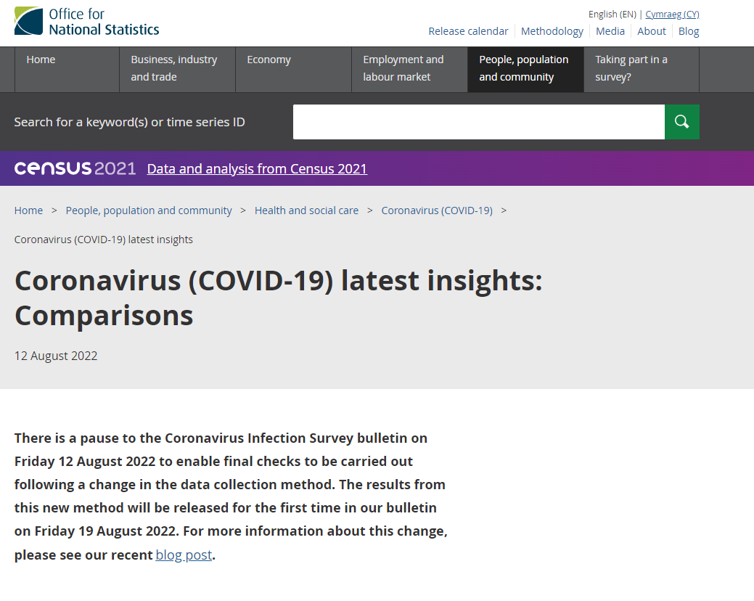

Slide 4
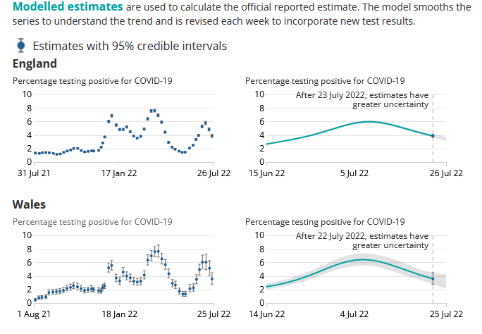
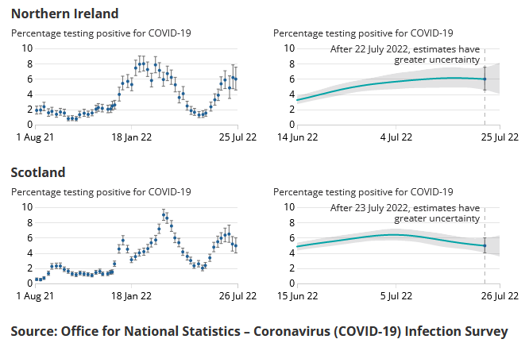
PERCENTAGE OF PEOPLE TESTING POSITIVE nb last week’s data

Slide 5
HOSPITAL DATA

Slide 6
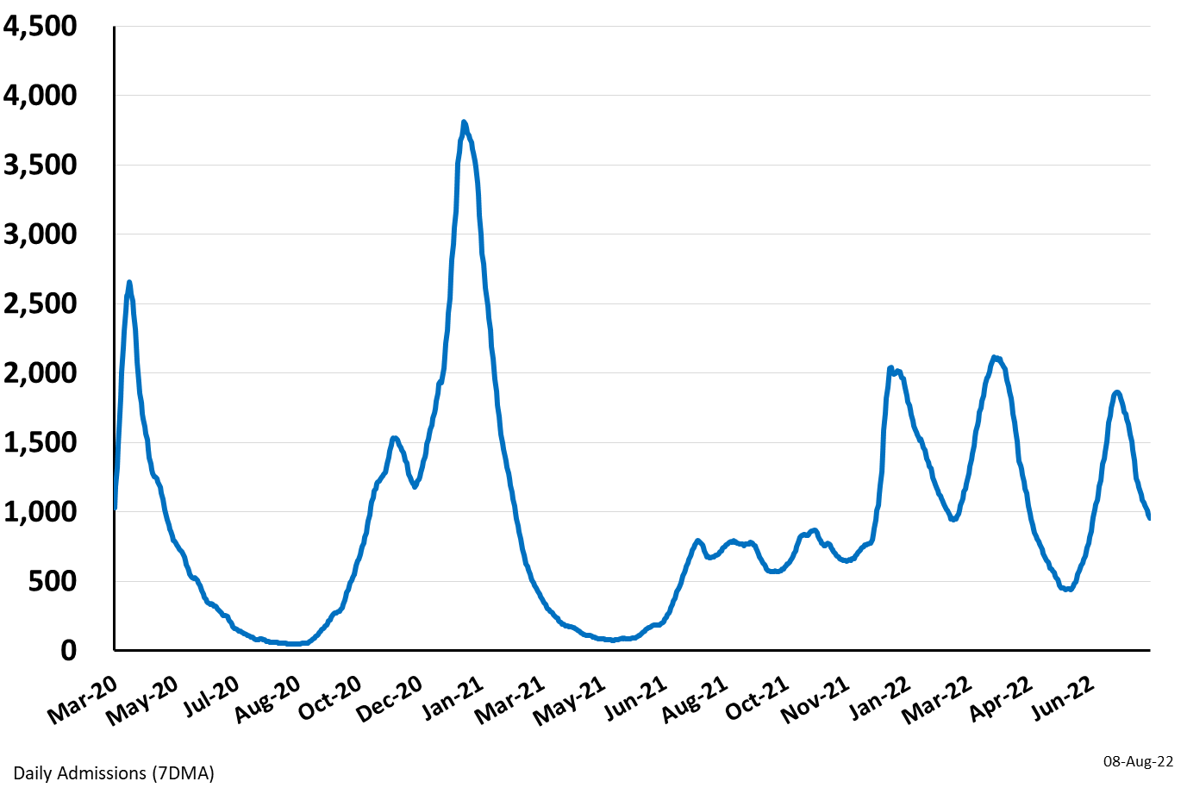
Daily Hospital Admissions for England: Mar 26 2020 – Aug 8 2022
(Source: Covid Daily Update)

Slide 7
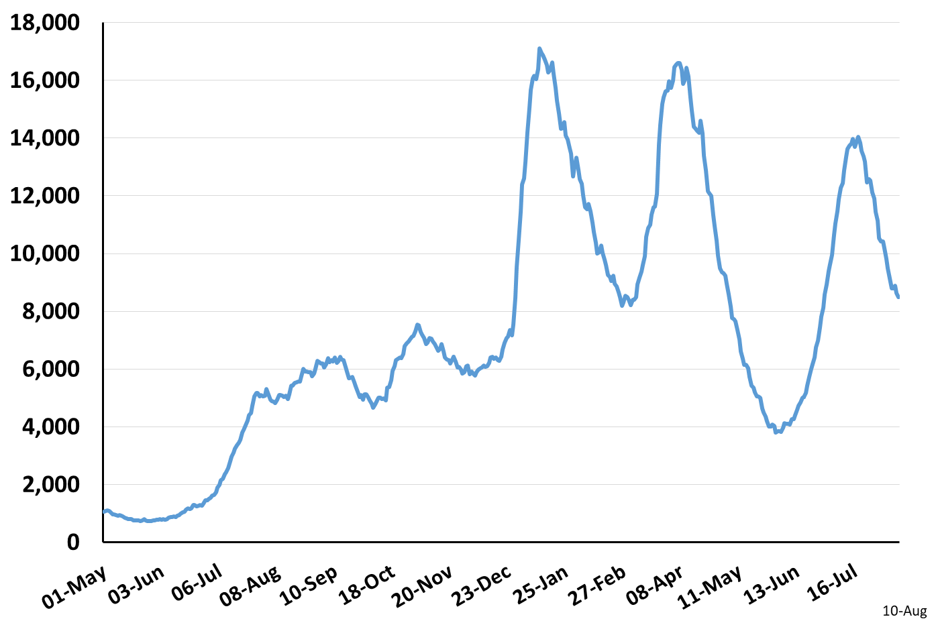
Daily Occupied Beds for England: May 1 2021 – Aug 10 2022
(Source: Covid Daily Update)

Slide 8
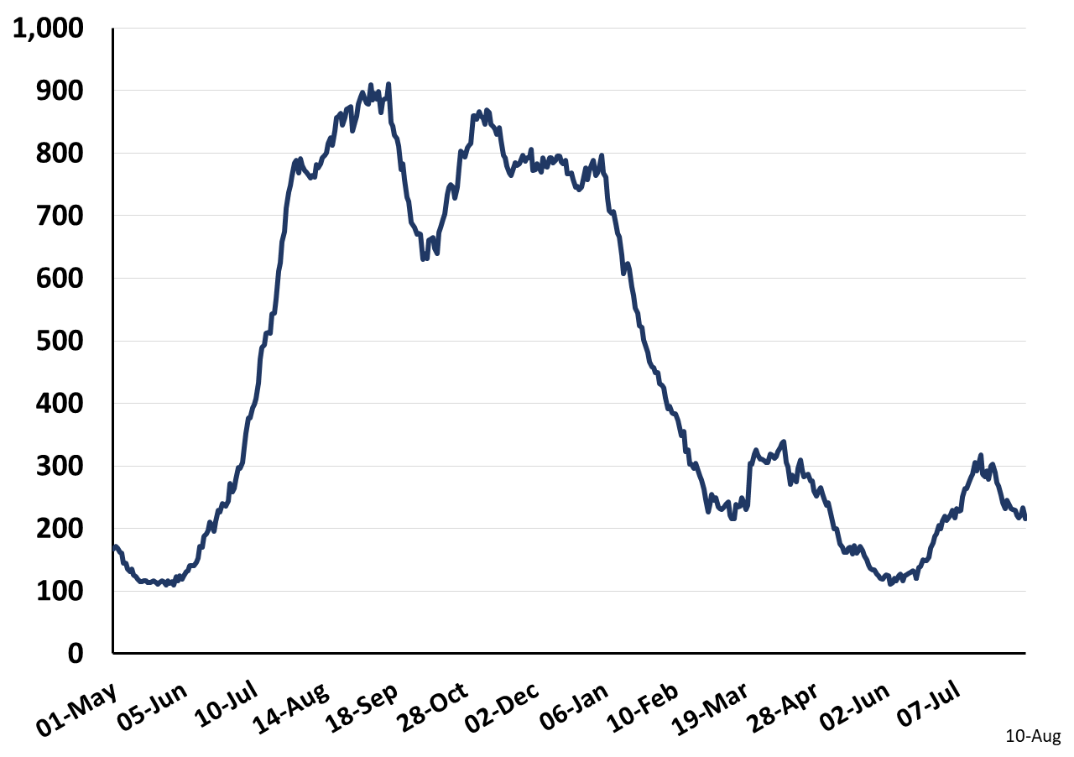
Daily Occupied Mechanically Ventilated Beds for England
May 1 2021 – Aug 10 2022
(Source: Covid Daily Update)

Slide 9
HOSPITAL KPIs

Slide 10
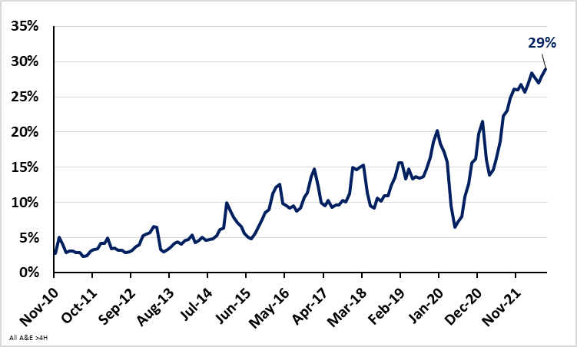
Percent of A&E attendances greater than 4 hours from arrival to admission, transfer or discharge for England: Nov 2010 – Jul 2022
(Source: NHS Monthly A&E Attendances and Emergency Admissions)
559,183 A&E Patients (29%) waited longer than four hours from arrival to admission / transfer / discharge in Jul 2022
https://www.england.nhs.uk/statistics/statistical-work-areas/ae-waiting-times-and-activity/

Slide 11
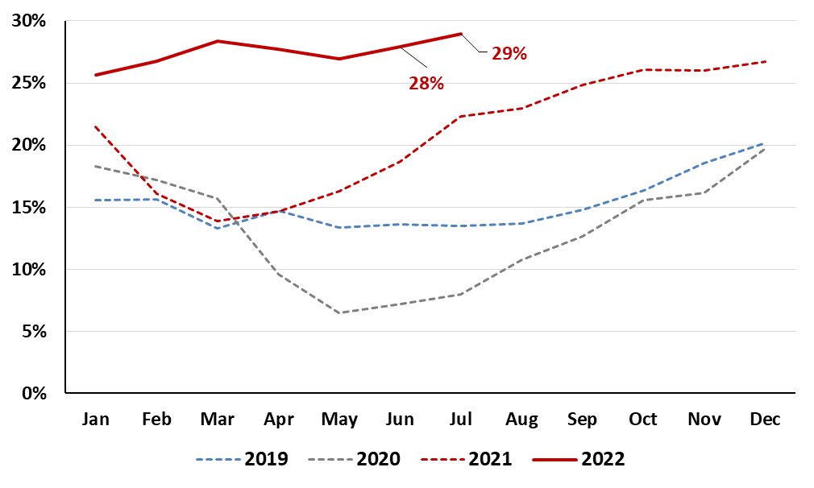
Percent of A&E attendances greater than 4 hours from arrival to admission, transfer or discharge by Month and Year for England
(Source: NHS Monthly A&E Attendances and Emergency Admissions)
https://www.england.nhs.uk/statistics/statistical-work-areas/ae-waiting-times-and-activity/

Slide 12
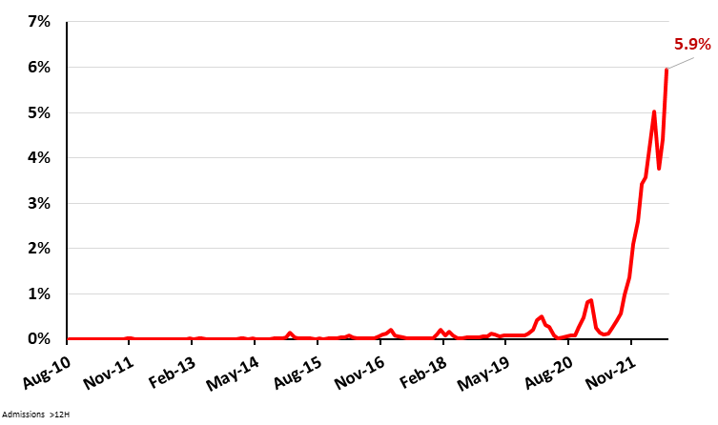
Percent of A&E attendances greater than 12 hours from ‘decision to admit’ to hospital admission for England: Nov 2010 – Jul 2022
(Source: NHS Monthly A&E Attendances and Emergency Admissions)
29,317 A&E Patients (5.9%) waited longer than 12 hours from ‘decision to admit’ to admission in Jul 2022
https://www.england.nhs.uk/statistics/statistical-work-areas/ae-waiting-times-and-activity/

Slide 13
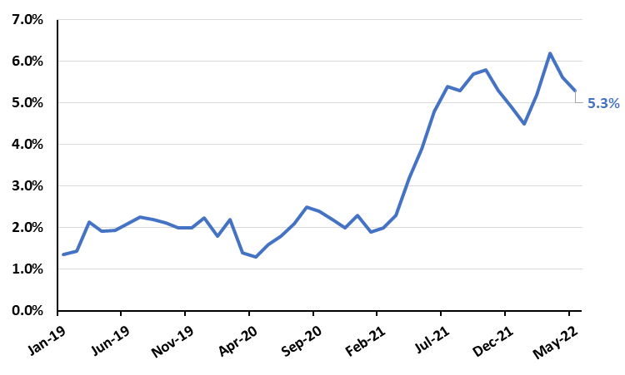
Percent of Patients Leaving A&E before Treatment is Completed for England
Jan 2019 – Jun 2022
(Source: NHS Digital Provisional Accident and Emergency Quality Indicators for England)
106,419 A&E Patients (5.3%) left before completing treatment in Jun 2022
https://digital.nhs.uk/data-and-information/publications/statistical/provisional-accident-and-emergency-quality-indicators-for-england

Slide 14
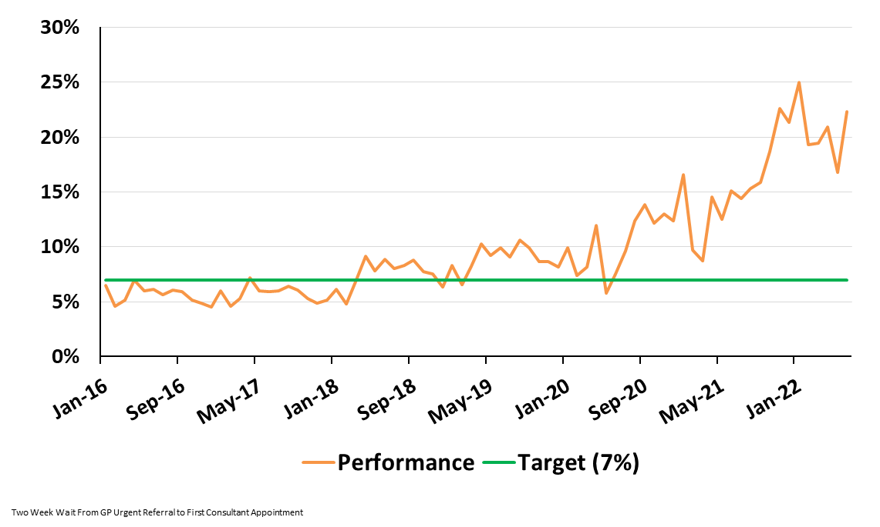
Percent of Patients Waiting Longer than Two Weeks to see a Consultant following an Urgent GP Referral by Month: England (Jan 2016 to Jun 2022)
(Source: NHS Monthly Cancer Waiting Times Report)
https://www.england.nhs.uk/statistics/statistical-work-areas/cancer-waiting-times/

Slide 15
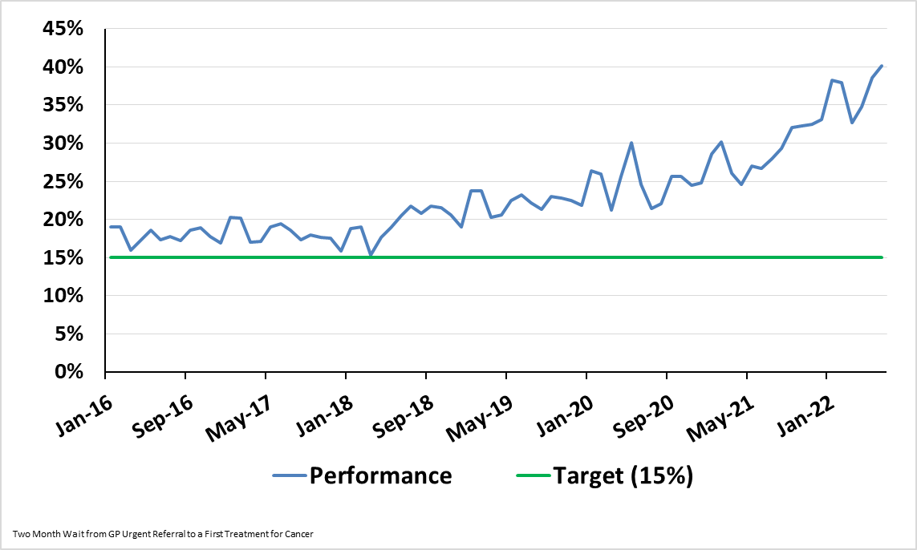
Percent of Patients Waiting Longer than Two Months to Start Treatment following an Urgent GP Referral by Month: England (Jan 2016 to Jun 2022)
(Source: NHS Monthly Cancer Waiting Times Report)
https://www.england.nhs.uk/statistics/statistical-work-areas/cancer-waiting-times/

Slide 16
AMBULANCE DATA

Slide 17
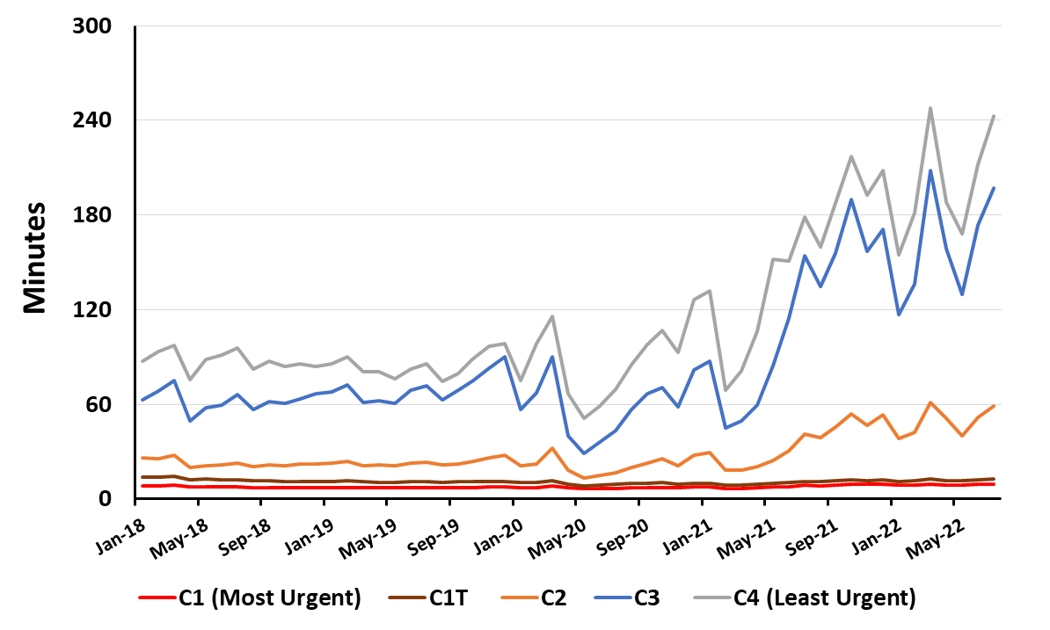
Average Ambulance Response Times (Minutes) by Urgency in England
Jan 2018 to Jul 2022
(Source: NHS England Ambulance Quality Indicators 2021-22 )
https://www.england.nhs.uk/statistics/statistical-work-areas/ambulance-quality-indicators/

Slide 18
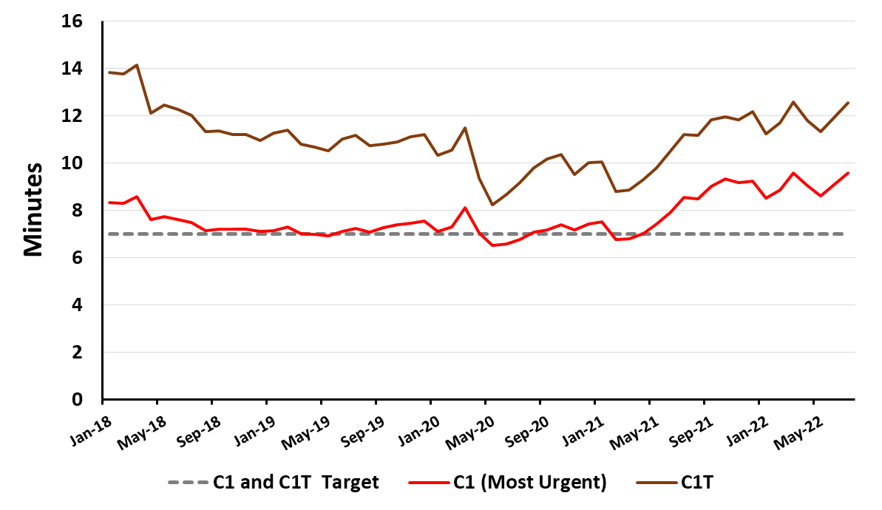
Average Ambulance Response Times (Minutes) for the Most Urgent Calls in England: Jan 2018 to Jul 2022
(Source: NHS England Ambulance Quality Indicators 2021-22 )
https://www.england.nhs.uk/statistics/statistical-work-areas/ambulance-quality-indicators/

Slide 19
VACCINATIONS

Slide 20
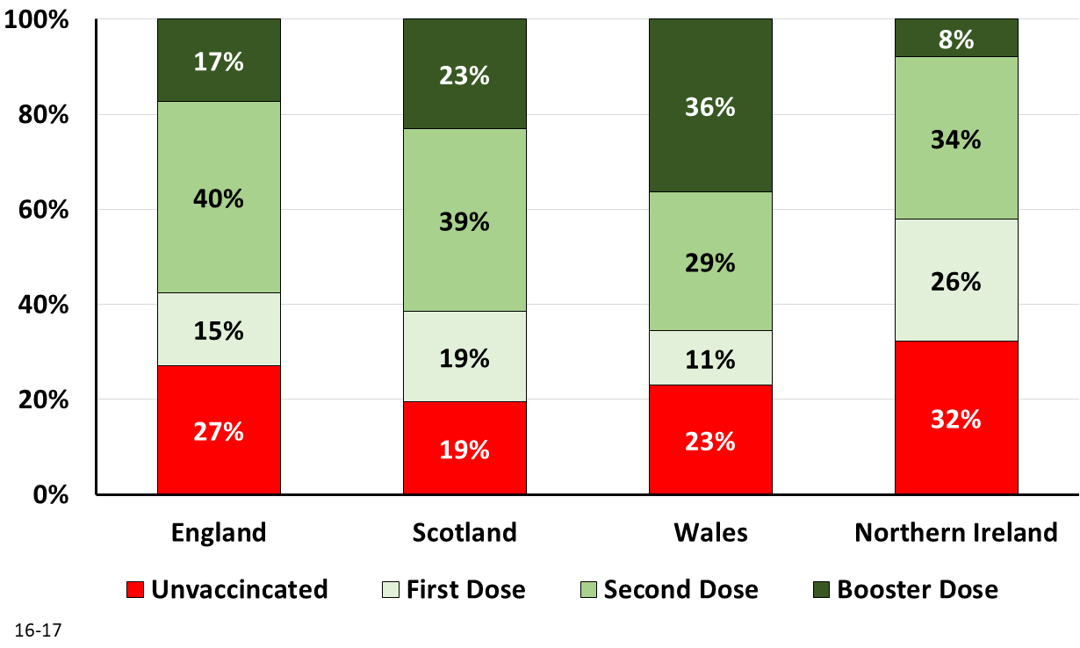
Percent of 16-17 Year Olds Unvaccinated, First Dose, Second Dose, and Boosted Latest Data
(Source: NHS Vaccination Daily Report, Scotland Weekly Vaccination Report, Wales Daily Covid Surveillance Dashboard and NI Vaccination Dashboard)

Slide 21
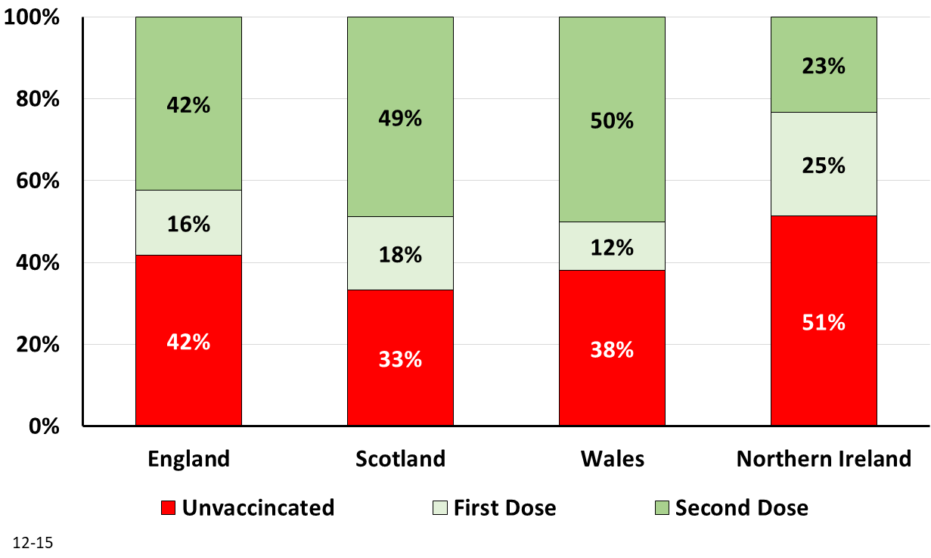
Percent of 12-15 Year Olds Unvaccinated, First Dose, and Second Dosed
Latest Data
(Source: NHS Vaccination Daily Report, Scotland Weekly Vaccination Report, Wales Daily Covid Surveillance Dashboard and NI Vaccination Dashboard)

Slide 22
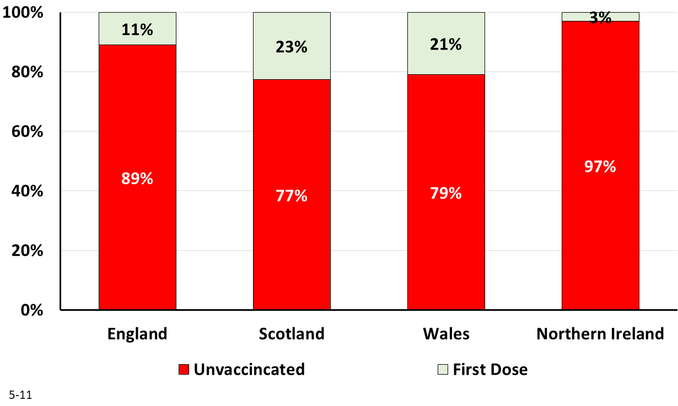
Percent of 5-11 Year Olds Unvaccinated and First Dosed
Latest Data
(Source: NHS Vaccination Daily Report, Scotland Weekly Vaccination Report, Wales Daily Covid Surveillance Dashboard and NI Vaccination Dashboard)

Slide 23
VARIANTS

Slide 24
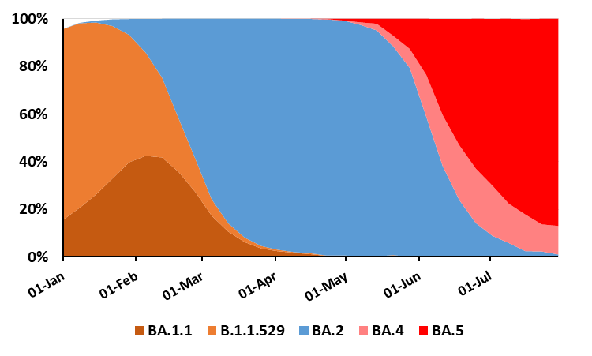
Percent of Variants by Week for England: Jan 1 to Jul 30 2022
(Source: Sanger Institute COVID–19 Genomic Surveillance Website)
Omicron
https://covid19.sanger.ac.uk/lineages/raw

Slide 25
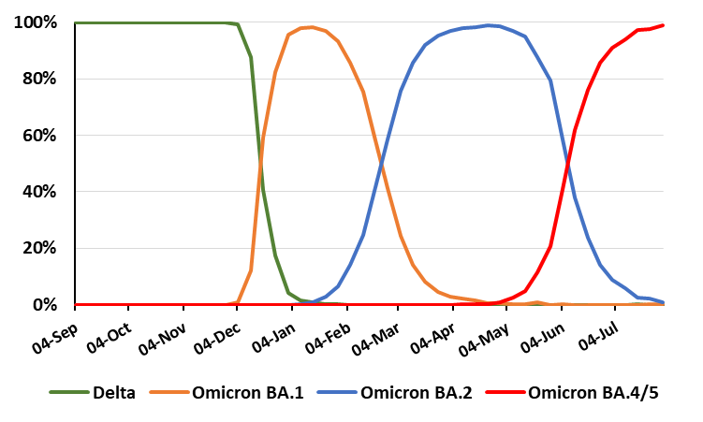
Percent of Variants by Week for England: Sep 4 2021 to Jul 30 2022
(Source: Sanger Institute COVID–19 Genomic Surveillance Website)
https://covid19.sanger.ac.uk/lineages/raw

Slide 26
EXCESS DEATHS
Data from Office for Health Improvement and Disparities (previously part of PHE)
nb note scales on vertical axis – these are not the same between charts
https://app.powerbi.com/view?r=eyJrIjoiYmUwNmFhMjYtNGZhYS00NDk2LWFlMTAtOTg0OGNhNmFiNGM0IiwidCI6ImVlNGUxNDk5LTRhMzUtNGIyZS1hZDQ3LTVmM2NmOWRlODY2NiIsImMiOjh9

Slide 27
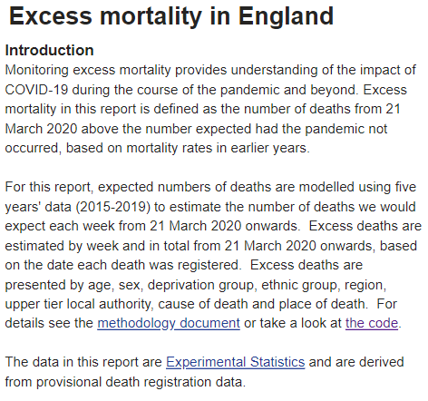
EXCESS MORTALITY
Source: OHID (Office for Health Improvement and Disparities)

Slide 28
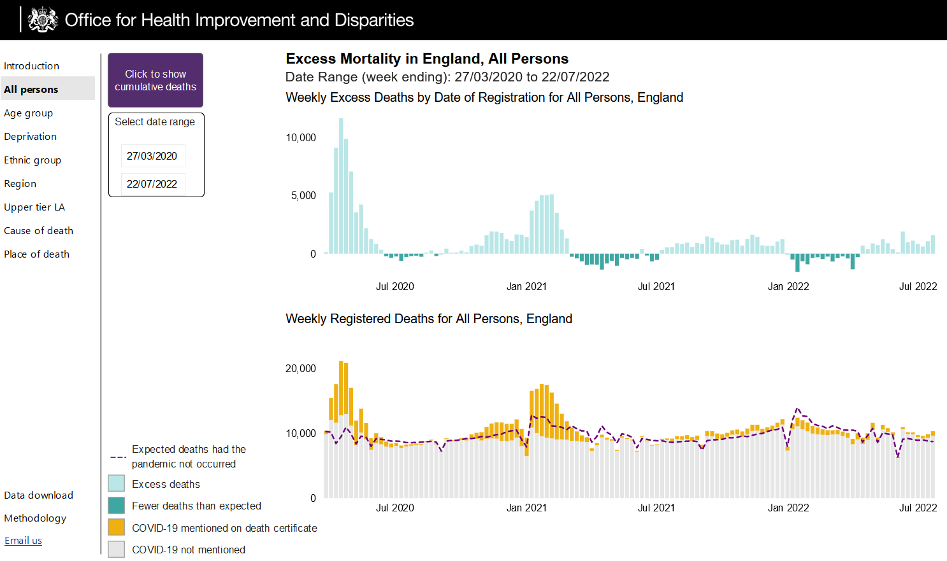
.

Slide 29
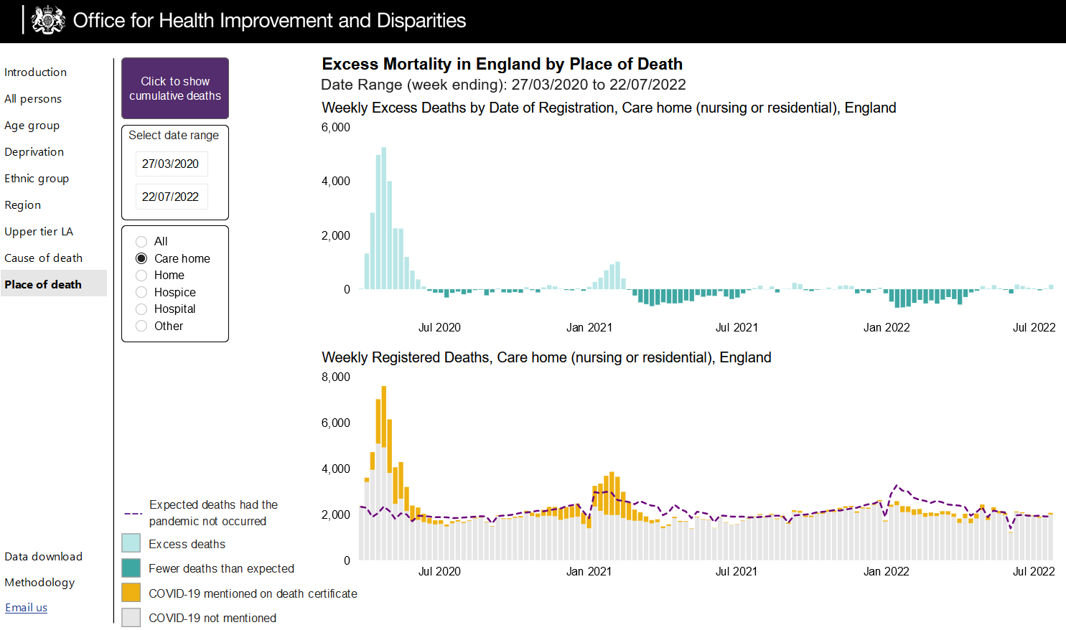
PLACE OF DEATH

Slide 30
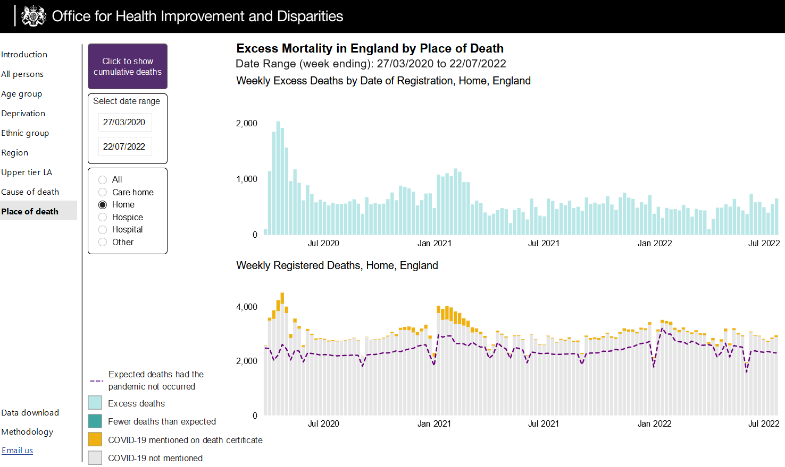
PLACE OF DEATH

Slide 31
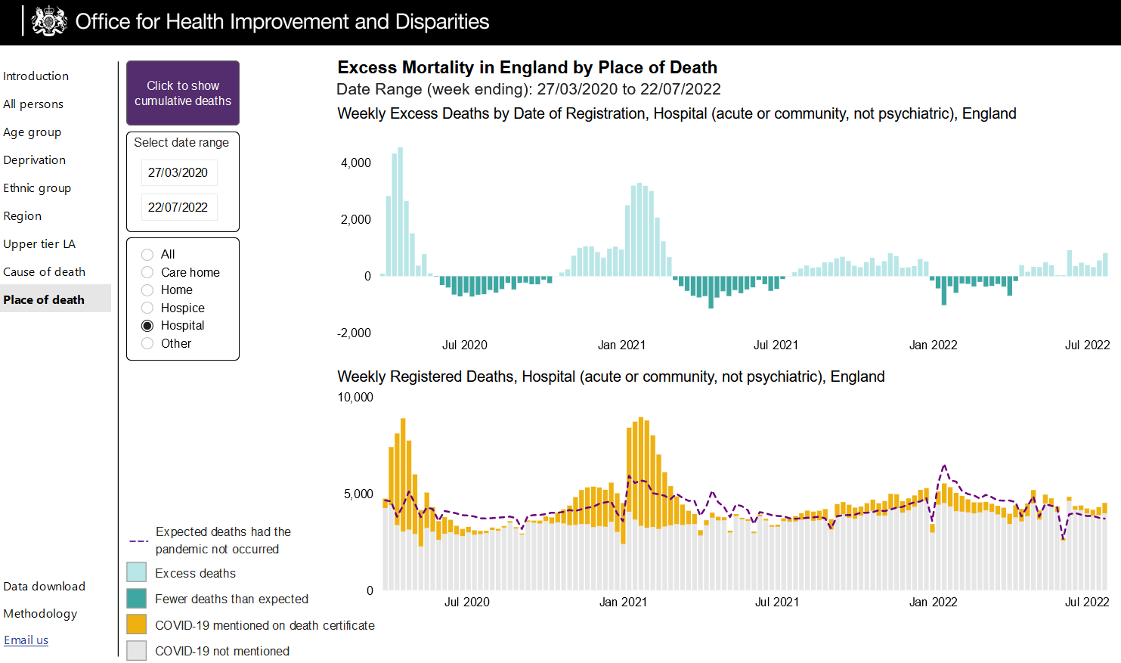
PLACE OF DEATH

Slide 32
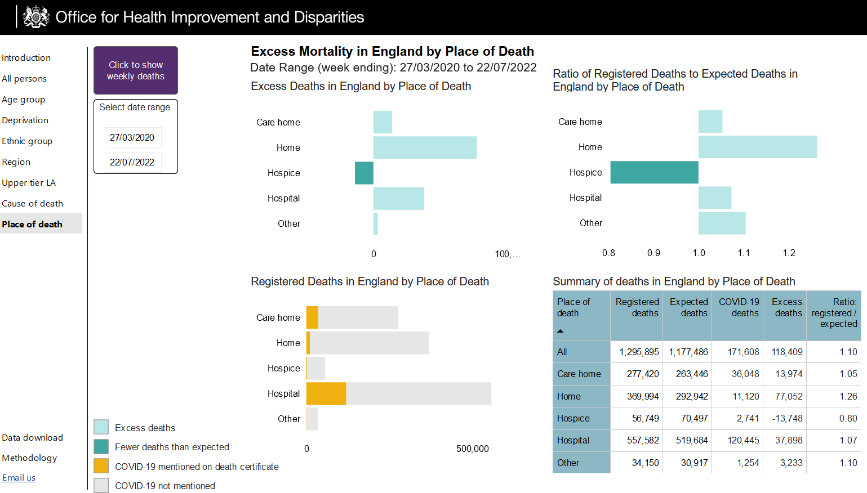
PLACE OF DEATH

Slide 33
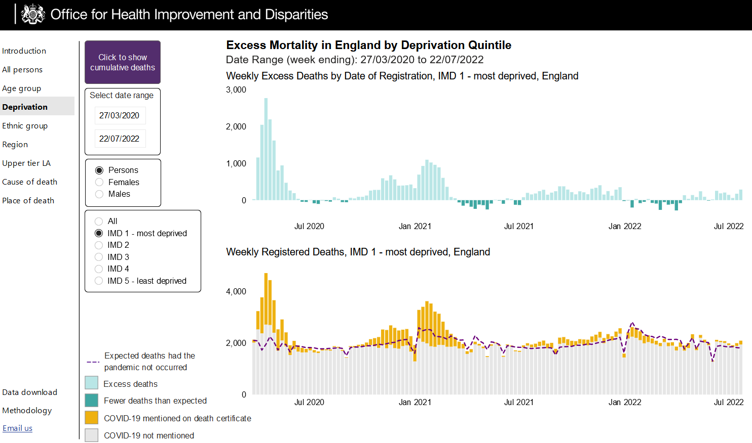
DEPRIVATION

Slide 34
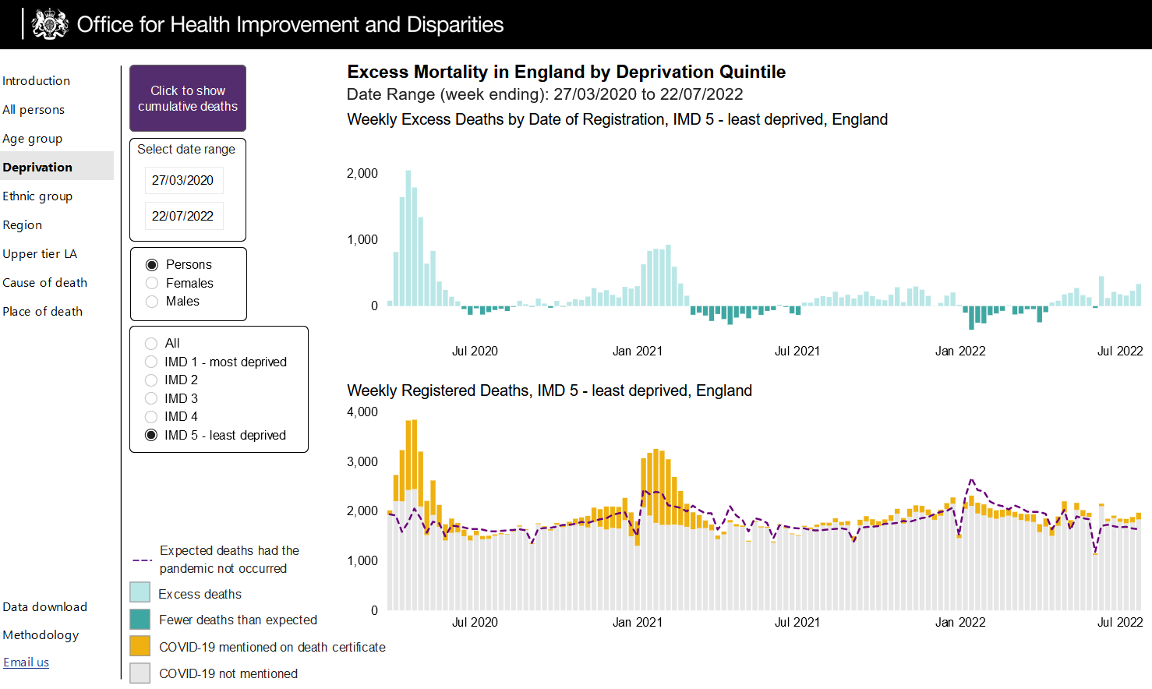
DEPRIVATION

Slide 35
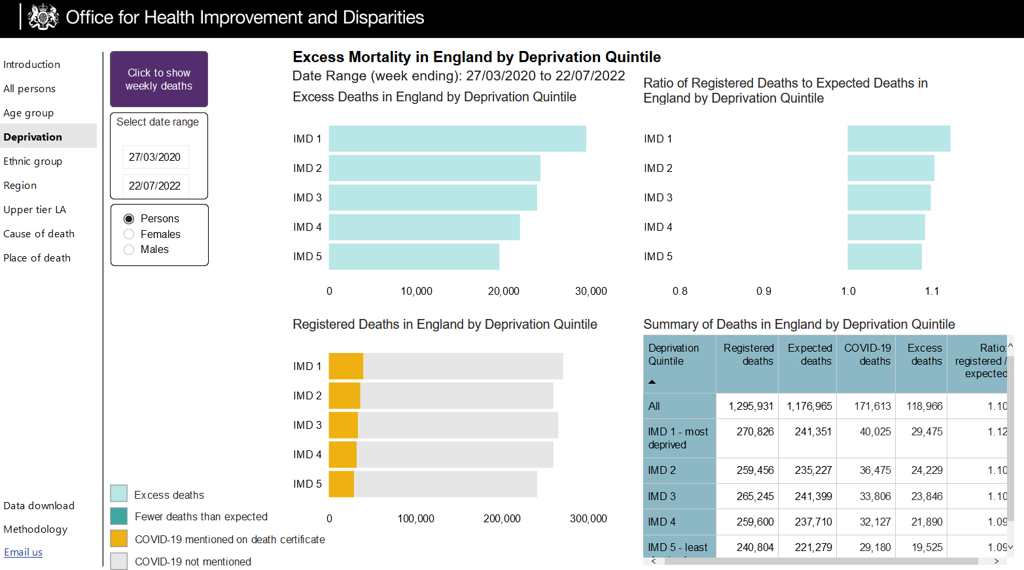
DEPRIVATION

Slide 36
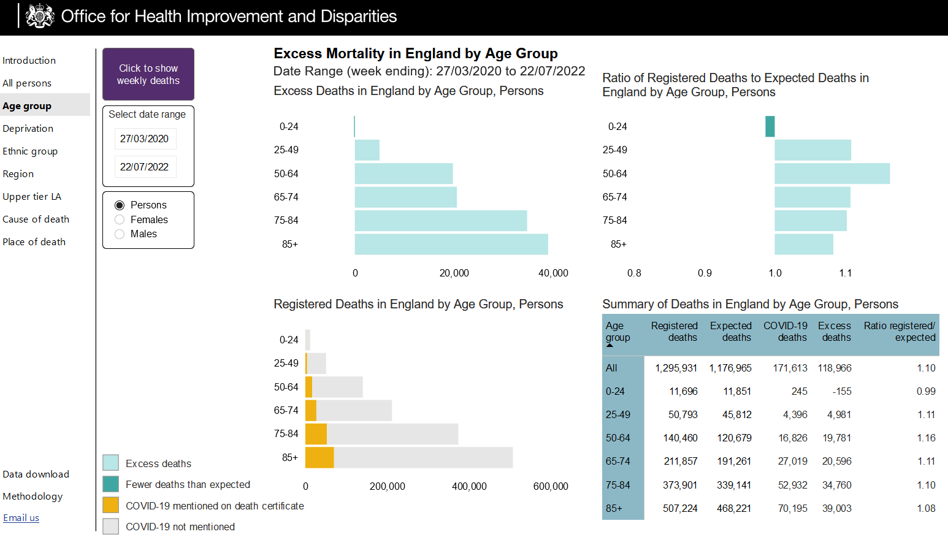
AGE GROUP

Slide 37
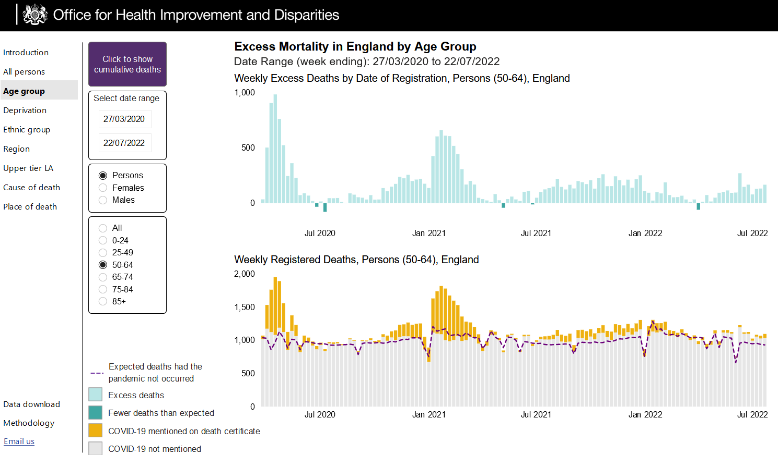
AGE GROUP

Slide 38
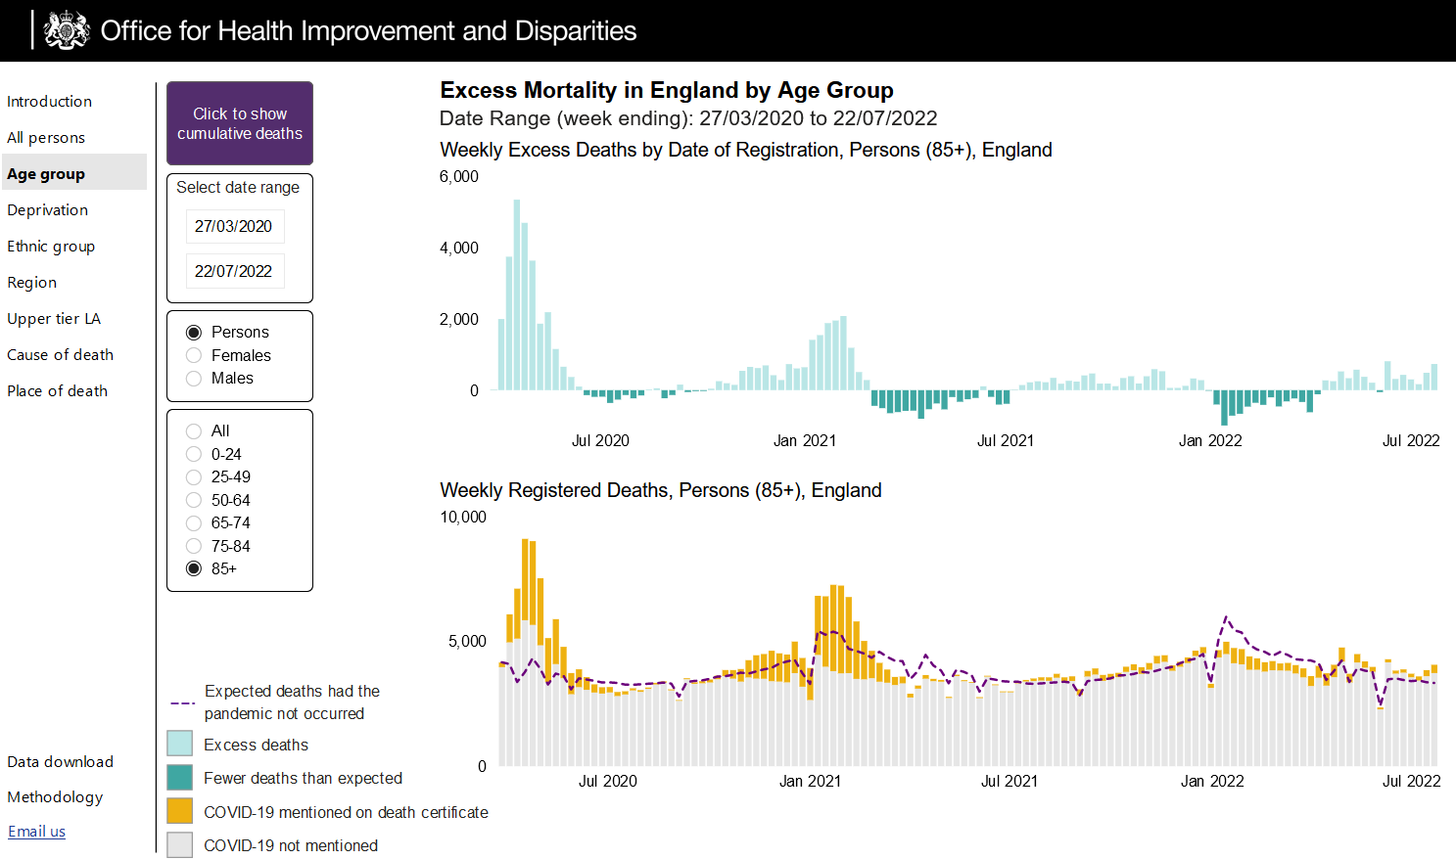
AGE GROUP

Slide 39
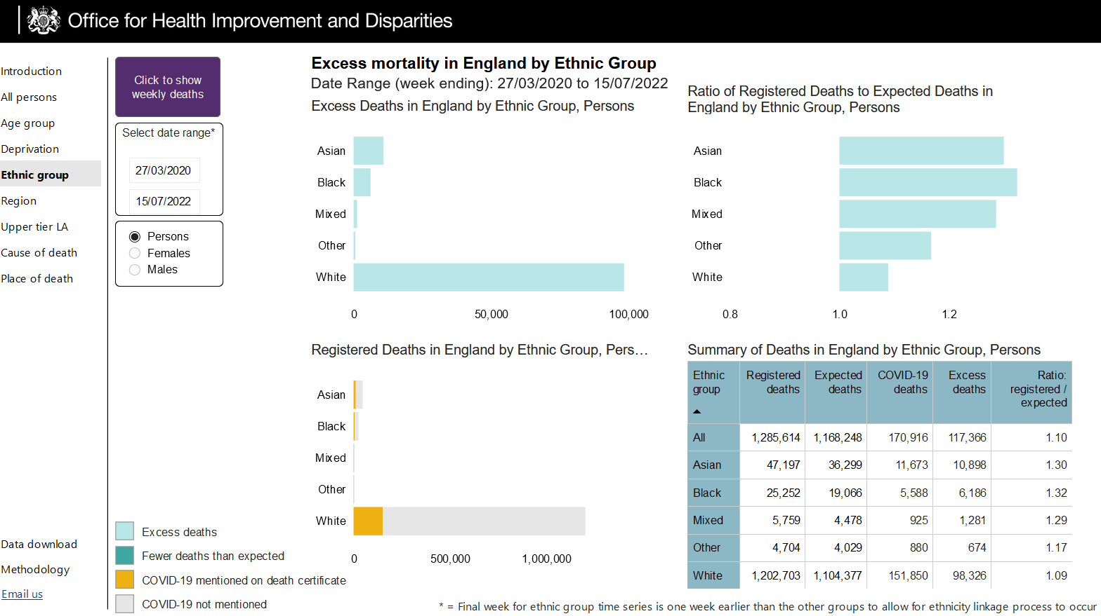
ETHNIC GROUP

Slide 40
Data Presentation 12 August 2022
Infections expected to be falling & Hospitalizations and people in hospital falling (ONS data delayed)
Vaccination uptake in children low prior to return to school
Variants – BA5 wave peaked – no clear sign of next wave
Excess Deaths commentary
Thanks to Bob Hawkins for his assistance in preparing the presentation

