Slide 1
Data Presentation 18 November 2022
Infections (from ONS survey) falling
Hospital admissions levelling off
BQ.1/BQ.1.1 over 50% of sequences
Low take-up of Autumn 2022 booster in younger eligible age groups
Other respiratory infections
With thanks to Bob Hawkins for assistance in preparing the charts

Slide 2
INFECTIONS

Slide 3
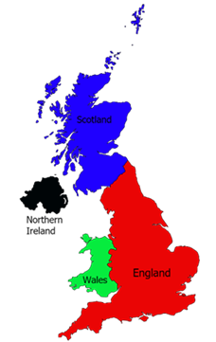
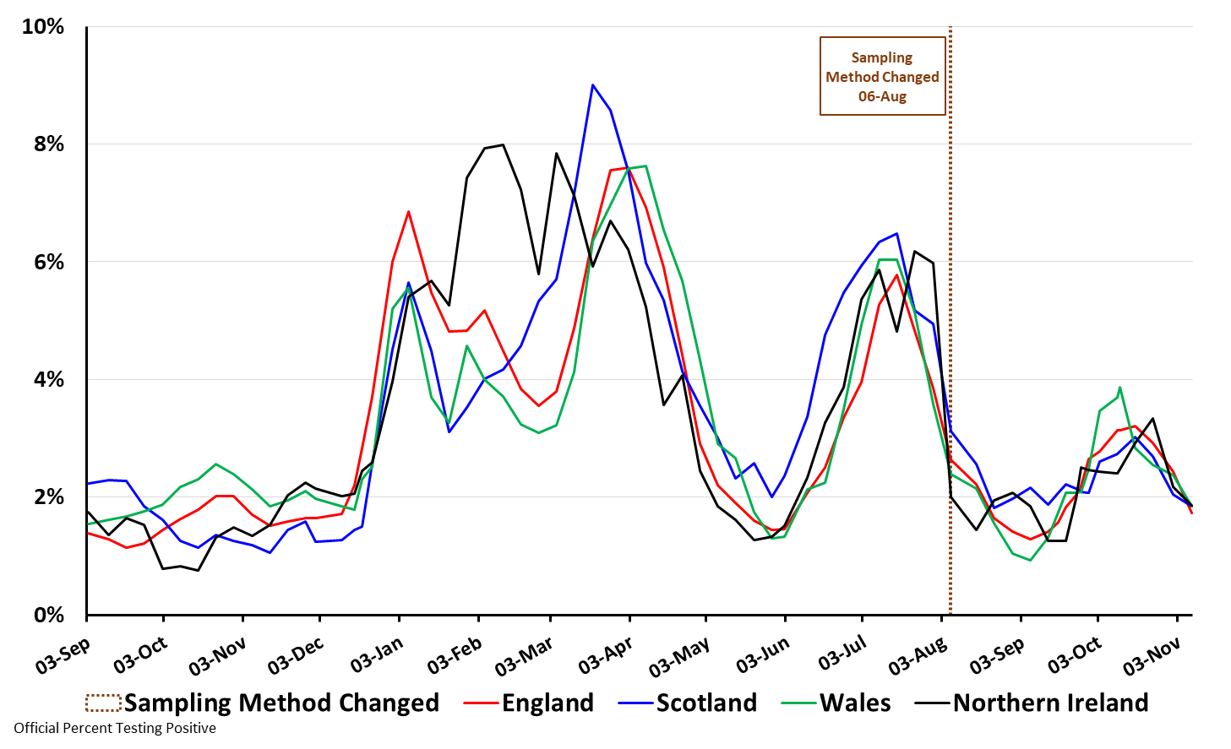
Percent Testing Positive by Nation: 3 Sep 2021 to 8 Nov 2022
(Source: ONS Coronavirus (COVID-19) Infection Survey results)
England | 1 in 60
Wales | 1 in 55
Northern Ireland | 1 in 55
Scotland | 1 in 55
Thanks to Bob Hawkins for the chart

Slide 4
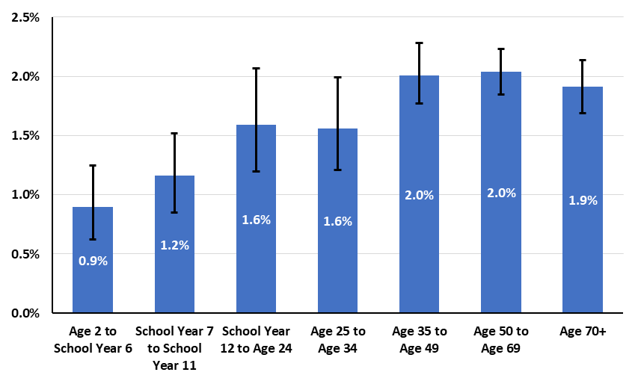
Percent Testing Positive by Age for England: 5 Nov 2022
(Source: ONS Coronavirus (COVID-19) Infection Survey results)
Thanks to Bob Hawkins for the chart

Slide 5
HOSPITALS

Slide 6
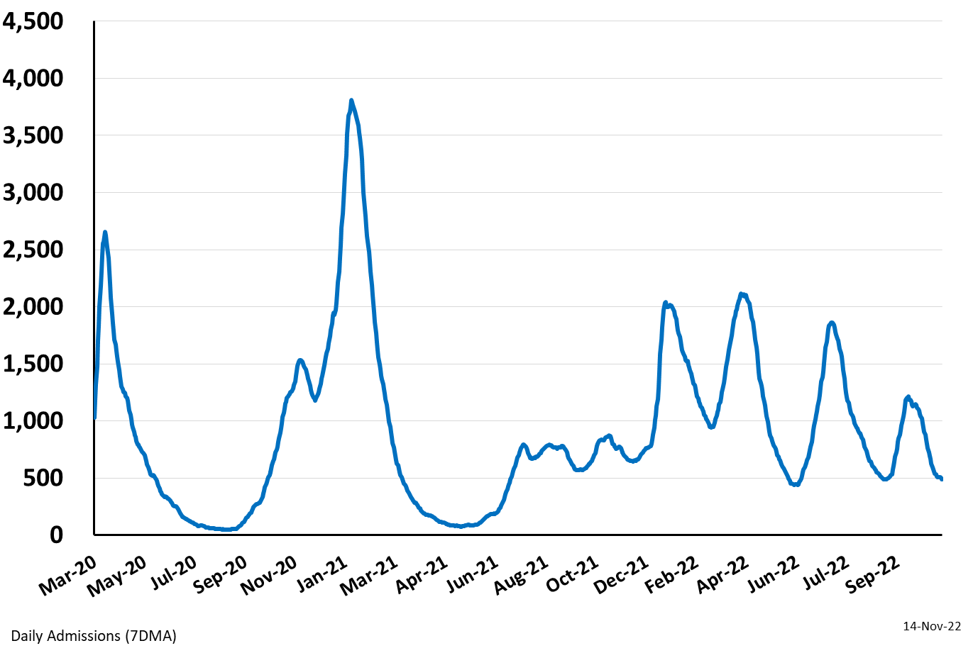
Daily Hospital Admissions for England: Mar 26 2020 – 14 Nov 2022
(Source: Covid Daily Update)

Slide 7
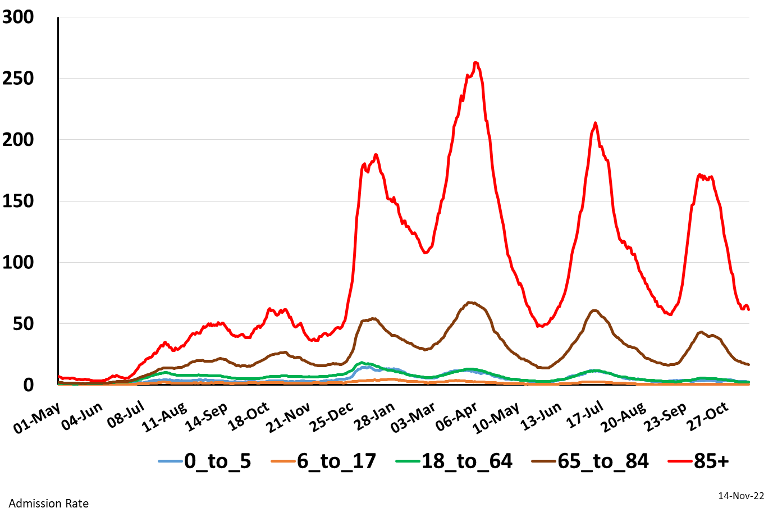
Seven Day Hospital Admissions Rate per 100K by Age
in England: May 1 2021 – 14 Nov 2022
(Source: Covid Daily Update)

Slide 8
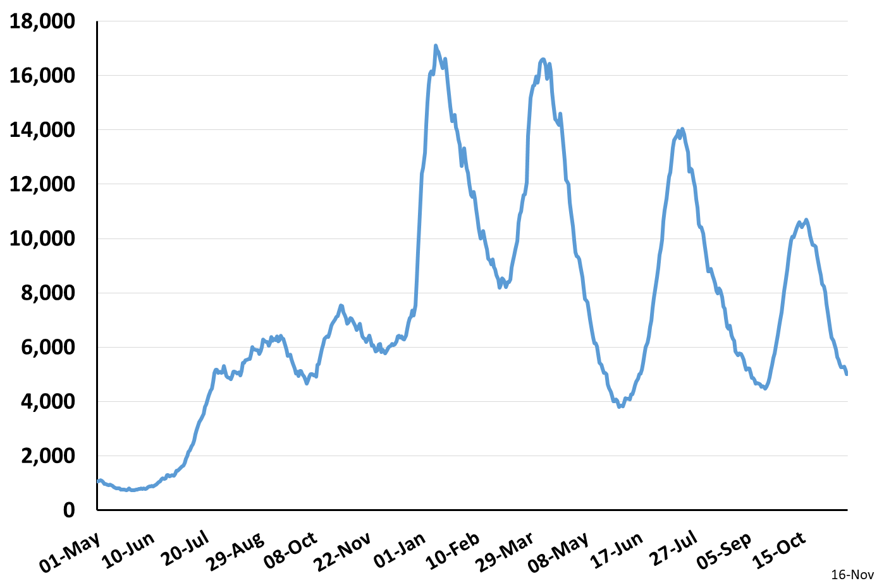
Daily Occupied Beds for England: May 1 2021 – Nov 16, 2022
(Source: Covid Daily Update)

Slide 9
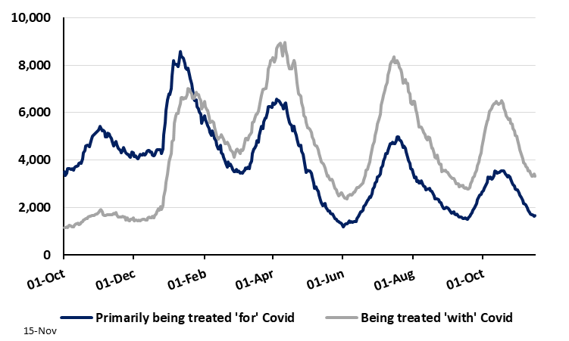
Daily Occupied Beds by Primarily and Incidental Covid
for England: Oct 1 2021 – Nov 15 2022
(Source: NHS COVID-19 Hospital Activity)
https://www.england.nhs.uk/statistics/statistical-work-areas/covid-19-hospital-activity/

Slide 10
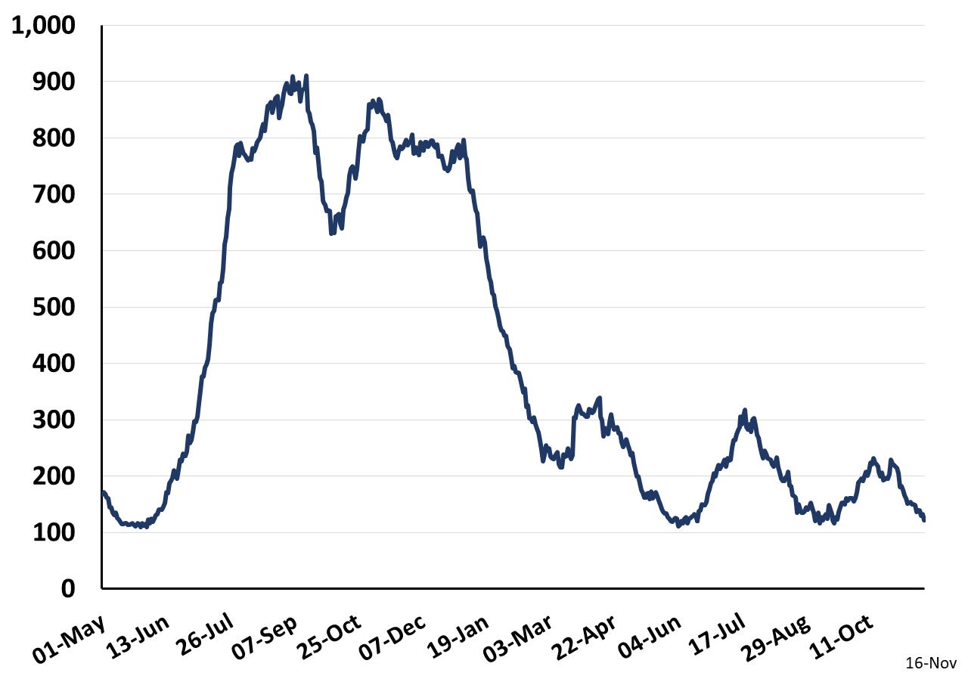
Daily Occupied Mechanically Ventilated Beds for England
May 1 2021 – Nov 16, 2022
(Source: Covid Daily Update)

Slide 11
DEATHS

Slide 12
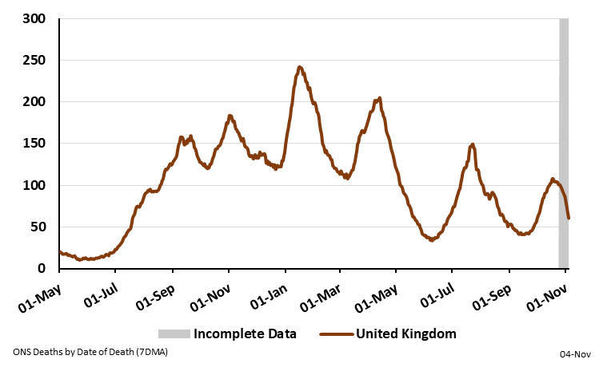
Daily deaths with COVID-19 on the death certificate by Date of Death
for the United Kingdom: 1 May 2021 – 4 Nov 2022
(Source: UK Covid Dashboard)
https://coronavirus.data.gov.uk/details/download

Slide 13
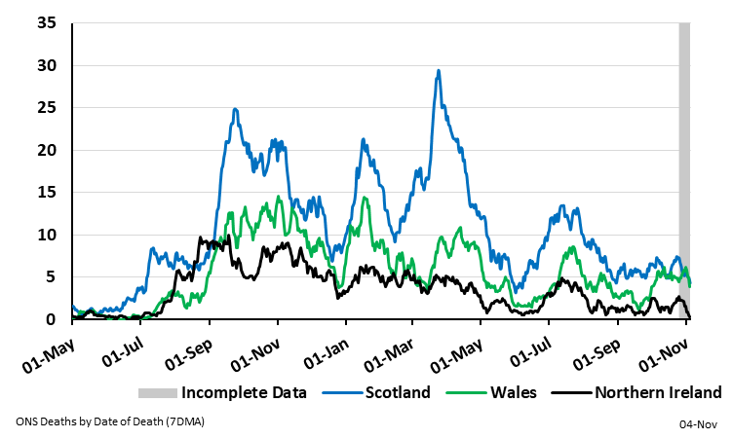
Daily deaths with COVID-19 on the death certificate by Date of Death
for Scotland, Wales and Northern Ireland: 1 May 2021 – 4 Nov 2022
(Source: UK Covid Dashboard)
https://coronavirus.data.gov.uk/details/download

Slide 14
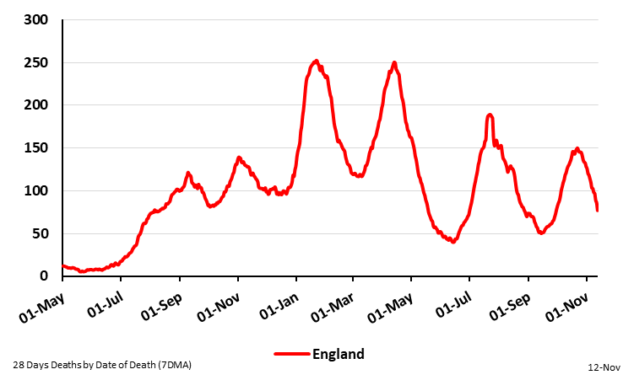
Daily Deaths Within 28 Days of Positive Test by Date of Death
For England: 1 May 2021 – 12 Nov 2022
(Source: UK Covid Dashboard)
https://coronavirus.data.gov.uk/details/download

Slide 15
NON-COVID SURVEILLANCE

Slide 16
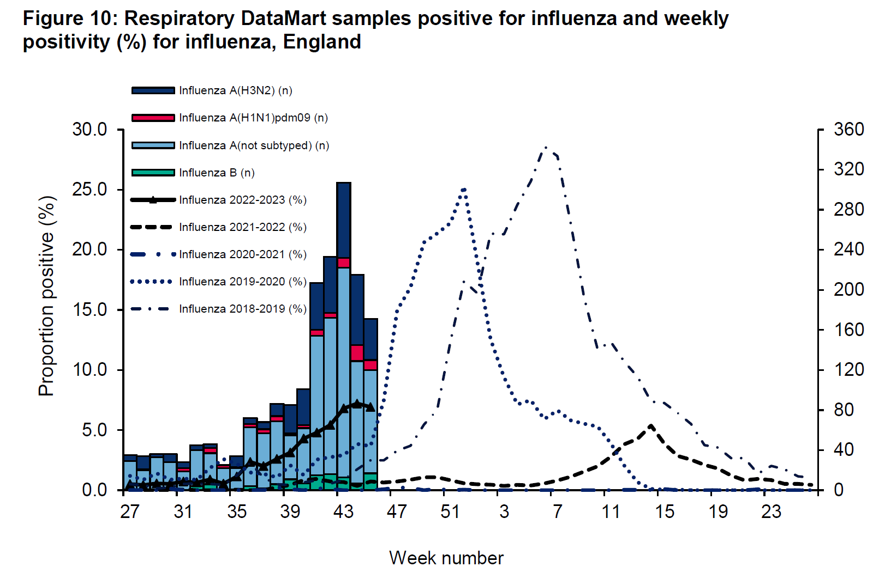
Source: UKHSA Influenza and Covid Report Week 46

Slide 17
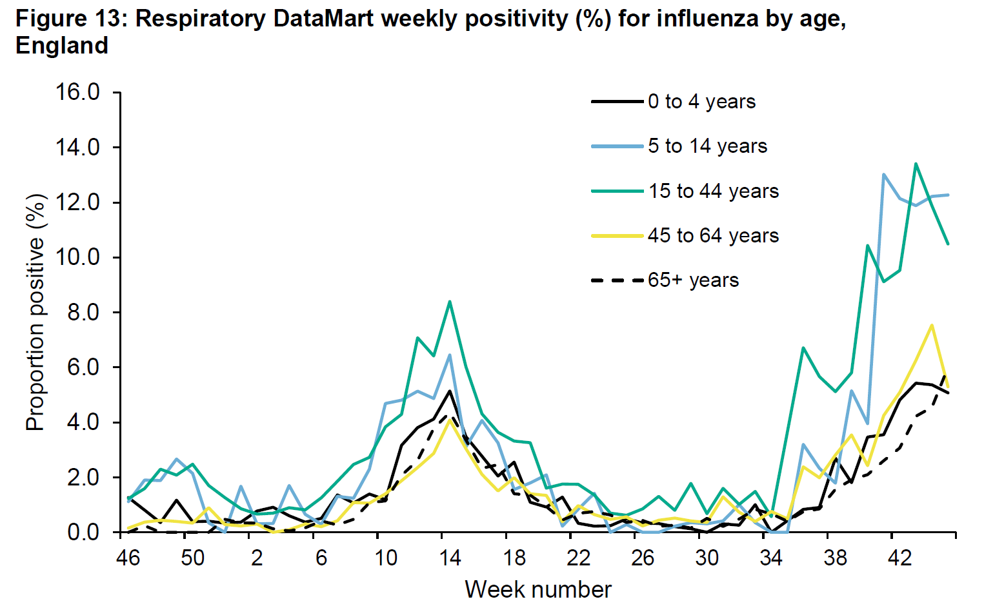
Source: UKHSA Influenza and Covid Report Week 46

Slide 18
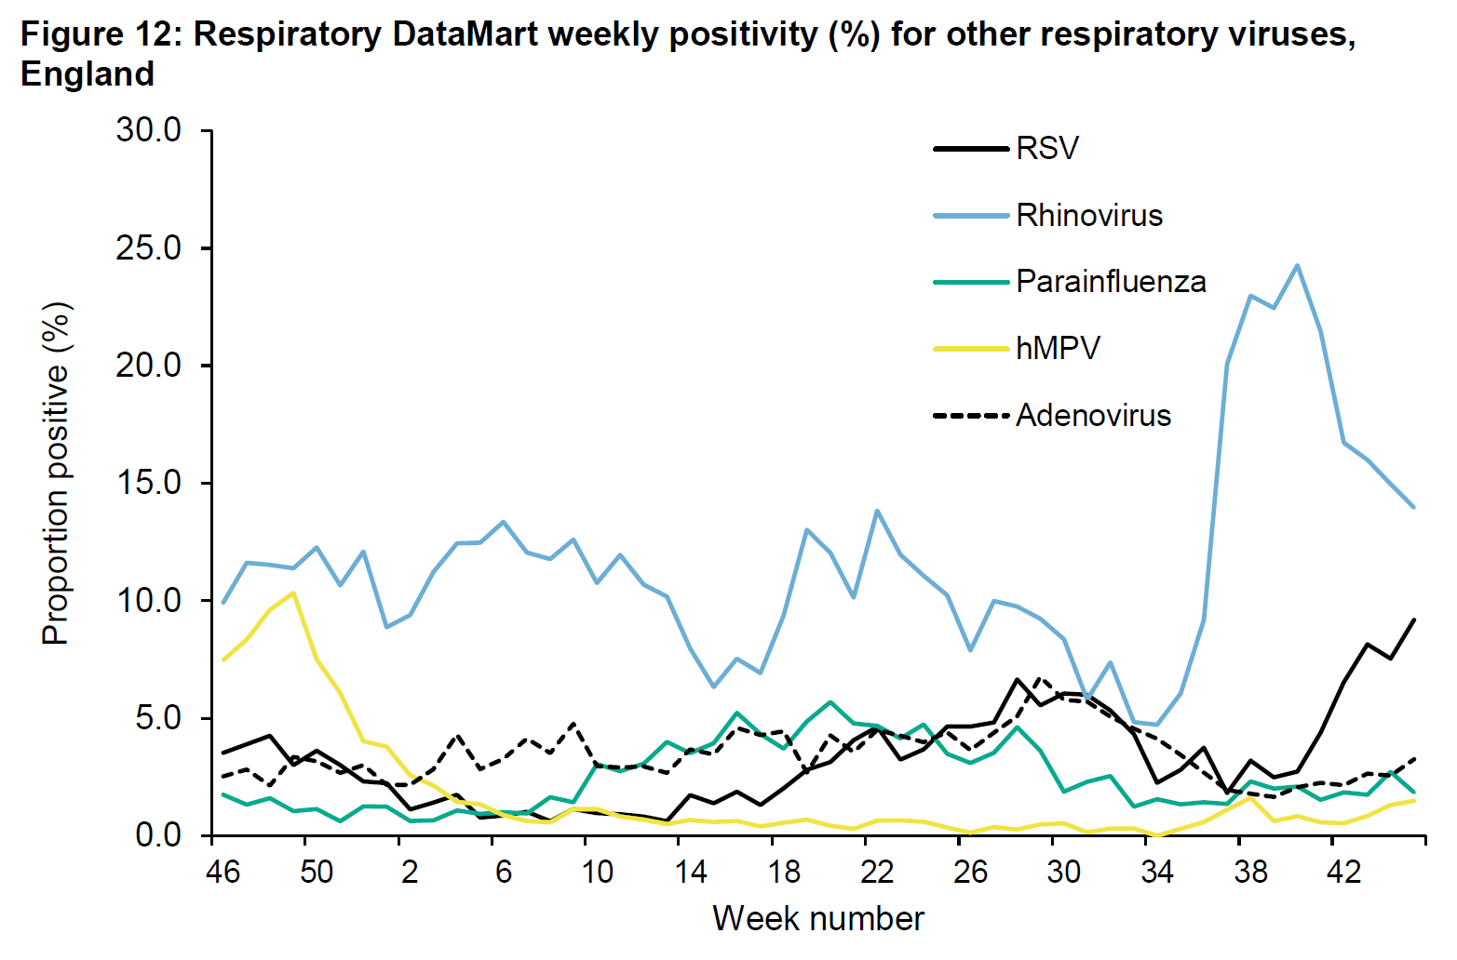
Source: UKHSA Influenza and Covid Report Week 46

Slide 19
VACCINATION

Slide 20
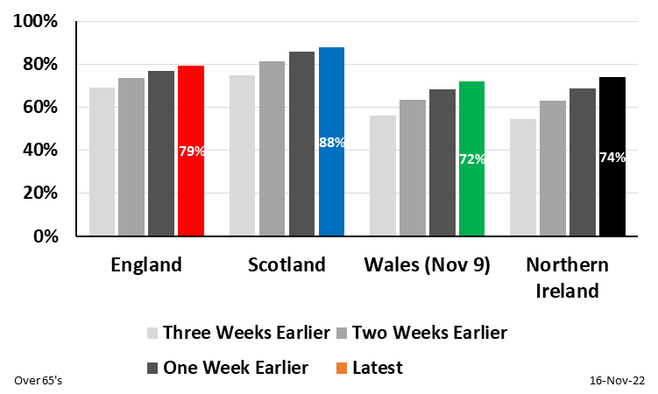
Autumn 2022 Booster Coverage for Over 65’s by Nation
Nov 16, 2022
(Source: Covid Daily Update, Scotland Vaccination Dashboard, Wales Vaccination Data, NI Vaccination Dashboard and Mid-2020 ONS Population Estimates)
Latest available data for Wales lags by one week

Slide 21
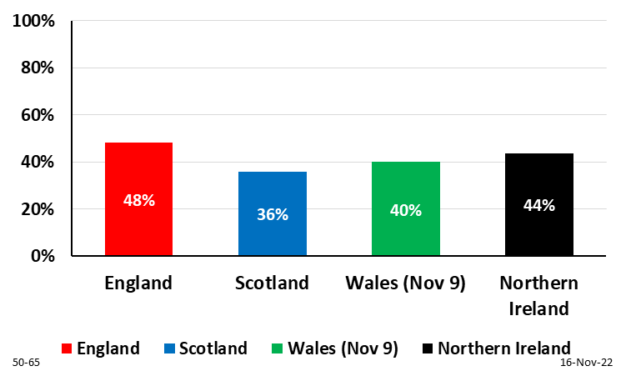
Autumn 2022 Booster Coverage for 50-64 Year Olds by Nation
Nov 16, 2022
(Source: Covid Daily Update, Scotland Vaccination Dashboard, Wales Vaccination Data, NI Vaccination Dashboard and Mid-2020 ONS Population Estimates)
Latest available data for Wales lags by one week

Slide 22
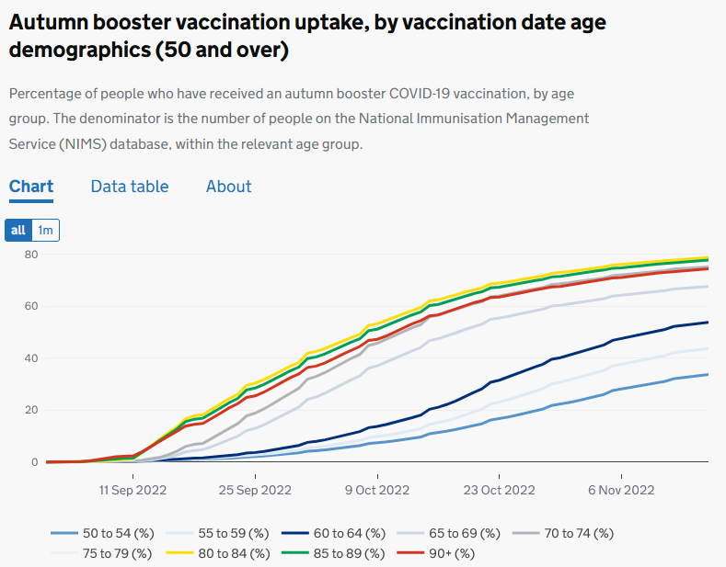
Source: UKHSA

Slide 23
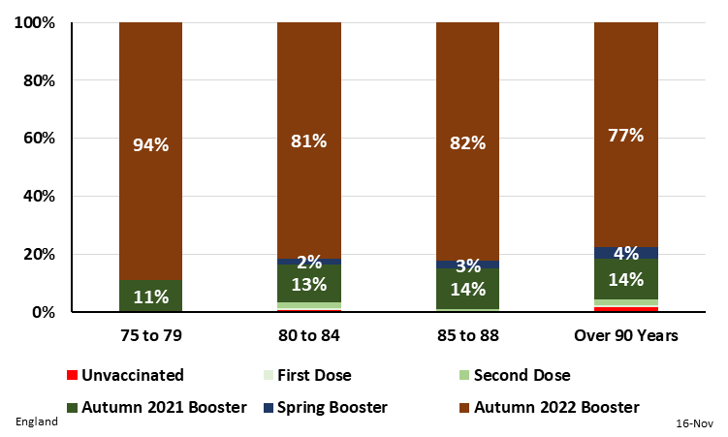
Vaccination Coverage for Over 75 Age Groups in England
Nov 16, 2022
(Source: NHS England Vaccination Daily Report and ONS 2020 Population Estimates)
https://www.england.nhs.uk/statistics/statistical-work-areas/covid-19-vaccinations/

Slide 24
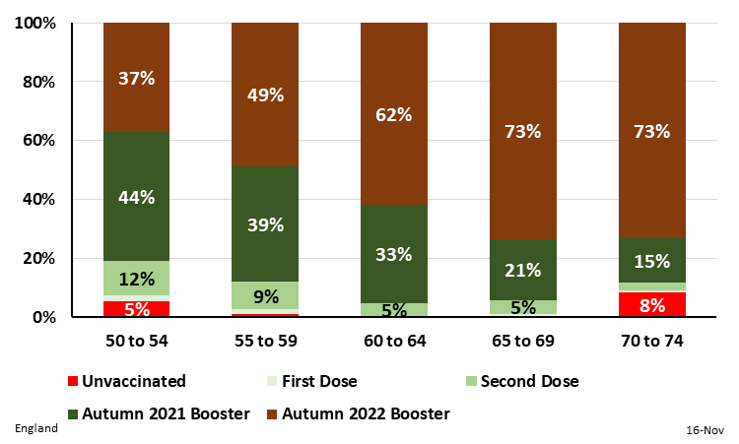
Vaccination Coverage for 50 to 74 Year Age Groups in England
Nov 16, 2022
(Source: NHS England Vaccination Daily Report and ONS 2020 Population Estimates)
https://www.england.nhs.uk/statistics/statistical-work-areas/covid-19-vaccinations/

Slide 25
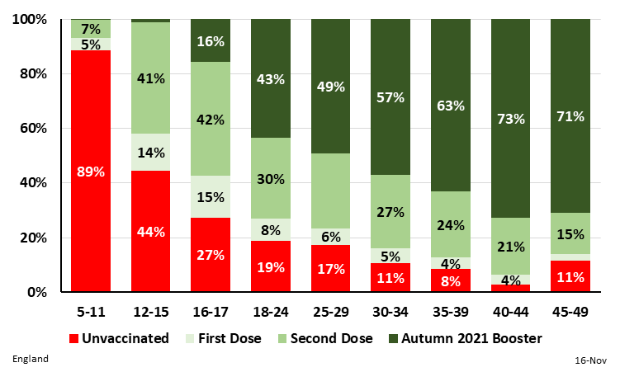
Vaccination Coverage for 5 to 49 Year Age Groups in England
Nov 16, 2022
(Source: NHS England Vaccination Daily Report and ONS 2020 Population Estimates)
https://www.england.nhs.uk/statistics/statistical-work-areas/covid-19-vaccinations/

Slide 26
VARIANTS

Slide 27
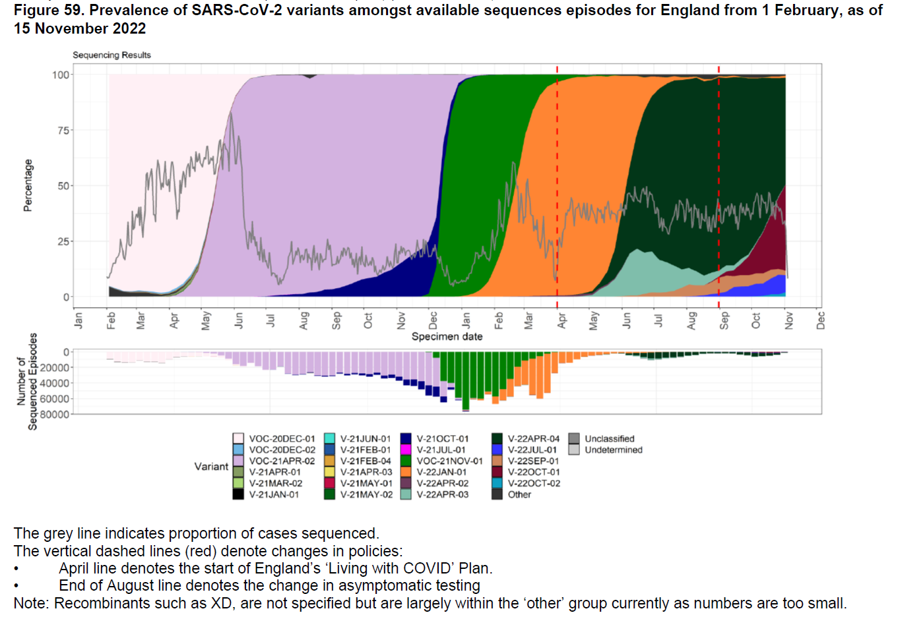
Source: UKHSA Influenza and Covid Report Week 46

Slide 28
Slide from Prof Christina Pagel

Slide 29
Data Presentation 18 November 2022
Infections (from ONS survey) falling
Hospital admissions levelling off
BQ.1/BQ.1.1 over 50% of sequences
Low take-up of Autumn 2022 booster in younger eligible age groups
Other respiratory infections
With thanks to Bob Hawkins for assistance in preparing the charts

