Slide 1
i_S
Indie_SAGE
Autumn session 2023
– 8th Sept
Looking forwards with lessons learnt

Slide 2
Data Presentation 8 September 2023
Hospital admissions low but starting to rise
BA.2.86 variant – still not classified as Variant of Concern but has been attributed to an outbreak in a care home
Autumn 2023 vaccination booster campaign about to launch (11/18 September in England – wait to be called if eligible)
UKHSA to increase surveillance over the winter period – more details to come
With thanks to Bob Hawkins for help in preparing the charts

Slide 3
CASES & TESTS

Slide 4
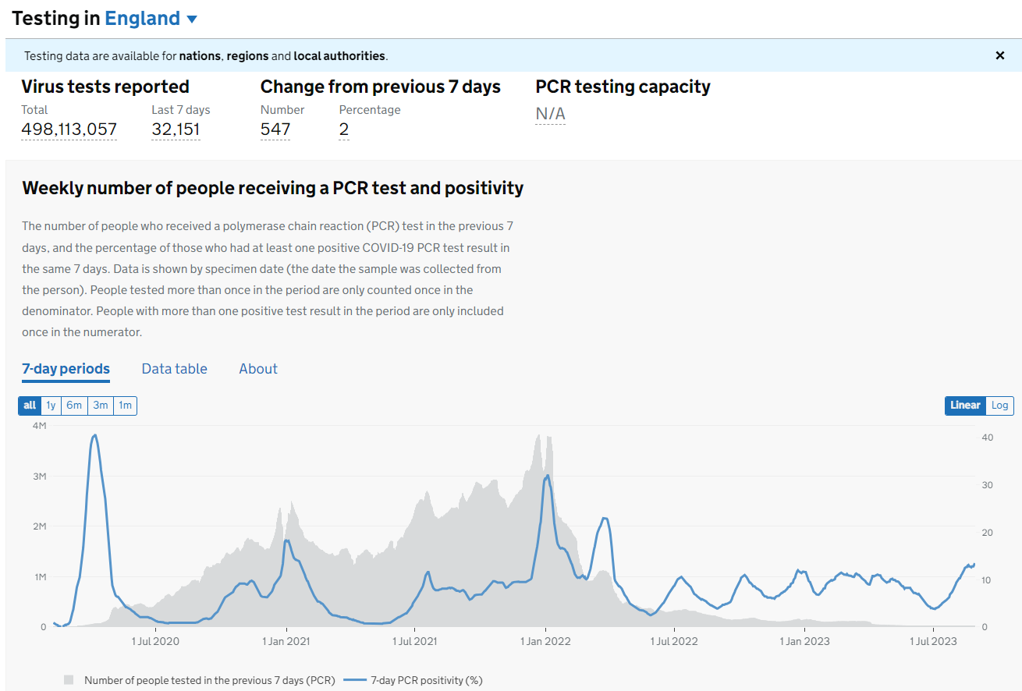
Source: Covid Dashboard

Slide 5
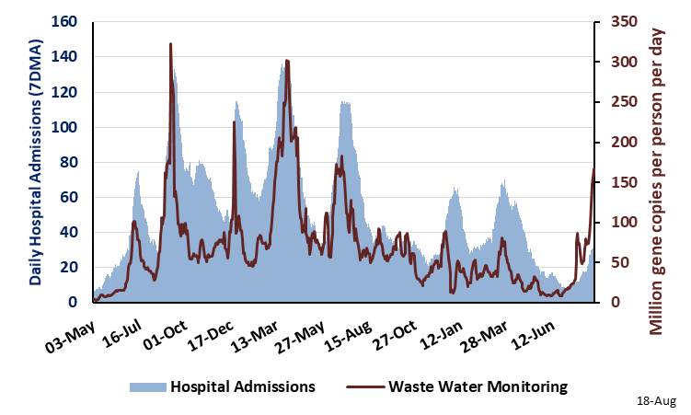
Daily Hospital Admissions and Weekly Waste Water Monitoring Trend Scotland: May 3, 2021 – Aug 18, 2023
(Source: COVID-19 & Respiratory Surveillance in Scotland Report)
https://scotland.shinyapps.io/phs-respiratory-covid-19/

Slide 6
HOSPITAL ADMISSIONS

Slide 7
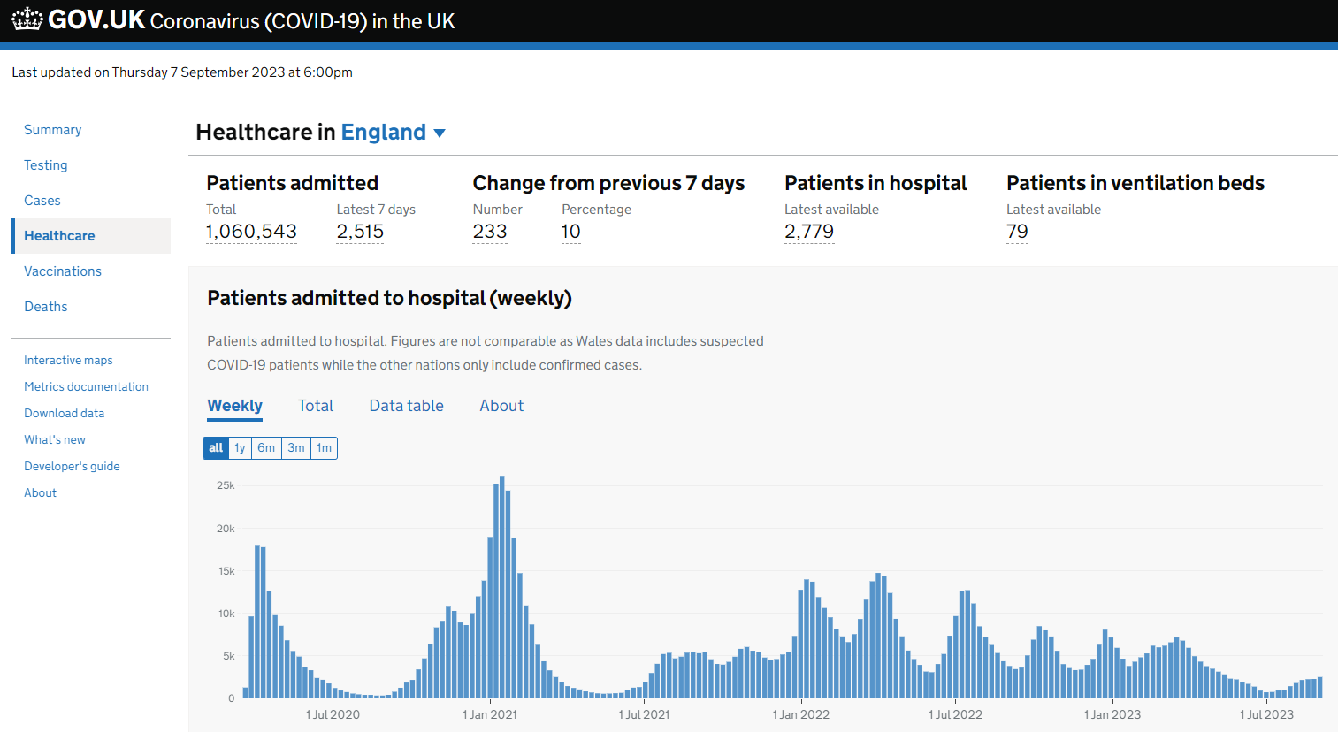
Source: Covid Dashboard

Slide 8
DIAGNOSTIC TEST WAITING LISTS

Slide 9
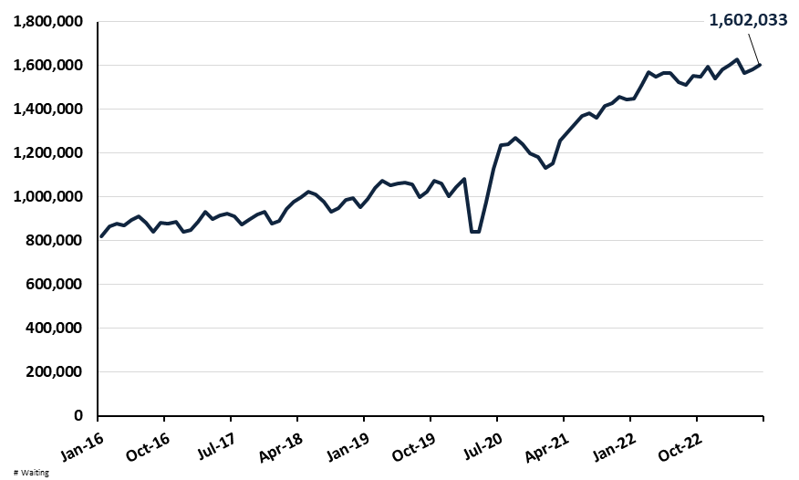
Number of Patients Waiting for Diagnostic Tests by Month
England (Jan 2016 to Jun 2023)
(Source: NHS Monthly Diagnostic Waiting Times and Activity Report)
https://www.england.nhs.uk/statistics/statistical-work-areas/diagnostics-waiting-times-and-activity/monthly-diagnostics-waiting-times-and-activity/monthly-diagnostics-data-2021-22/

Slide 10
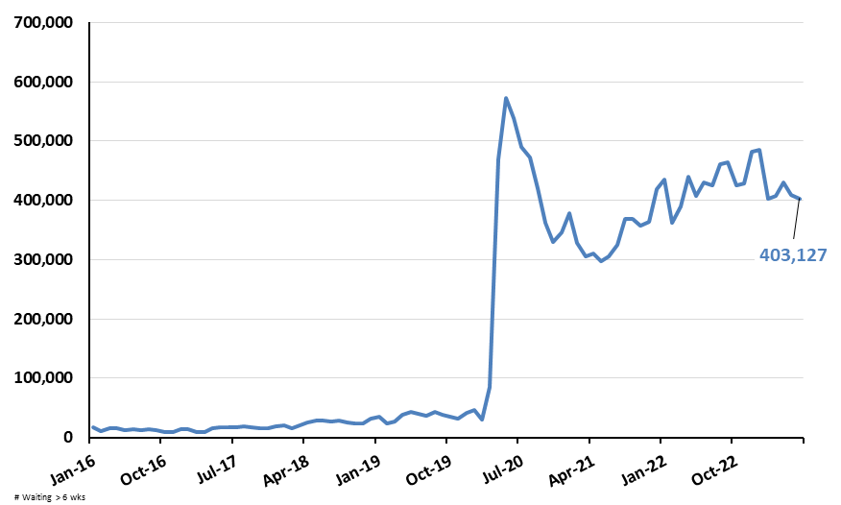
Number of Patients Waiting Longer than 6 Weeks for Diagnostic Tests by Month for England (Jan 2016 to Jun 2023)
(Source: NHS Monthly Diagnostic Waiting Times and Activity Report)
End of Jun 2023
Patients waiting: 403,127
Percent waiting: 25.2%
Target: 1%
https://www.england.nhs.uk/statistics/statistical-work-areas/diagnostics-waiting-times-and-activity/monthly-diagnostics-waiting-times-and-activity/monthly-diagnostics-data-2021-22/

Slide 11
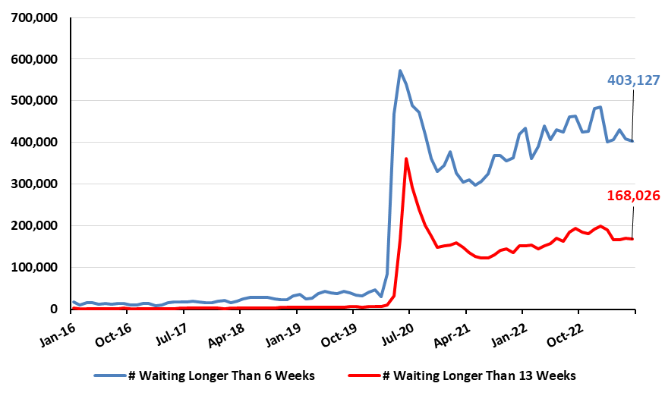
Number of Patients Waiting Longer than 6 and 13 Weeks for Diagnostic Tests by Month for England (Jan 2016 to Jun 2023)
(Source NHS Monthly Diagnostic Waiting Times and Activity Report)
https://www.england.nhs.uk/statistics/statistical-work-areas/diagnostics-waiting-times-and-activity/monthly-diagnostics-waiting-times-and-activity/monthly-diagnostics-data-2021-22/

Slide 12
HOSPITAL KPIs

Slide 13
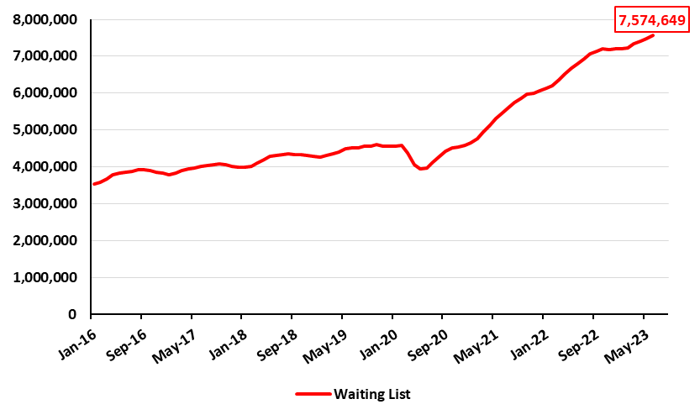
Number of Patients Waiting for Treatment in England (Jan 2016 to Jun 2023)
(Source: NHS Monthly A&E Attendances and Emergency Admissions)
One in Eight People were Waiting to Start Treatment in Jun 2023 in England
https://www.england.nhs.uk/statistics/statistical-work-areas/rtt-waiting-times/rtt-data-2021-22/

Slide 14
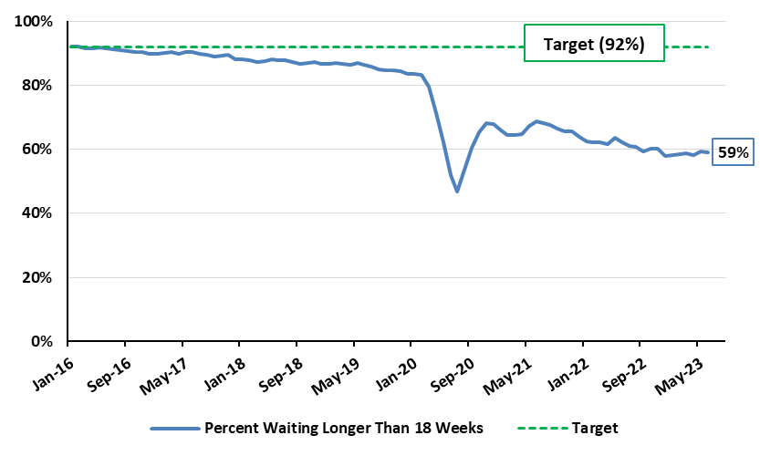
Percent of Patients Starting Non-Emergency Consultant Treatment within 18 Weeks of Referral by Month for England (Jan 2016 to Jun 2023)
(Source: NHS Monthly A&E Attendances and Emergency Admissions)
3,091,288 Patients (41%) waited longer than 18 Weeks to Start Treatment in Jun 2023
https://www.england.nhs.uk/statistics/statistical-work-areas/rtt-waiting-times/rtt-data-2021-22/

Slide 15
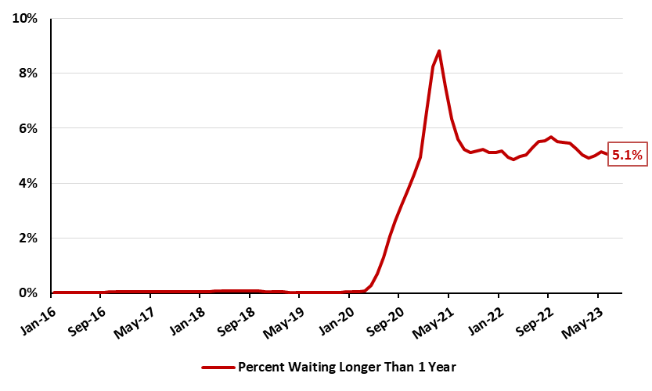
Percent of Patients Waiting Longer than One Year to Start Non-Emergency Consultant Treatment by Month for England (Jan 2016 to Jun 2023)
(Source: NHS Monthly A&E Attendances and Emergency Admissions)
383,083 Patients (5.1%) waited longer than One Year to Start Treatment in Jun 2023
https://www.england.nhs.uk/statistics/statistical-work-areas/rtt-waiting-times/rtt-data-2021-22/

Slide 16
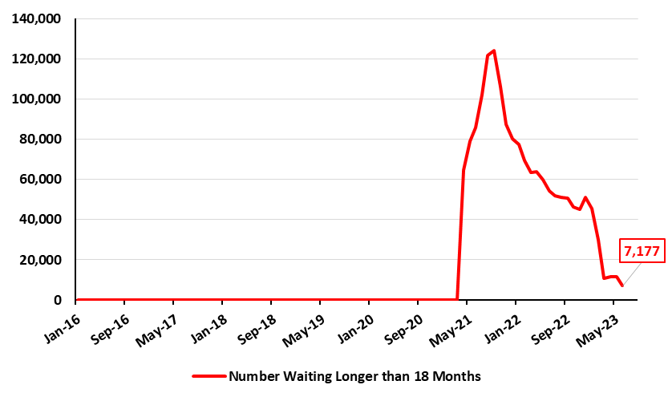
Number of Patients Waiting Longer than 18 Months to Start Non-Emergency Consultant Treatment by Month for England (Jan 2016 to Jun 2023)
(Source: NHS Monthly A&E Attendances and Emergency Admissions)
Target was that no one would be waiting longer than 18 months to start treatment by March 2023 in England
https://www.england.nhs.uk/statistics/statistical-work-areas/rtt-waiting-times/rtt-data-2021-22/

Slide 17
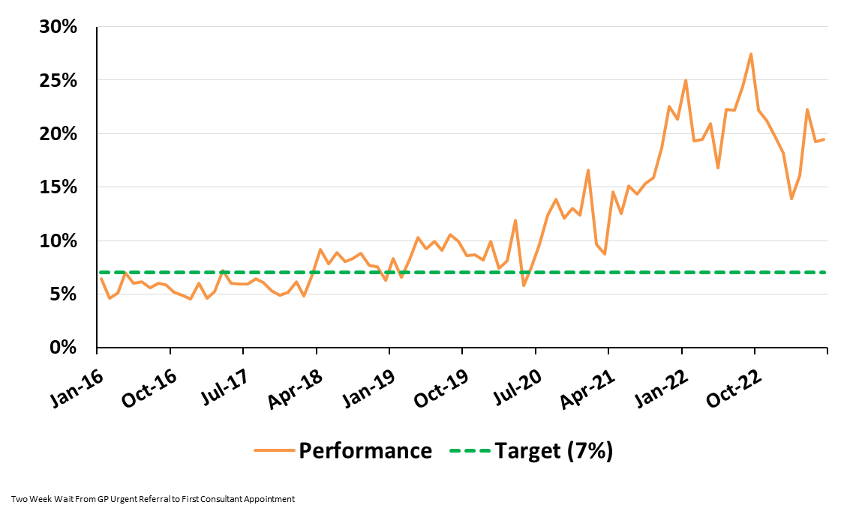
Percent of Cancer Patients Waiting Longer than Two Weeks to see a Consultant following an Urgent GP Referral by Month: England (Jan 2016 to Jun 2023)
(Source: NHS Monthly Cancer Waiting Times Report)
https://www.england.nhs.uk/statistics/statistical-work-areas/cancer-waiting-times/

Slide 18
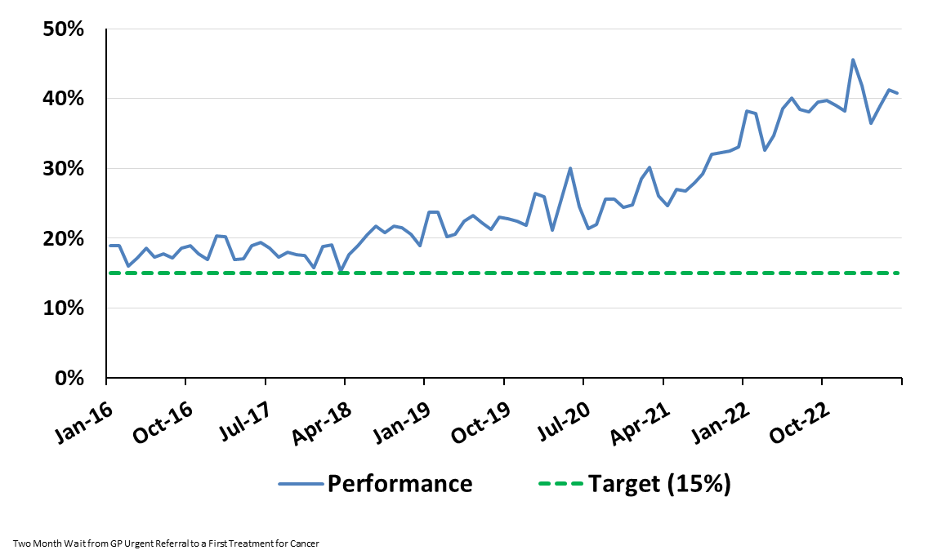
Percent of Cancer Patients Waiting Longer than Two Months to Start Treatment following an Urgent GP Referral by Month: England (Jan 2016 to Jun 2023)
(Source: NHS Monthly Cancer Waiting Times Report)
https://www.england.nhs.uk/statistics/statistical-work-areas/cancer-waiting-times/

Slide 19
NHS VACANCIES

Slide 20
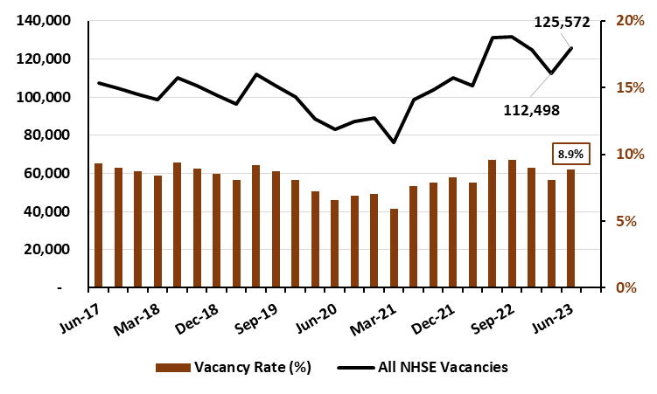
Number of NHS Vacancies and Vacancy Rate by Quarter
England: Jun 2017 to Jun 2023
(Source: NHS Digital Vacancy Statistics)
Note that these data do not indicate how much of the reported substantive gap is filled by temporary staff
https://digital.nhs.uk/data-and-information/publications/statistical/nhs-vacancies-survey

Slide 21
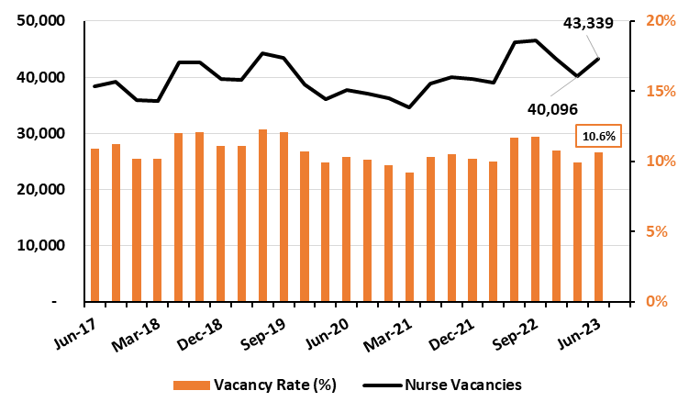
Number of Nurse Vacancies and Vacancy Rate by Quarter
England: Jun 2017 to Jun 2023
(Source: NHS Digital Vacancy Statistics)
Note that these data do not indicate how much of the reported substantive gap is filled by temporary staff
https://digital.nhs.uk/data-and-information/publications/statistical/nhs-vacancies-survey

Slide 22
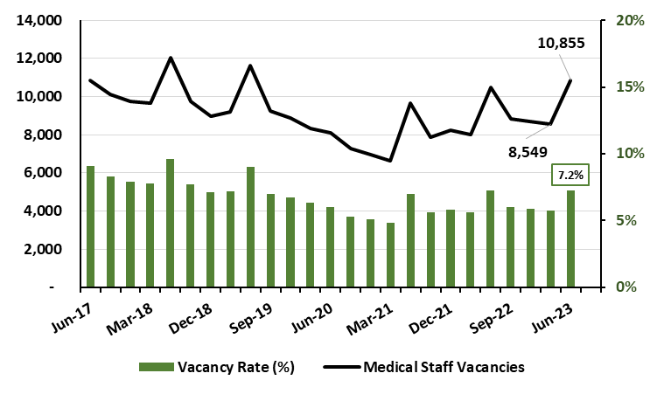
Number of Medical Staff Vacancies and Vacancy Rate by Quarter
England: Jun 2017 to Jun 2023
(Source: NHS Digital Vacancy Statistics)
Note that these data do not indicate how much of the reported substantive gap is filled by temporary staff
https://digital.nhs.uk/data-and-information/publications/statistical/nhs-vacancies-survey

Slide 23
VACCINATION RECENCY

Slide 24
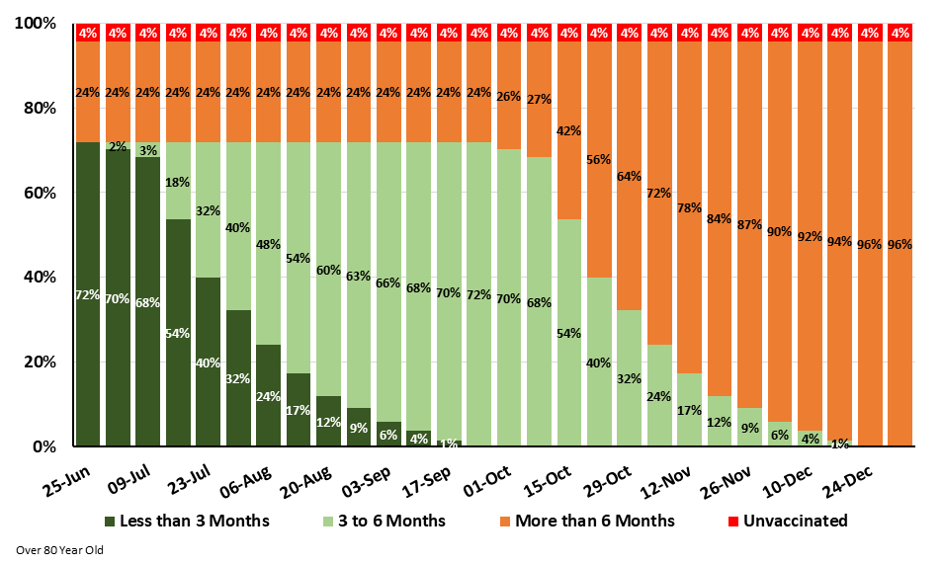
Percent of Over 80’s Vaccinated in the Last 3 Months, 3 to 6 Months,
More than 6 Months, and Unvaccinated in England
Forecast for Jun 25 – Dec 31, 2023 BEFORE AUTUMN BOOSTER CAMPAIGN
(Source: National Influenza and COVID-19 Surveillance Data Report based on NIMS Population Estimates)
https://www.gov.uk/government/statistics/national-flu-and-covid-19-surveillance-reports-2022-to-2023-season

Slide 25
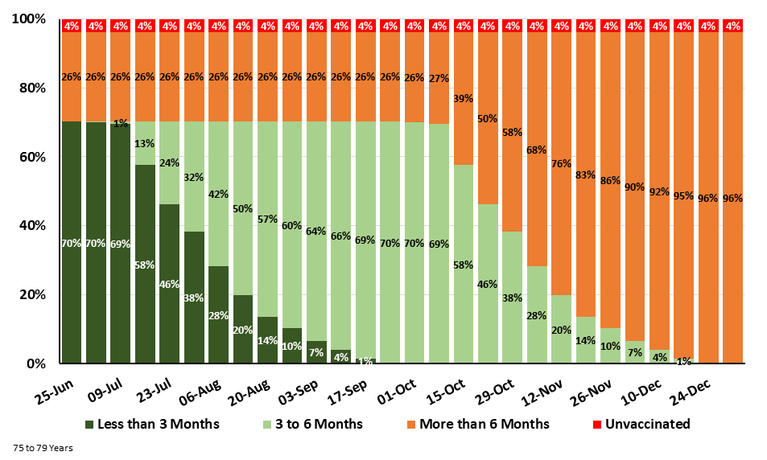
Percent of 75 – 79 Year Olds Vaccinated in the Last 3 Months, 3 to 6 Months,
More than 6 Months, and Unvaccinated in England
Forecast for Jun 25 – Dec 31, 2023 BEFORE AUTUMN 2023 BOOSTER CAMPAIGN
(Source: National Influenza and COVID-19 Surveillance Data Report based on NIMS Population Estimates)
https://www.gov.uk/government/statistics/national-flu-and-covid-19-surveillance-reports-2022-to-2023-season

Slide 26
BA.2.86

Slide 27
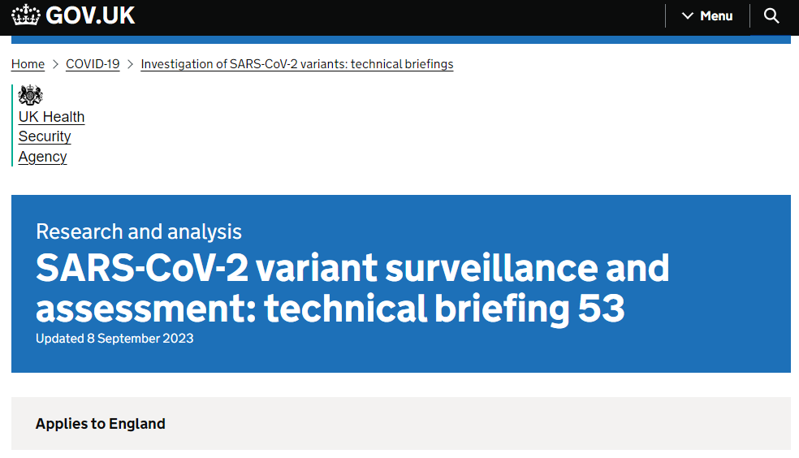
“There is an insufficient number of cases to make an assessment of outcome or severity. In the UK, the current surveillance systems do not support an assessment of comparative severity between variants but trends in severity and outcomes can be monitored over time through hospital data. It is likely that any such signal will take weeks to be visible and confirmed through sequencing.”

Slide 28
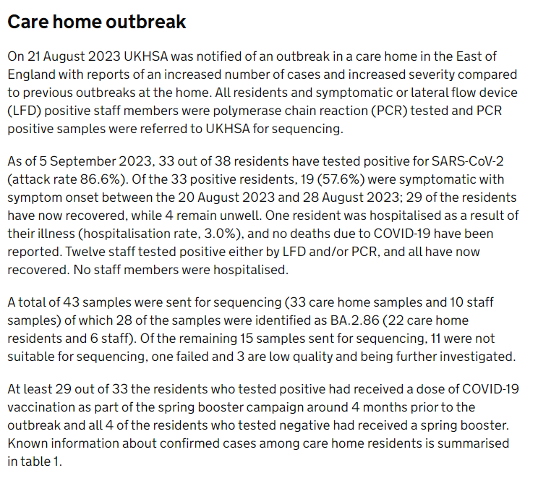
https://www.gov.uk/government/publications/investigation-of-sars-cov-2-variants-technical-briefings/sars-cov-2-variant-surveillance-and-assessment-technical-briefing-53

Slide 29
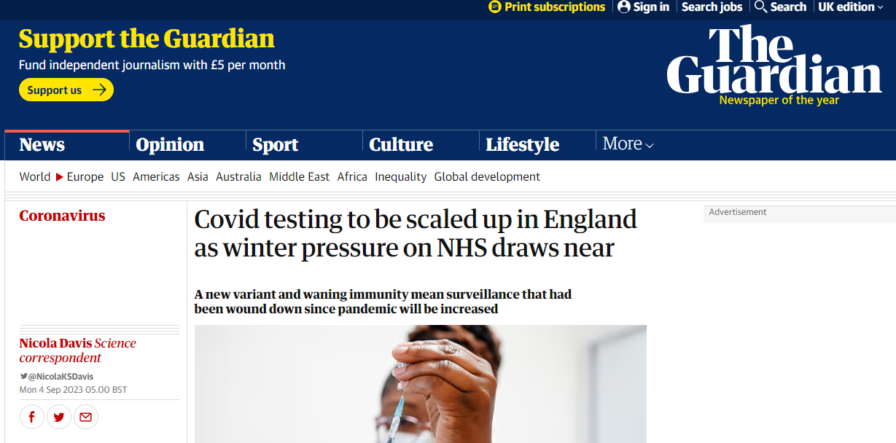
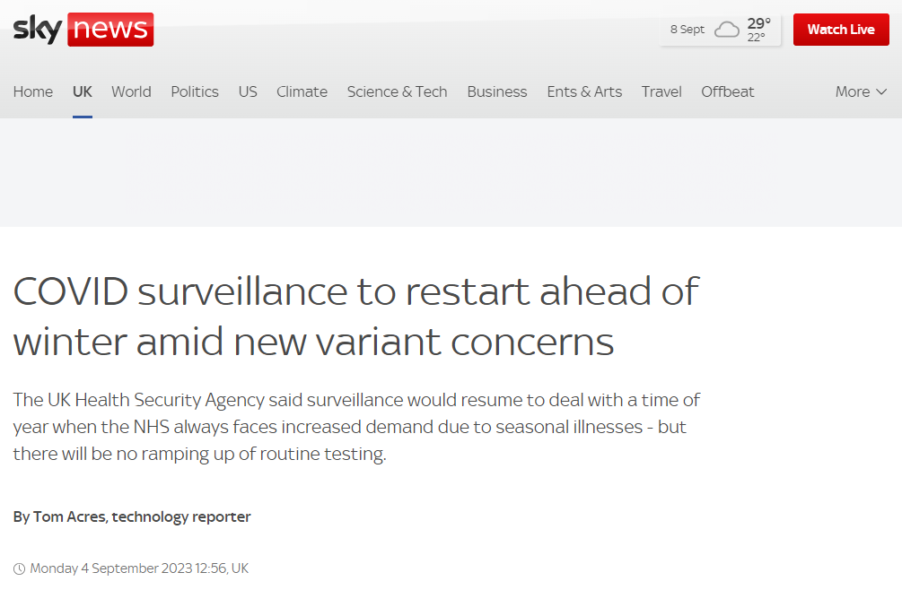

Slide 30
Data Presentation 8 September 2023
Hospital admissions low but starting to rise
BA.2.86 variant – still not classified as Variant of Concern but has been attributed to an outbreak in a care home
Autumn 2023 vaccination booster campaign about to launch (11/18 September in England – wait to be called if eligible)
UKHSA to increase surveillance over the winter period – more details to come
With thanks to Bob Hawkins for help in preparing the charts

