Slide 1
i_S
Indie_SAGE
Autumn session 2023
– 8th Sept
Looking forwards with lessons learnt

Slide 2
https://www.independentsage.org
Going Airborne
What have we learnt about airborne transmission of SARS-CoV-2 and the implications for preventing transmission?
----
Trish Greenhalgh, Helen Salisbury, Binita Kane
8th September 2023

Slide 3
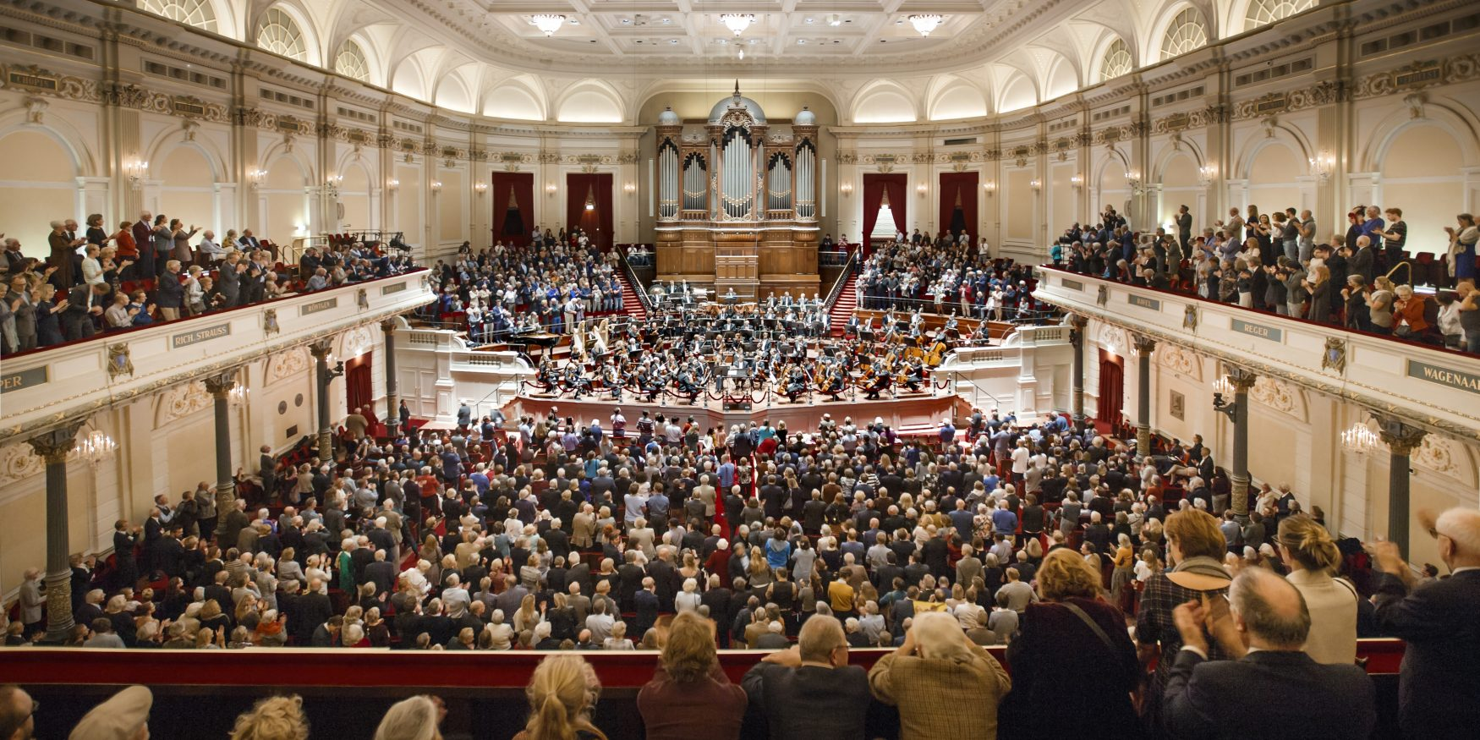
● 8th March 2020 ● Amsterdam Concertgebouw ● Bach’s St John Passion ● 102/130 infected ● 4 dead

Slide 4
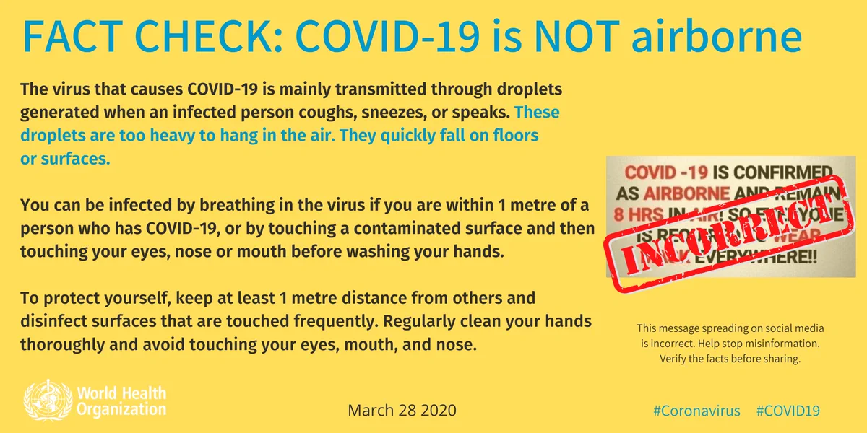
● 28th March 2020 ● WHO’s “fake news” Tweet
● 23rd November 2022 ● WHO chief scientist Dr Soumya Swaminathan “Biggest regret?”
“We were not forcefully saying: ‘This is an airborne virus.’ I regret that we didn't do this much, much earlier.”
Science Insider 23.11.22

Slide 5
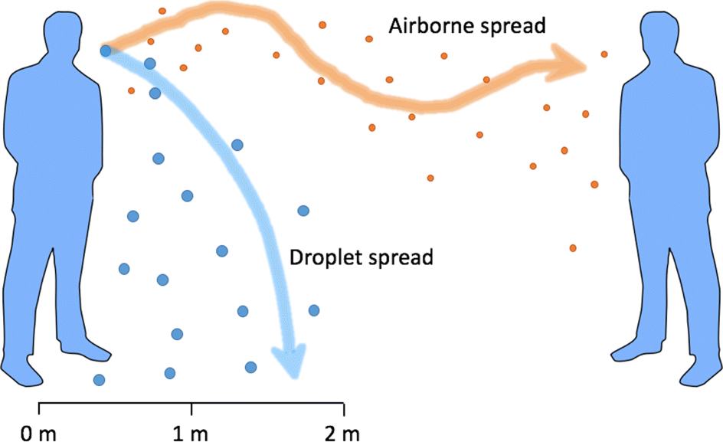

Slide 6
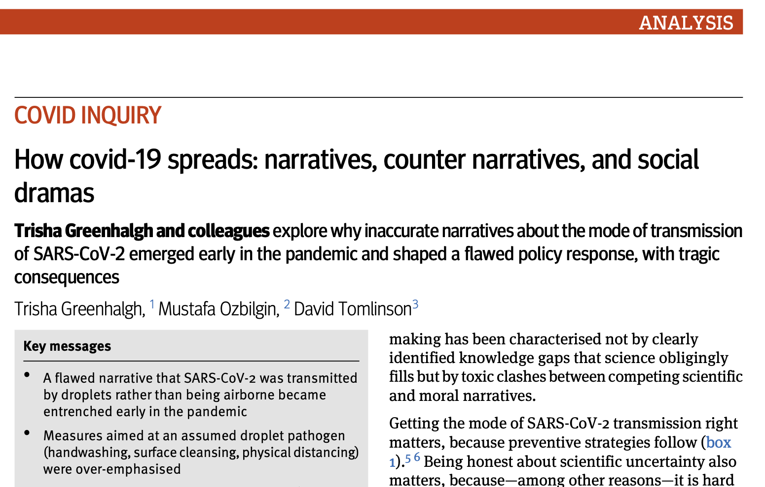
Lancet 2021; 397: 1603
BMJ 2022; 378:e069940

Slide 7
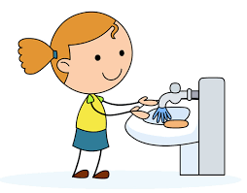
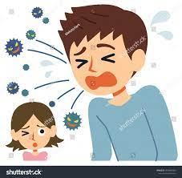
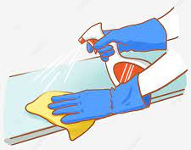
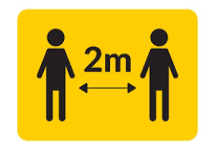
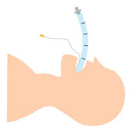
Prevention policy used a flawed ‘droplet’ model:
● hand-washing ❌
● isolate only if coughing / sneezing ❌
● surface cleansing ❌
● waterproof mask only if within 2m of person with symptoms ❌
● physical distancing ((✅))
● respirator mask only for aerosol-generating procedures ❌
● face shields and Perspex screens ❌

Slide 8
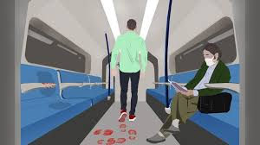
Because SARS-CoV-2 is transmitted via the air, we need:
● note: people may be asymptomatic but contagious ✅
● physical distancing when indoors ((✅))
● everyone wearing well-fitting respirator masks indoors ✅
● limit time spent indoors, especially in crowded spaces ✅
● avoid indoor singing / shouting / heavy exercise ✅
● ventilate buildings (and/or filter air) ✅

Slide 9
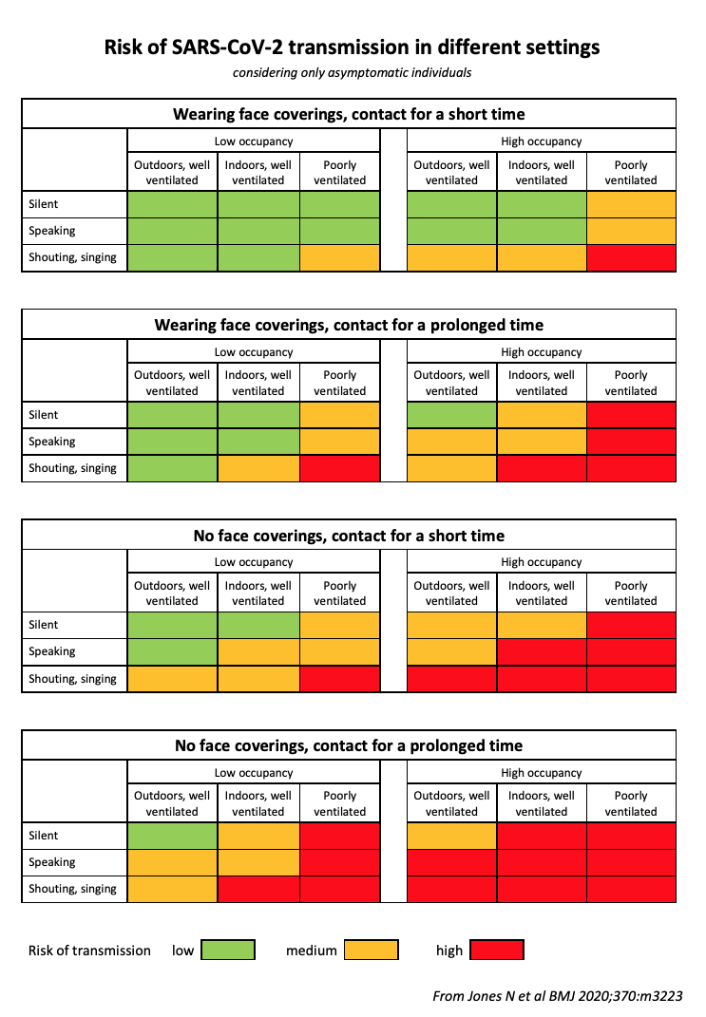
Outdoors, well-ventilated, silent, masked = SAFE
Indoors, poorly-ventilated, noisy, unmasked = UNSAFE

Slide 10
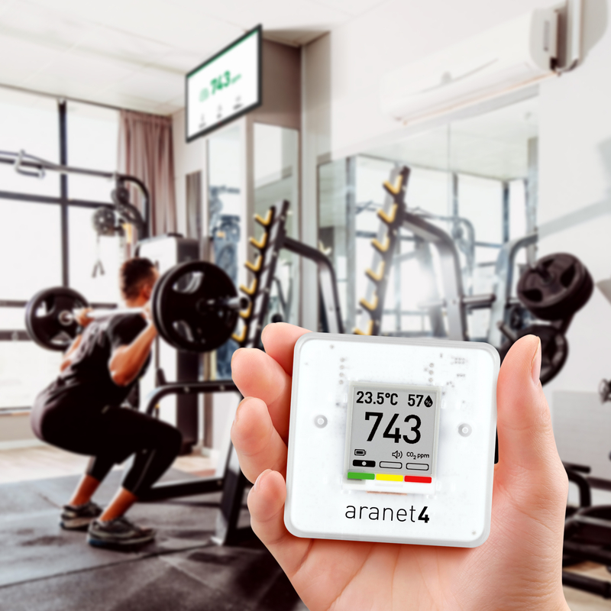
CO₂ monitoring is useful when ventilation (not filtration) is used
The more air changes per hour, the better
If lots of people and heavy breathing, need to ventilate more
https://forhealth.org/tools/co2-calculator/

Slide 11
Droplet precautions are mostly about individual behaviour
(“you do you”)
Airborne precautions need action from employers and governments (e.g. safe buildings, safe employees)

Slide 12
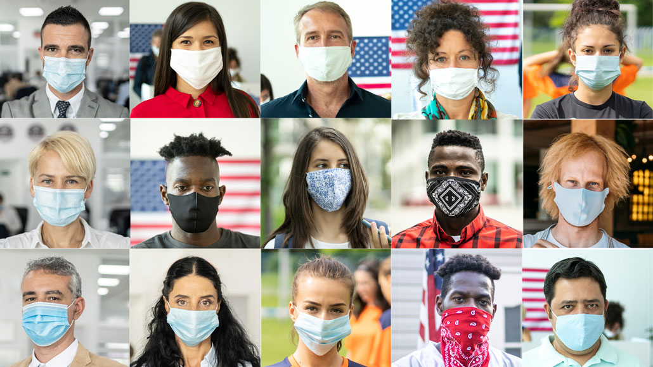
MASKS DON’T WORK if you’re not wearing them all the time when you’re indoors
MASKS DON’T WORK if they don’t fit you with good seal
MASKS DON’T WORK [well] if they’re made of the wrong material
MASKS DON’T WORK if you keep taking them off

Slide 13
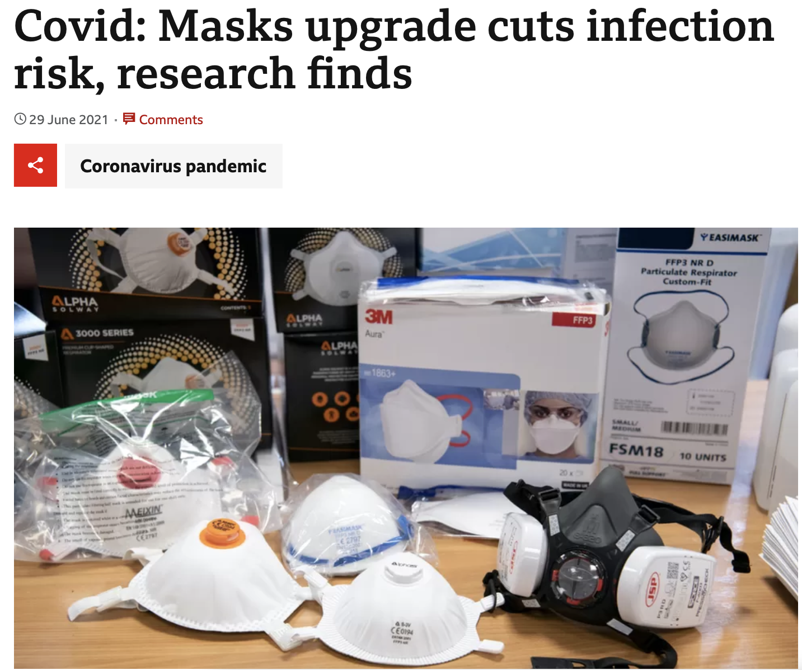
Respirator-grade masks for all staff in health and care settings is an occupational health issue
RCTs of respirators v masks were ‘negative’ – perhaps because respirators were not worn continuously while indoors

Slide 14
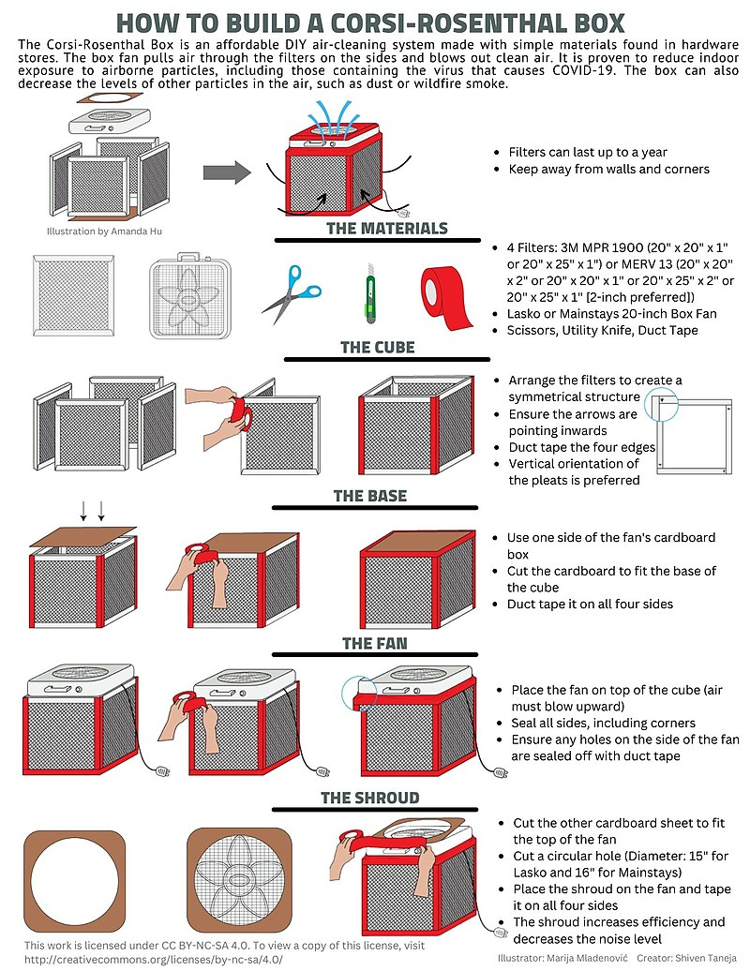
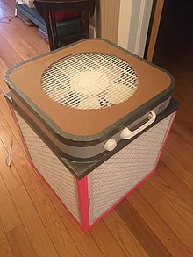
Corsi-Rosenthal box (Wikipedia)

Slide 15
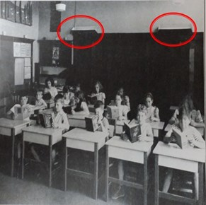
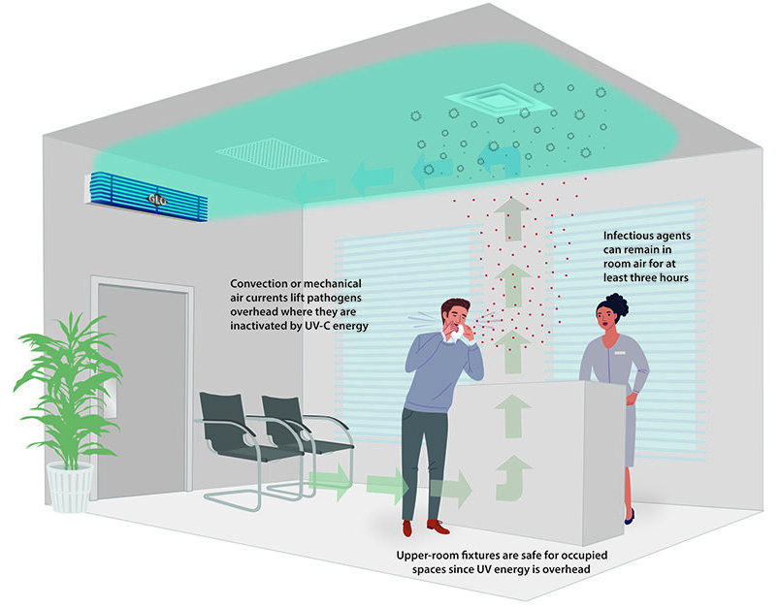
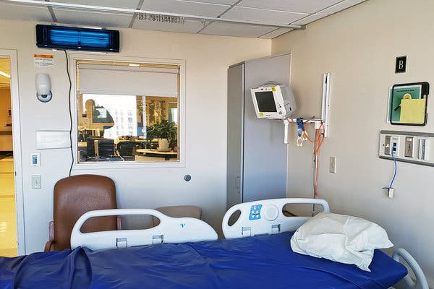
Learning from the past: Upper-room UV-C
1942

Slide 17
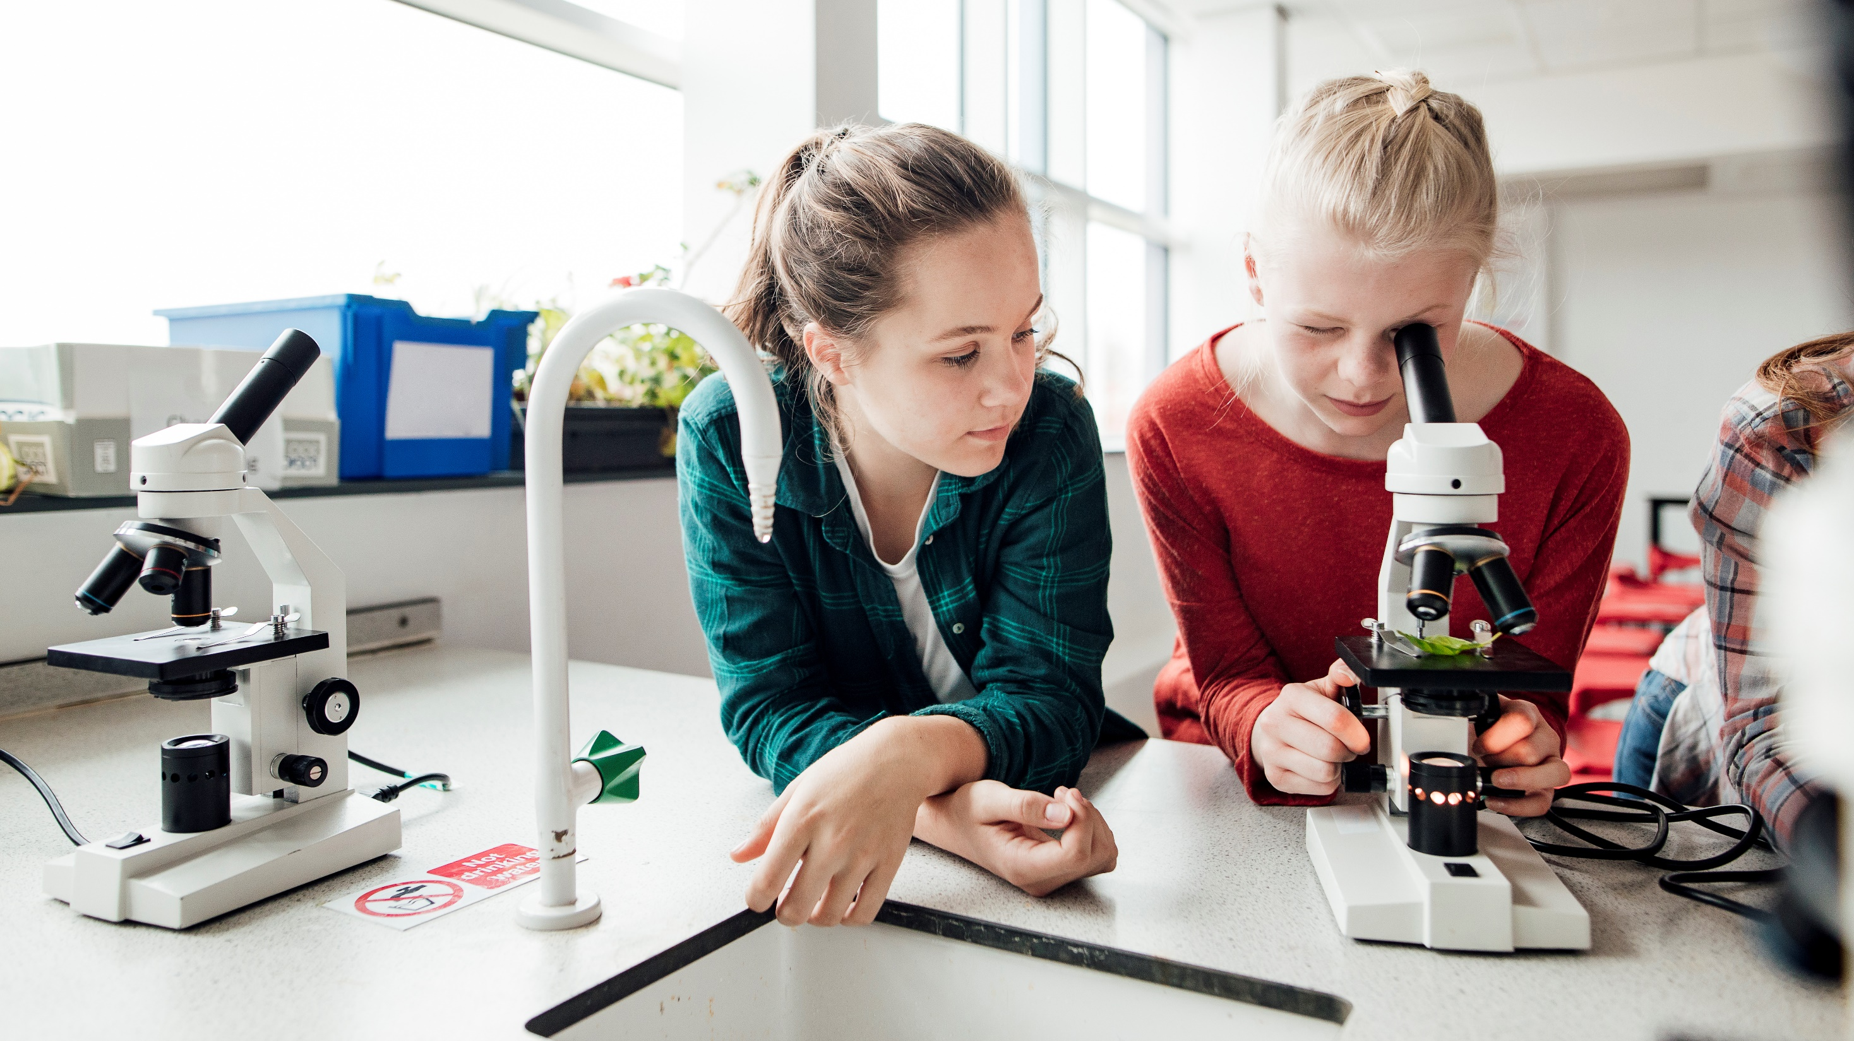
Clean Air For Schools Warrington Project Dr Binita Kane Leila Williams With the support of: Public Health team Warrington BC Dr Stefan Stojanovic Michelle Wong @PeteUK7 (Twitter)
Notes:
Three Warrington parents
supported by BC colleagues and technical colleagues

Slide 18
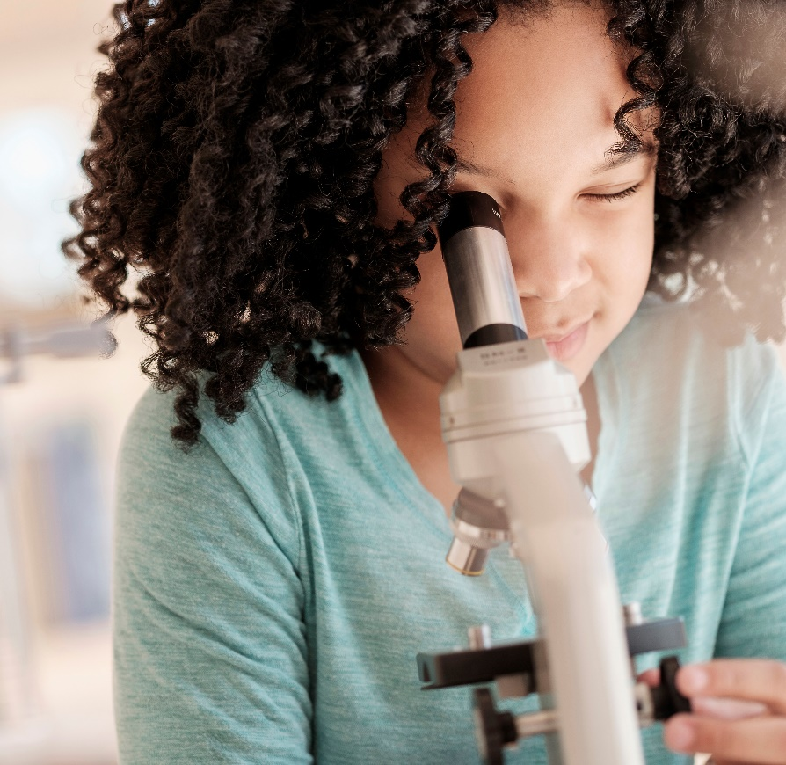
Why clean air is important
Improves learning
Reduces sickness
Improves health
estimated to be worth an extra SIX weeks in school each year
By removing viruses reduce sickness and reduce absences
Improves respiratory, cardiovascular health + neurological function
Protects staff
significant benefits to mental health

Slide 19
Proposal: STEM Project
Why clean air is important
How to clean the air we breathe
Kids learn the science
STEM career opportunities
Improves learning
Reduces absence
Improve mental + physical healt
Ventilation
Filtration

Slide 20
Our AMBITION
Clean outdoor air
Cleaner indoor air
Healthy children, young people and school staff

Slide 21
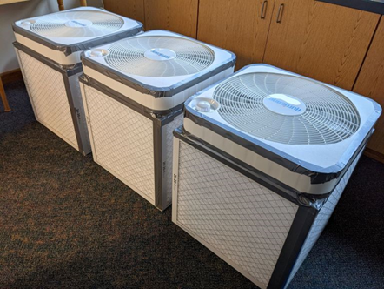
Warrington schools
Funding from local recycling business Novelis
Support from Science and Technology Facilities Council (STFC)
Participants
- High Schools x 2
- Primary schools x 2
Plan for year 5 air quality projects / exhibition to ‘teach’ pre-schoolers about clean air
Build DIY air filters

Slide 22
Warrington schools
STEM Clubs up and running
To date >30 Clean Air Filters built – CorsiRosenthal boxes
Linking up with other projects e.g. SAMHE (Schools’ Air Quality Monitoring for Health and Education)
Looking for more funding opportunities
Where there is a will there’s a way

